Slide 1
Wetland Buffers against Non-Point Source Pollution
Taylor Border
Aquatic Resources Education Center
DNREC: Division of Fish and Wildlife

Slide 2
How do pollutants enter our waterways?

Slide 3
Common non-point pollutants…
Soil
Pesticides
Trash
Fertilizers
Oil/
Anti-Freeze
Road Salt

Slide 4
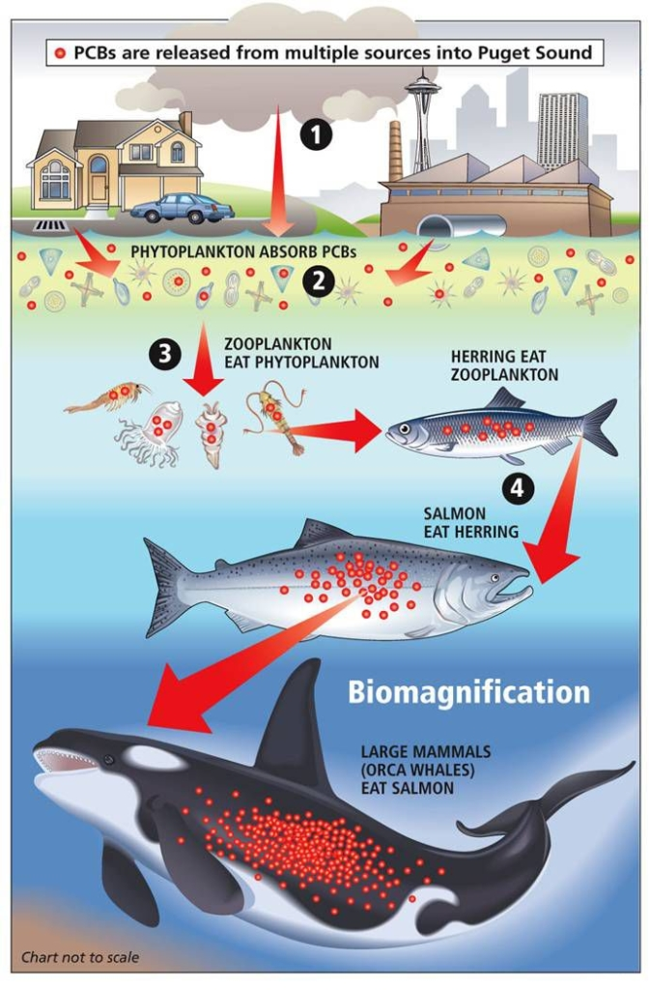
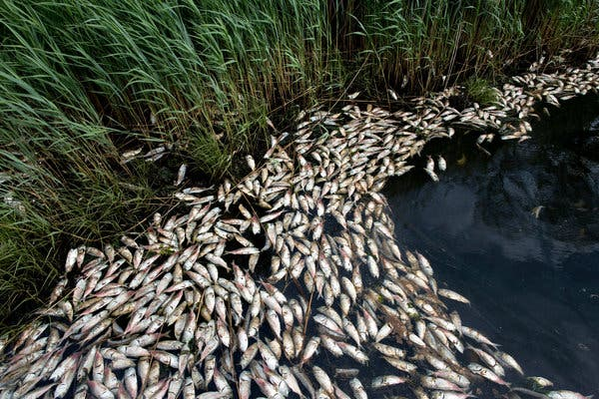
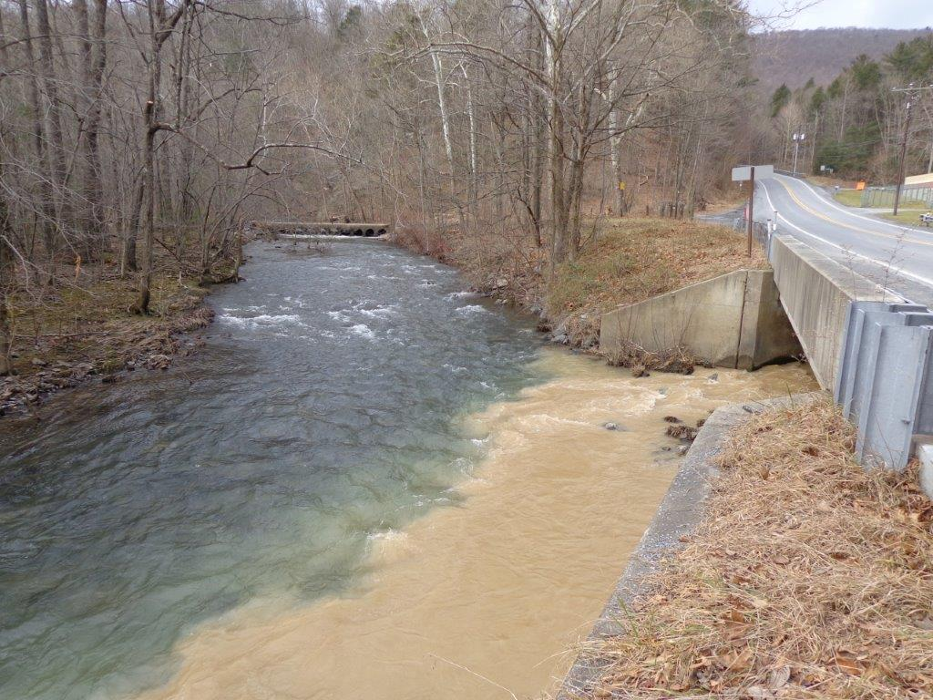
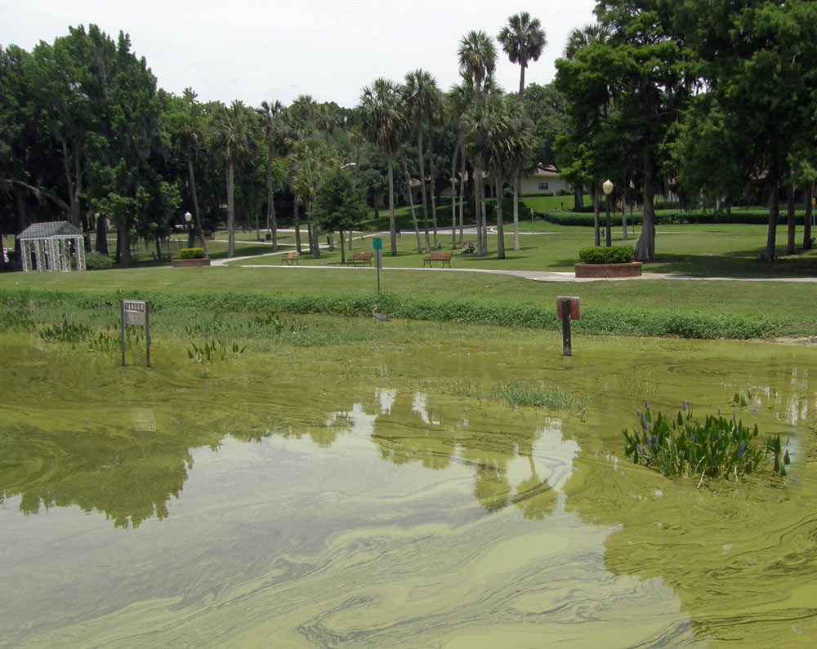
Runoff collects and magnifies the effect of pollutants on our watershed!
Nutrients
Toxic Substances
Soil Itself
NYT 2016
Wayne Co. Conservation District
USGS 2016
CIMI 2024

Slide 5
Watersheds have a natural defense…

Slide 6
Common non-point pollutants…
Soil
Pesticides
Trash
Fertilizers
Oil/
Anti-Freeze
Road Salt

Slide 7
But this time, we’ll incorporate wetlands!
Flood
Storage
Erosion Control
Filtering and Sediment Trapping

Slide 8
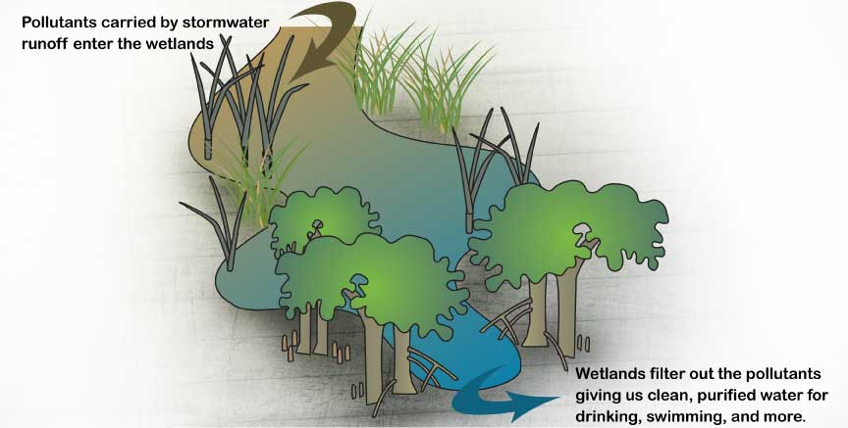
DNREC 2025

Slide 9
Questions?

