Slide 1
Envirothon 2026
Delaware
Environmental Processes
Presented by:
Amber Bataille – Delaware Department of Natural Resources and Environmental Control

Slide 2
Key Topics
Water Cycle
Watersheds
Biochemical Cycles
Drinking Water/Source Water and BMPs

Slide 3
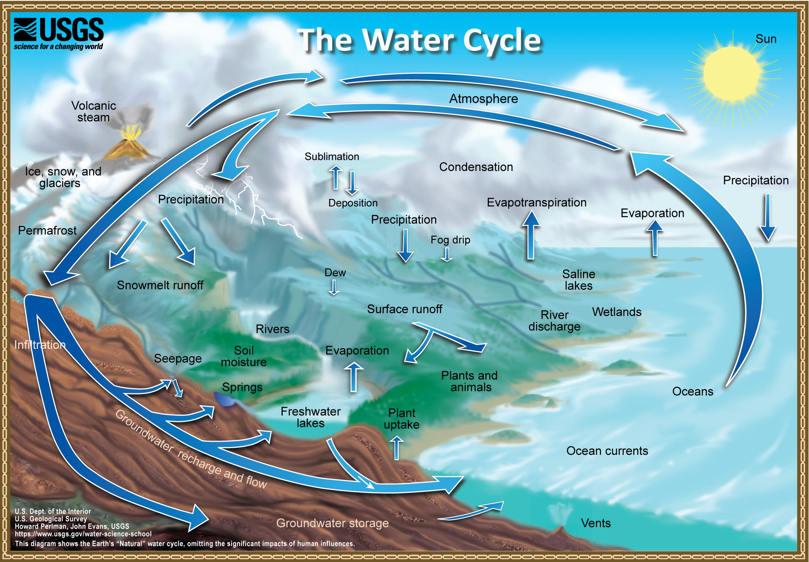
Hydrologic Cycle
Precipitation
Recharge
Runoff
Transpiration/Evaporation
Where Water is stored
  Oceans
  Atmosphere
  Ice
  Groundwater
  Lakes/Rivers/Streams

Slide 4
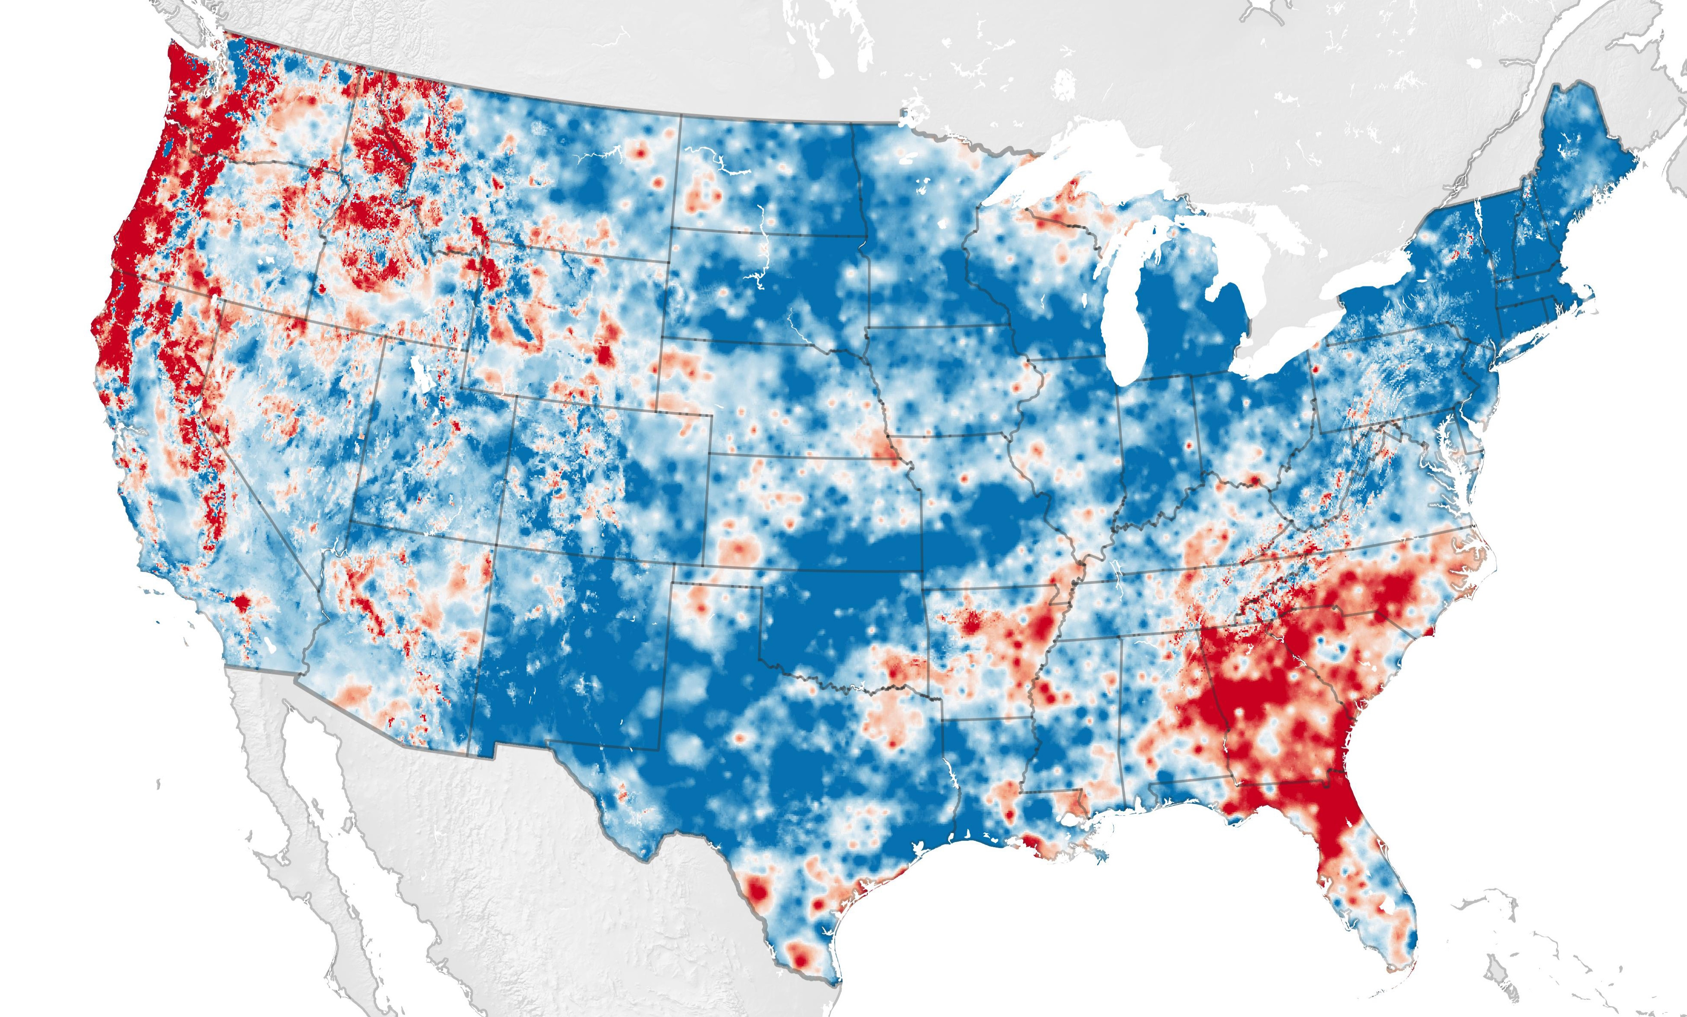
Sidebar –> Water Cycle Speed Increasing
Water cycle intensity (P + AET)
Quantitative indicator of water cycle intensity
Increasing over most of the U.S.
Soil moisture storage is declining in parts of SE, NW, & midwestern U.S.
There has been an increase in the flow between the various stages of the water cycle over most the U.S. in the past seven decades. The rates of ocean evaporation, terrestrial evapotranspiration, and precipitation have been increasing. In other words, water has been moving more quickly and intensely through the various stages.
A new indicator framework for quantifying the intensity of the terrestrial water cycle
lThomas G.HuntingtonªPeter K.Weiskel^{b}David M.Wolock^{c}Gregory J.McCabe^{d}
https://doi.org/10.1016/j.jhydrol.2018.02.048

Slide 5
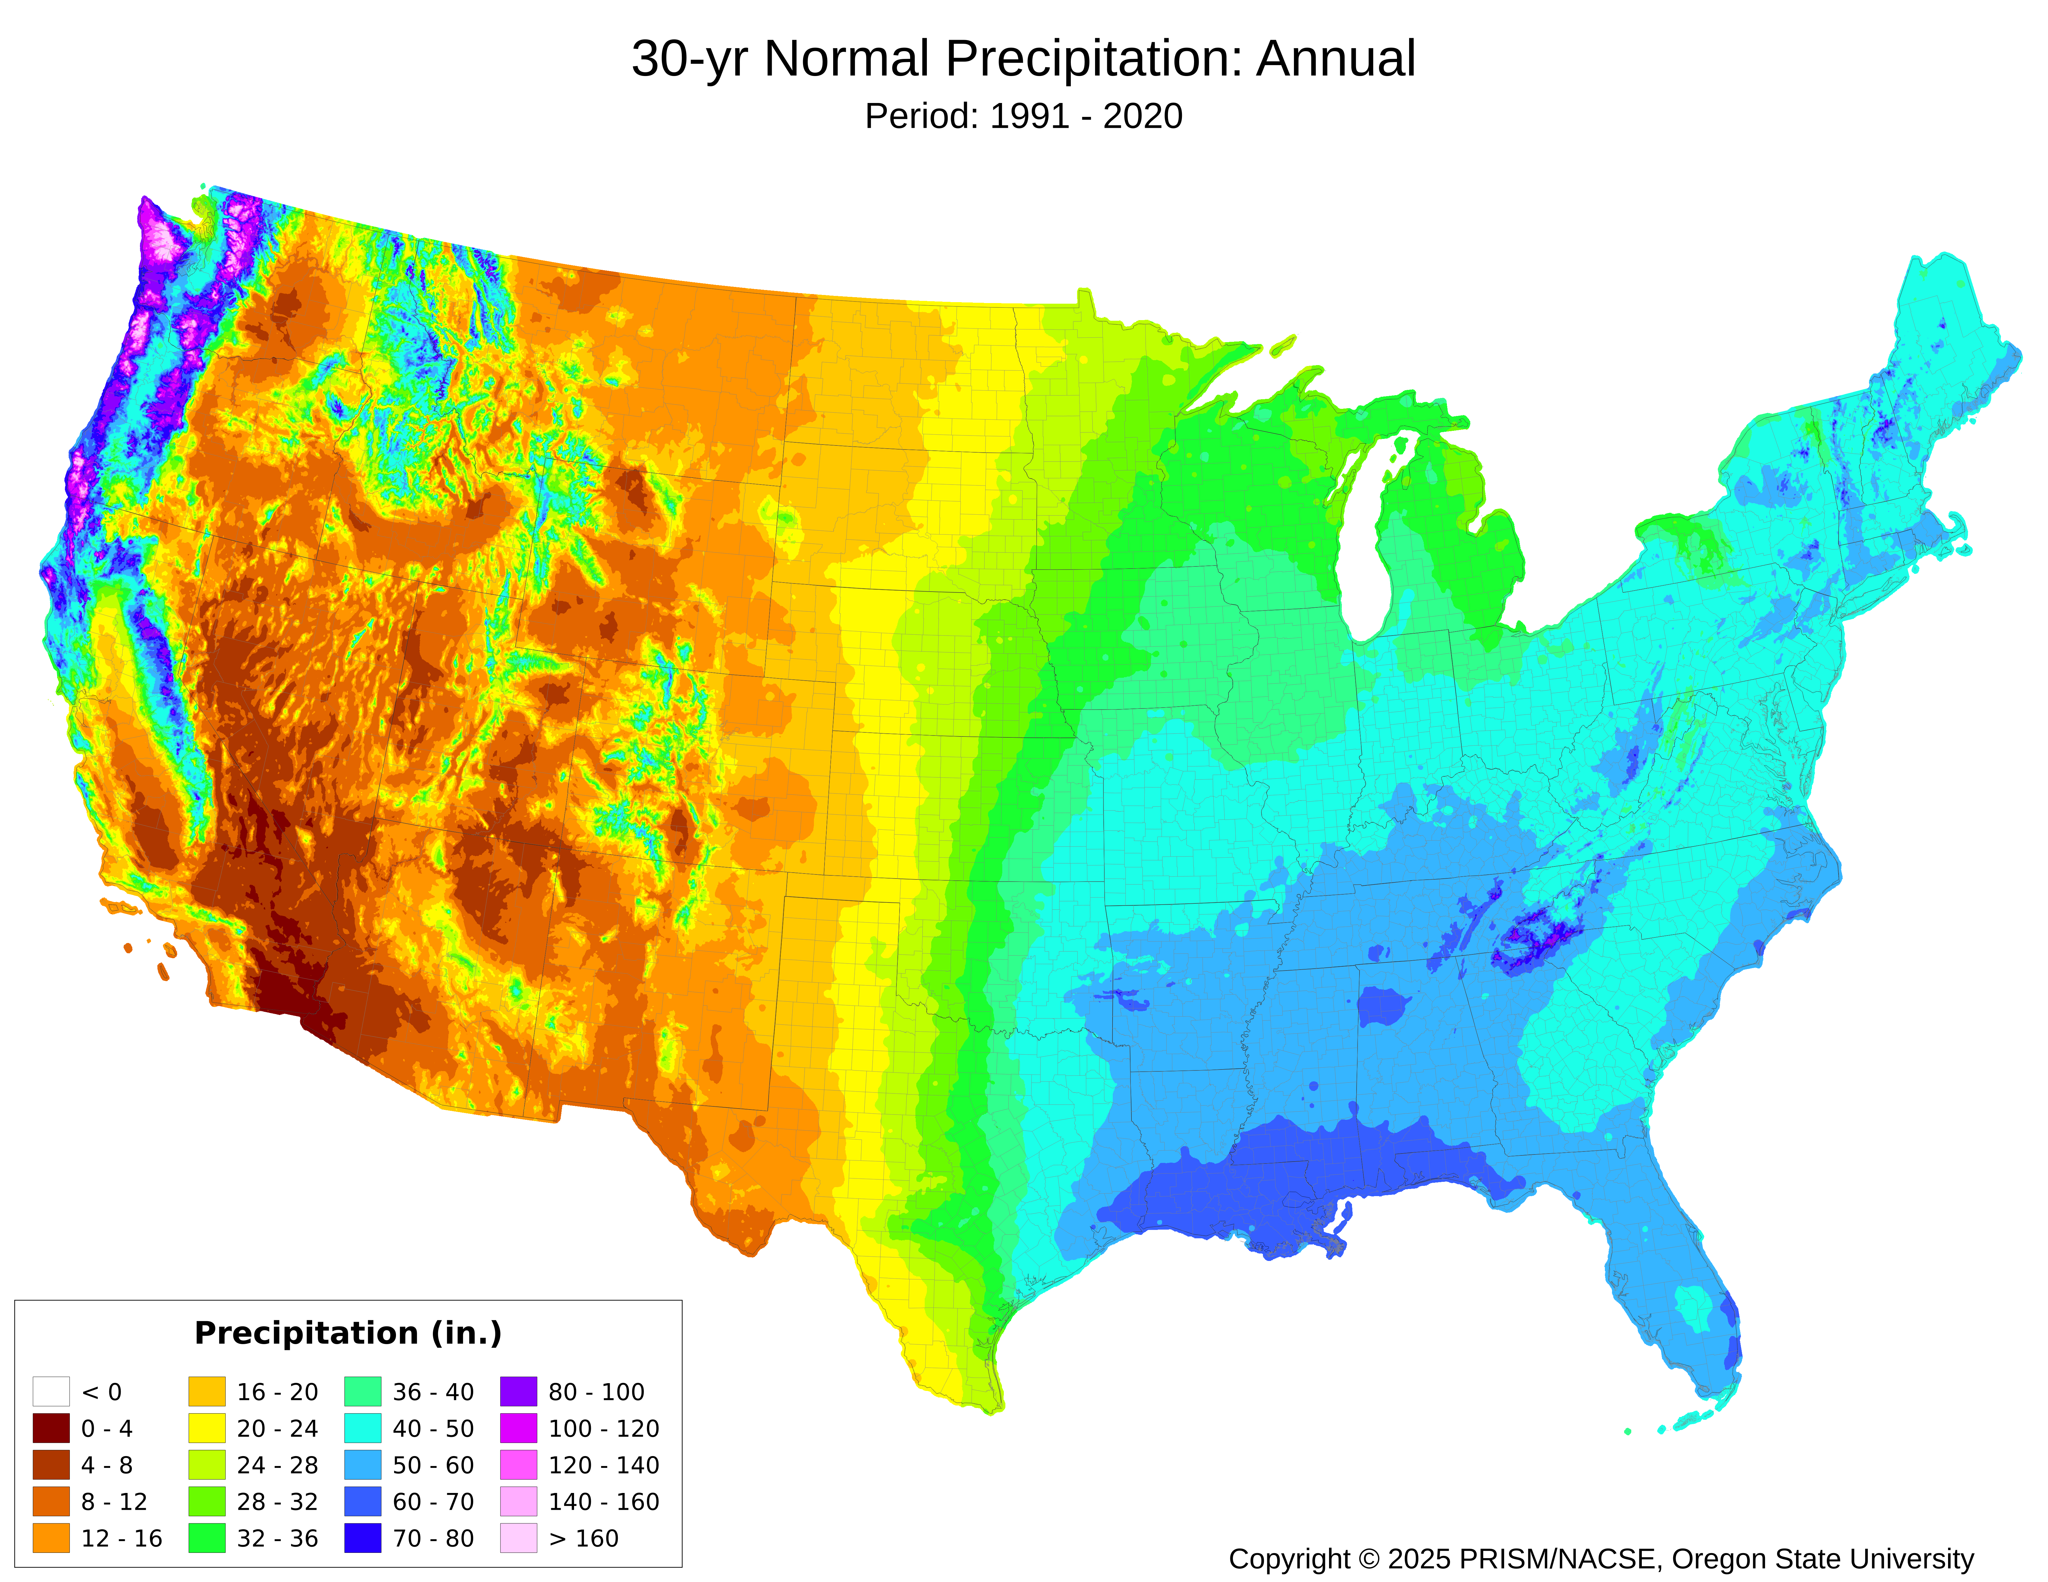
United States Rainfall

Slide 6
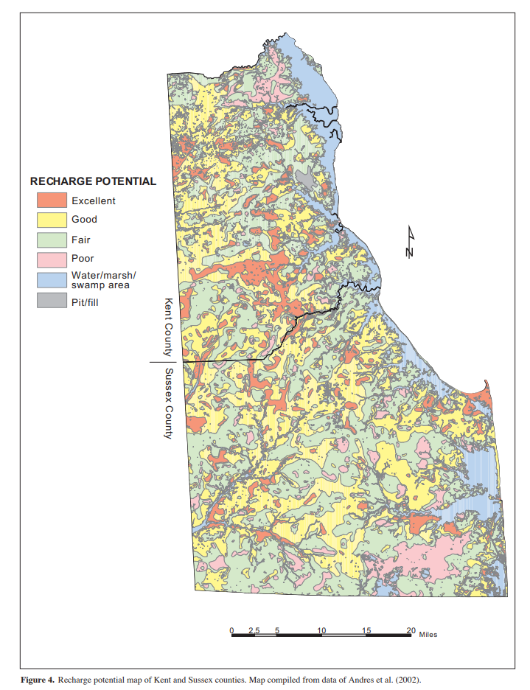
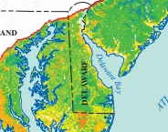

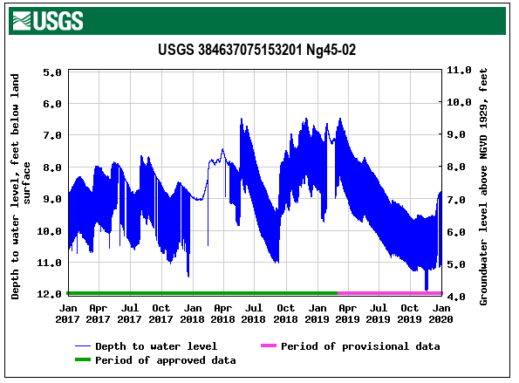
Recharge
Water enters aquifers through a process called recharge
Depends on precipitation, soils, slope, plants
Can vary greatly over time and space
In the Eastern US most recharge is seasonal
              Delaware receives approximately 40 inches of precipitation annually.
              Approximately 12 to 15 inches recharges groundwater annually
              Excellent Recharge areas are protected in Delaware through Source Water Protection Ordinances
https://www.dgs.udel.edu/sites/default/files/publications/ri66.pdf
Andres, GROUND-WATER RECHARGE POTENTIAL MAPPING IN KENT AND SUSSEX COUNTIES, DELAWARE

Slide 7
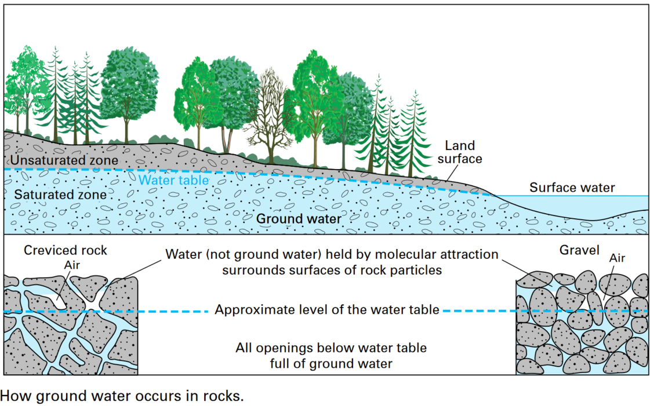
How Water is Stored in the Ground
Groundwater is the saturated zone of soil/rock below the land surface
How Ground Water Occurs
Difficult to visualize water underground. Some people believe that ground water collects in underground lakes or flows in underground rivers.
Ground water is simply the subsurface water that fully saturates pores or cracks in soils and rocks. Ground water is replenished (recharged) by precipitation and, depending on the local climate and geology, is unevenly distributed in both quantity and quality.
When rain falls or snow melts, some of the water evaporates, some is transpired by plants, some flows overland and collects in streams, and some infiltrates into the pores or cracks of the soil and rocks.
The first water that enters the soil replaces water that has been evaporated or used by plants during a preceding dry period. Between the land surface and the aquifer water is a zone that hydrologists call the unsaturated zone.
In this unsaturated zone, there usually is at least a little water, mostly in smaller openings of the soil and rock; the larger openings usually contain air instead of water.
After a significant rain, the zone may be almost saturated; after a long dry spell, it may be almost dry. Some water is held in the unsaturated zone by molecular attraction, and it will not flow toward or enter a well. Similar forces hold enough water in a wet towel to make it feel damp after it has stopped dripping.
https://www.usgs.gov/media/images/groundwater-saturated-zone-soilrock-below-land-surface

Slide 8
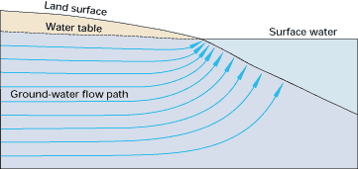
Groundwater Moves through the Earth

Slide 9
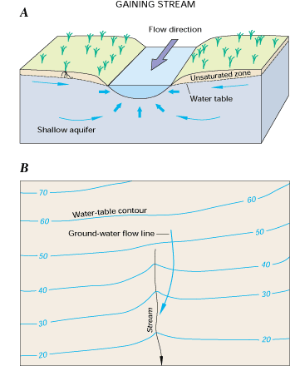
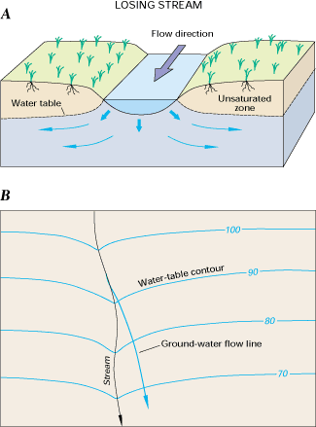
Groundwater and Streams
Groundwater and Streams (surface water) interact
  Gaining Stream – Groundwater is flowing towards the stream. The Stream is a reflection of the water table just at the land surface. Stream is getting “Gaining” water from groundwater.
  Losing Stream – Groundwater is getting water from the Stream. The water table is deeper than the stream
https://pubs.usgs.gov/circ/circ1139/

Slide 10
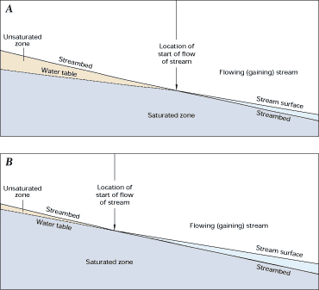
Changing Streams
Where streamflow is generated in head-waters areas, the changes in streamflow between gaining and losing conditions may be particularly variable.
The headwaters segment of streams can be completely dry except during storm events or during certain seasons of the year when snowmelt or precipitation is sufficient to maintain continuous flow for days or weeks. During these times, the stream will lose water to the unsaturated zone beneath its bed.
However, as the water table rises through recharge in the headwaters area, the losing reach may become a gaining reach as the water table rises above the level of the stream. Under these conditions, the point where ground water first contributes to the stream gradually moves upstream.
https://pubs.usgs.gov/circ/circ1139/

Slide 11
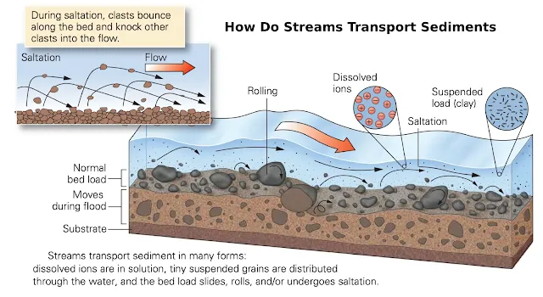
The constant movement…
Sediment is constantly moving as a stream flows
Movement depends on:
  Particle size
  Stream Flow rate
  Channel Characteristics
  Slope
Location along the stream determines the biological communities
https://www.geologyin.com/2016/01/how-do-streams-transport-and-deposit.html

Slide 12
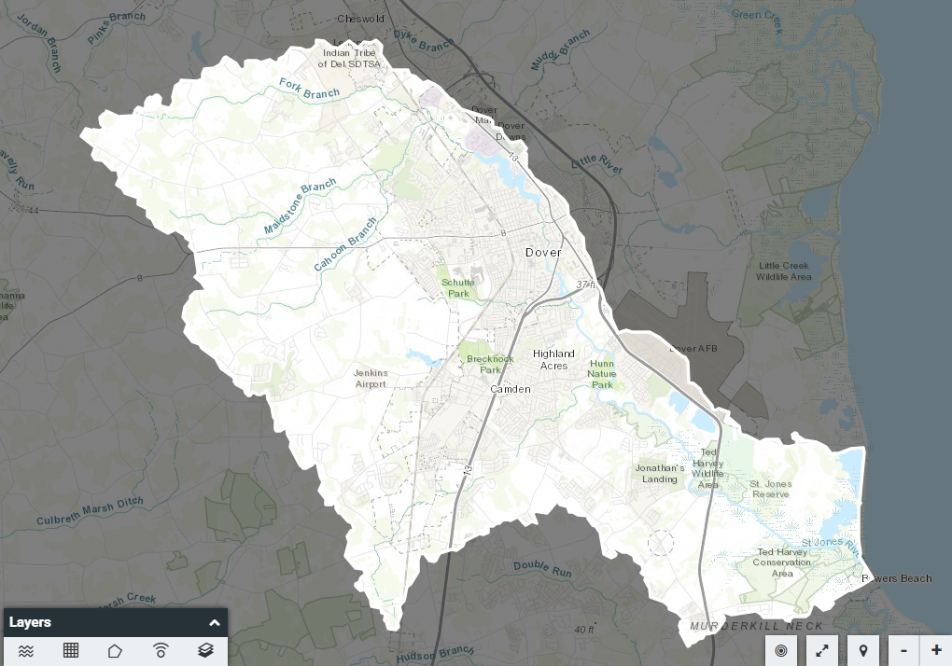
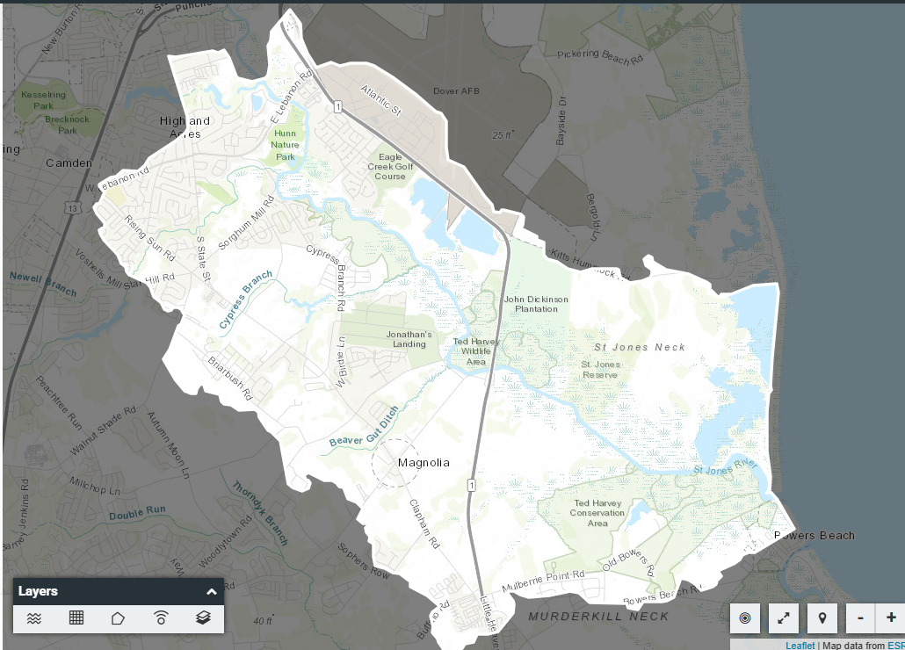
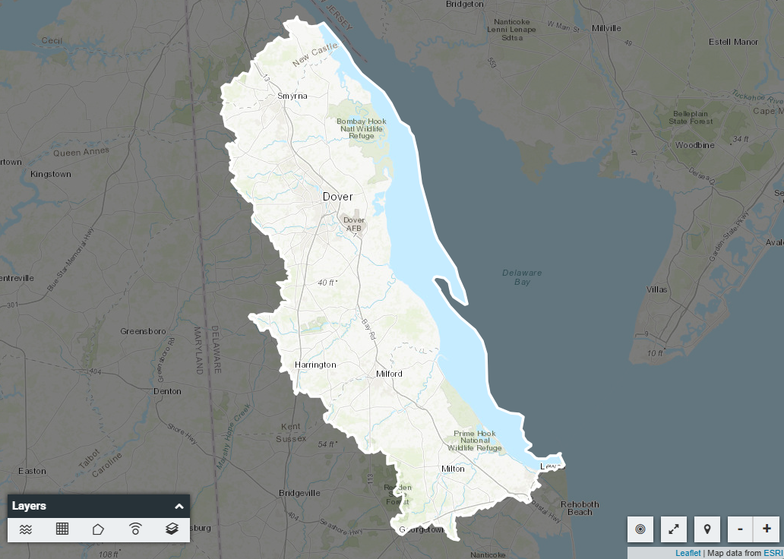
What is a watershed?
Watersheds are precipitation collectors
Size can range from a ditch/tributary up to river basin and up to oceanic size basins.
Groundwater tends to move with the watershed
Water quality in the watershed is determined by the land use and the entire reach of the drainage area
Notes:
HUC 12 – Lower St Jones River
HUC 10 – St Jones River
HUC 8 – Broadkill-Smyrna

Slide 13
Biogeochemical Cycles

Slide 14
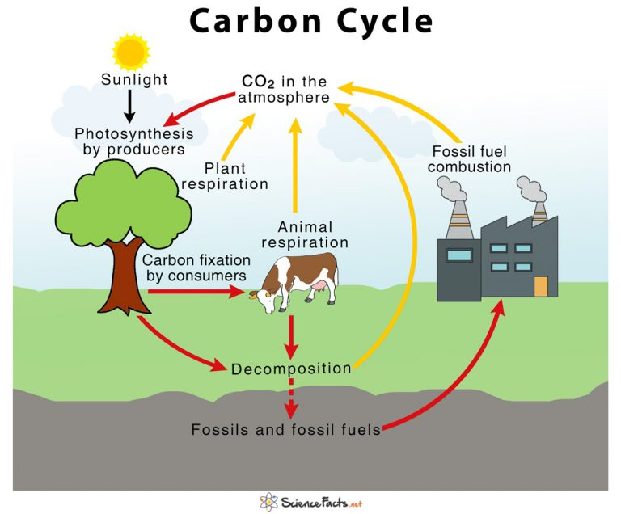
Carbon Cycle
Carbon dioxide can contribute to greenhouse gases and climate change
Bio-retention BMPs use the carbon cycle to function

Slide 15
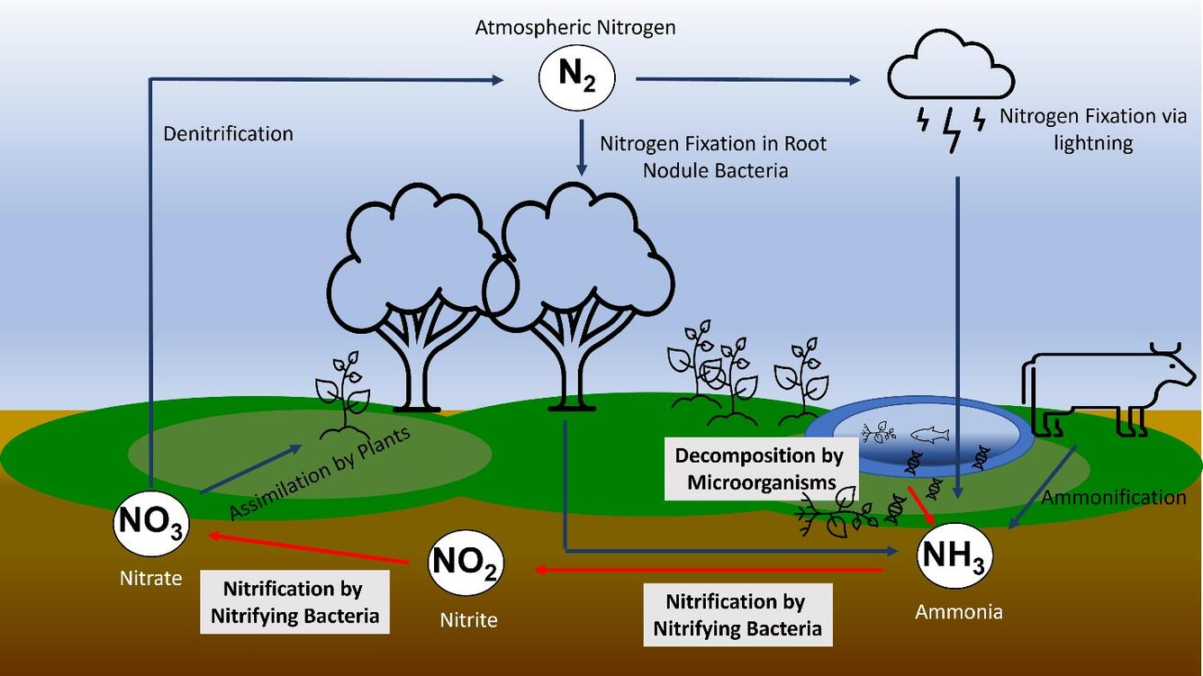
Nitrogen Cycle
Nitrate is a major contaminate of groundwater and surface water
Excessive nitrogen can cause algal blooms in surface water
Drinking water can be contaminated by nitrates and cause health effects for infants
https://www.usgs.gov/media/images/basic-overview-nitrogen-cycle

Slide 16
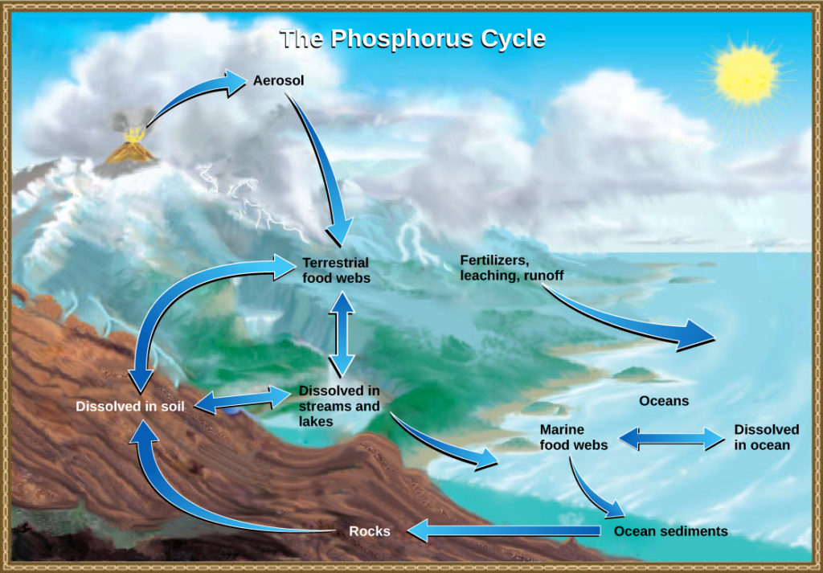
Phosphorus Cycle
Phosphorus enters surface water mainly through runoff, but groundwater can contribute.
Phosphorus can be dissolved but also through sediment
In surface water: limiting nutrient that causes the algae blooms

Slide 17
Biogeochemical Cycles
The biogeochemical process work together and determine the health of the stream and watershed.

Slide 18
BMPs and Drinking/Source Water

Slide 19
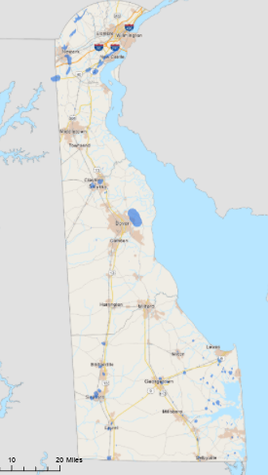
Where does your drinking water come from in Delaware?
North of the C&D Canal
  Surface Water from White Clay Creek, Brandywine Creek, Smalleys Pond
  Reservoirs – Hoopes Reservoir and Newark Reservoir
  Groundwater
    Public Supply
    Domestic Supply
South of the C&D Canal
  Groundwater
    Public Supply
    Domestic Supply

Slide 20
Source Water Protection and Wellhead Protection Areas
Wellhead Protection Areas are areas around a public drinking water well that are protected to help protect drinking water
Surface water providers use a watershed approach to protect drinking water
BMPs are implemented in these areas to help improve water quality

Slide 21
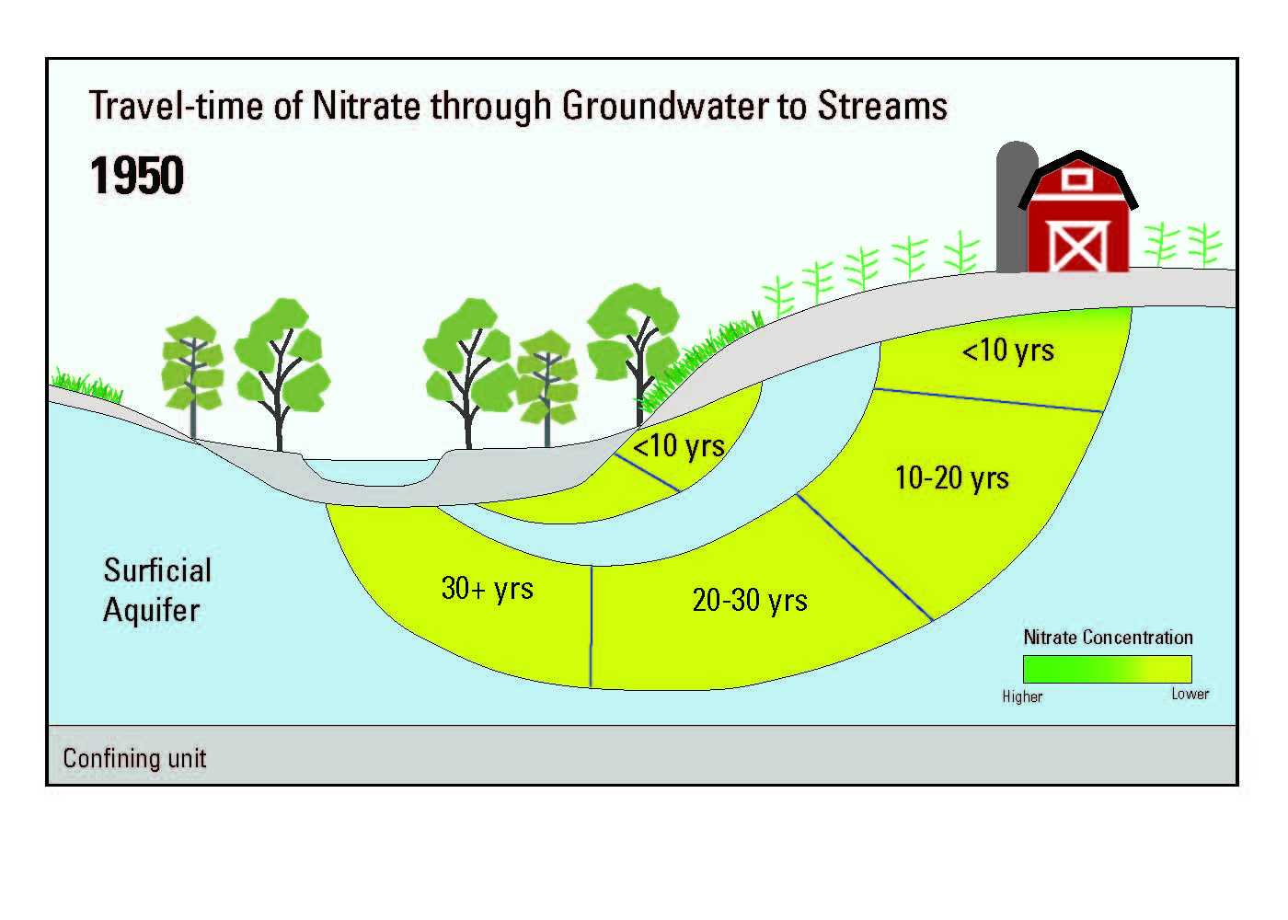
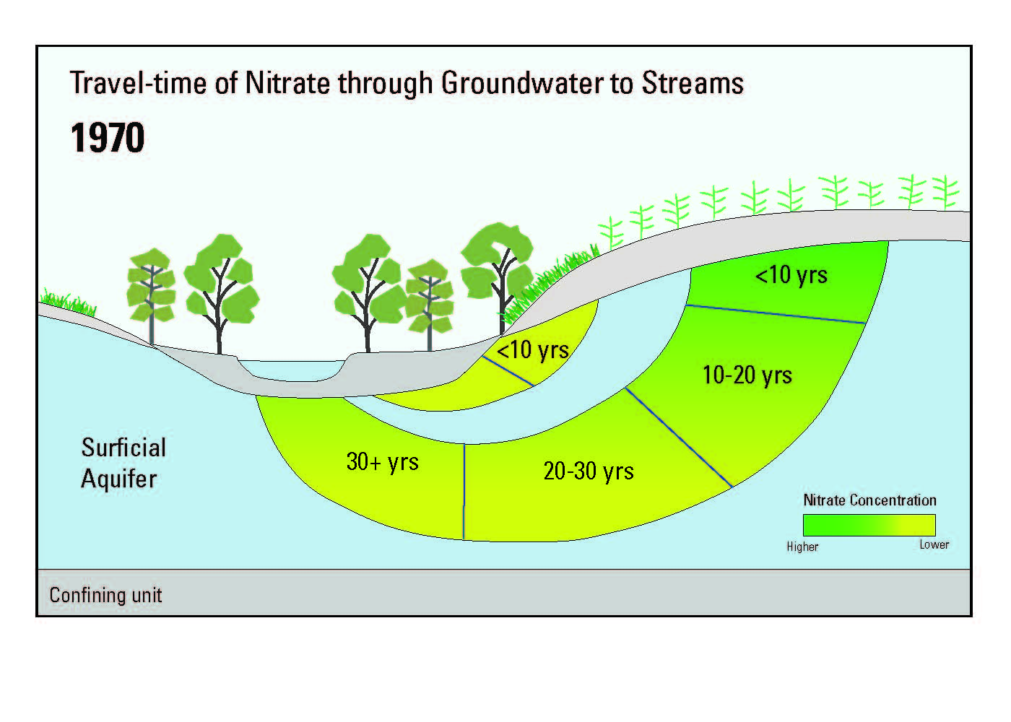
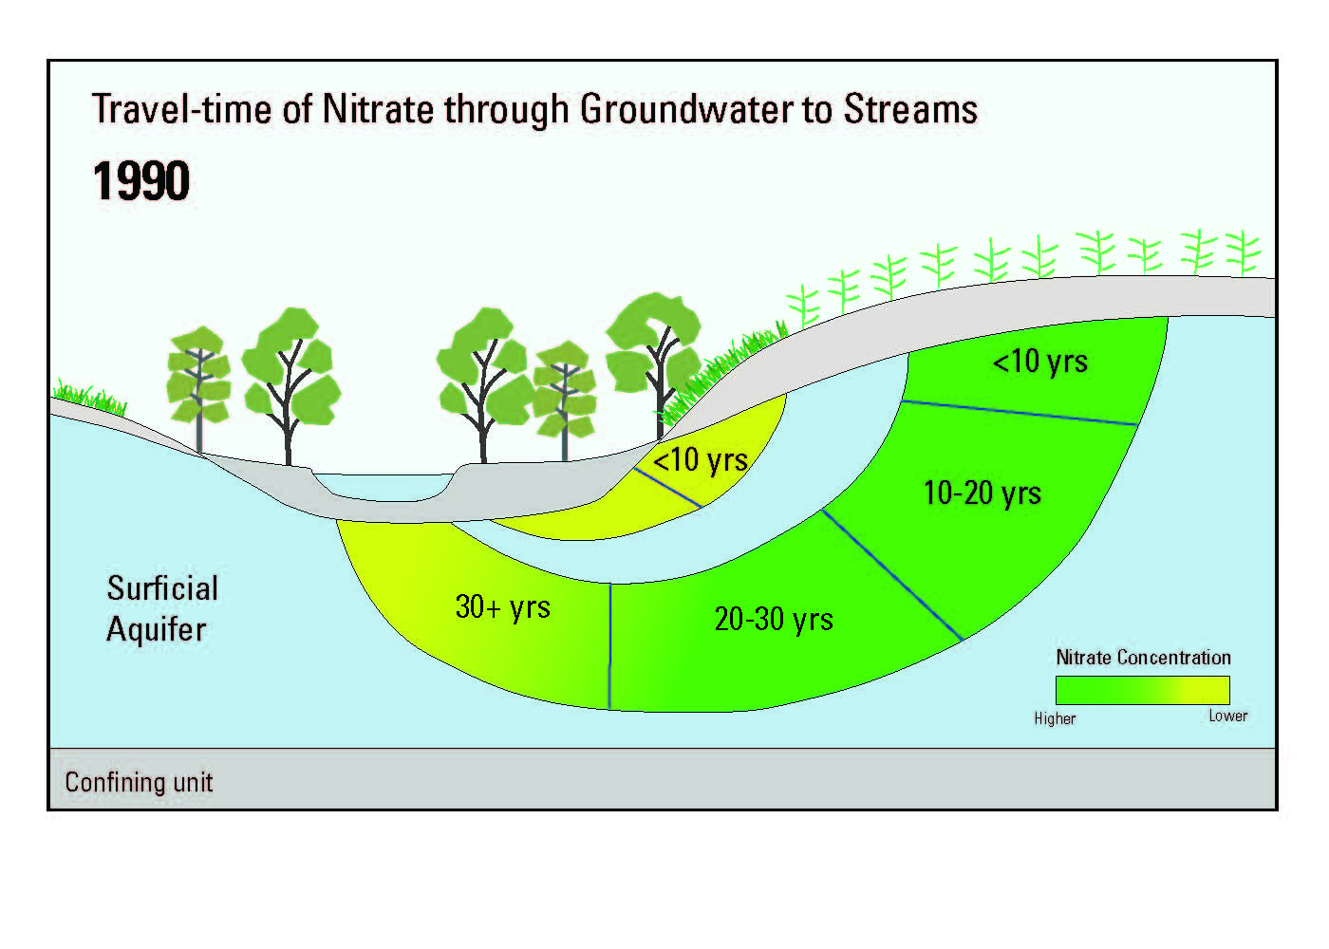
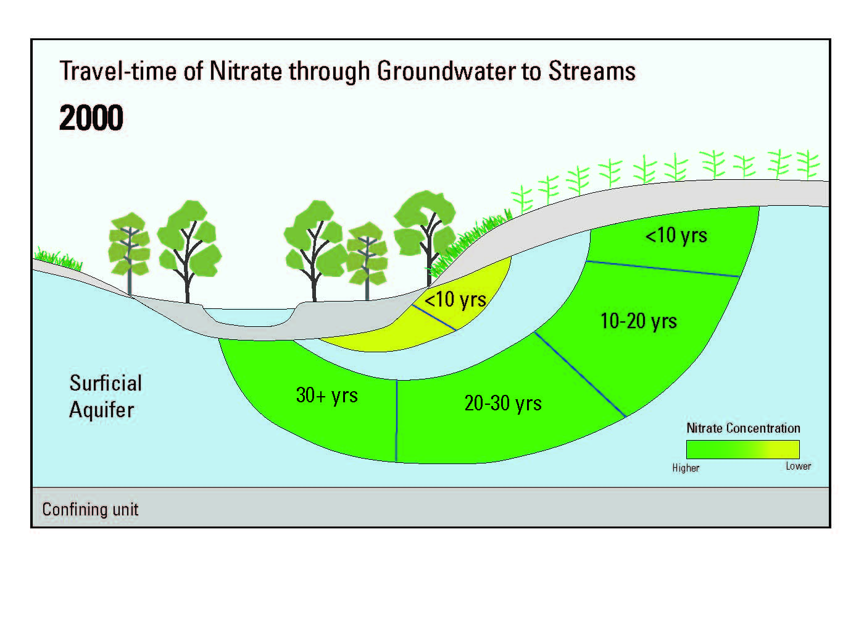
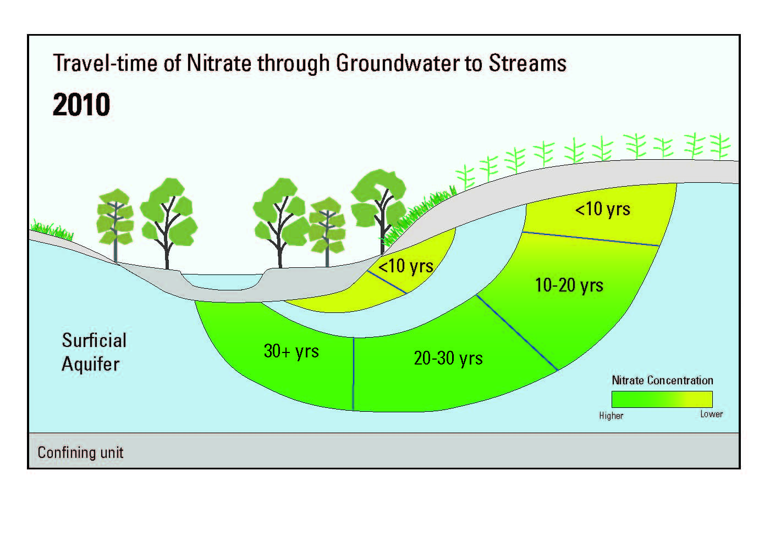
Notes:
See with cover crops—but do we see it with irrigation? Looking at that now.

Slide 22
Because Groundwater Moves slowly….
BMPS at the land surface can also have impacts on groundwater and drinking water
It takes a long time to see results

Slide 23
QUESTIONS??

