Slide 1
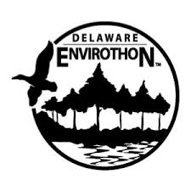

Water Quality Assessment - Protecting Designated Uses
Joshua Barth
DNREC, Division of Watershed Stewardship
Joshua.barth@delware.gov

Slide 2
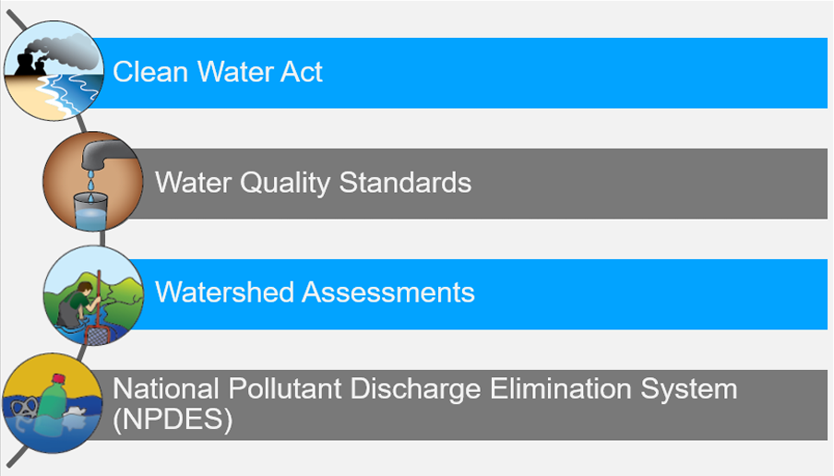
Water Quality Improvement

Slide 3
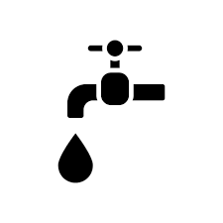
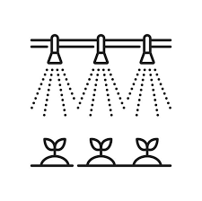



Protect Designated Uses
Public Water Supply
Fish, Shellfish, and Wildlife
Agricultural Water Supply
Recreation
Industrial Water Supply

Slide 4
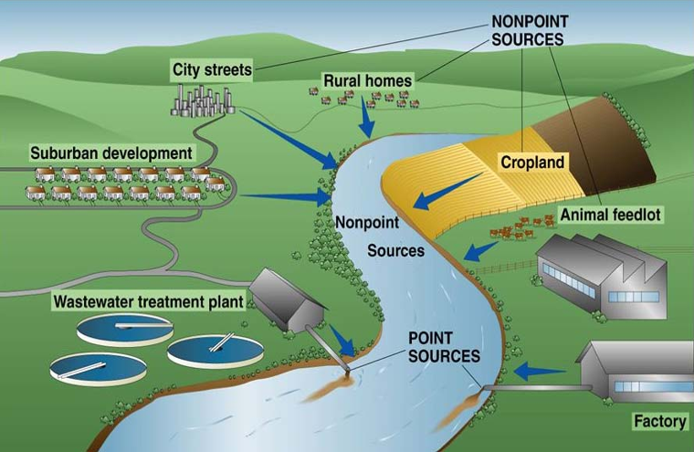

Non-Point Source Pollution

Slide 5
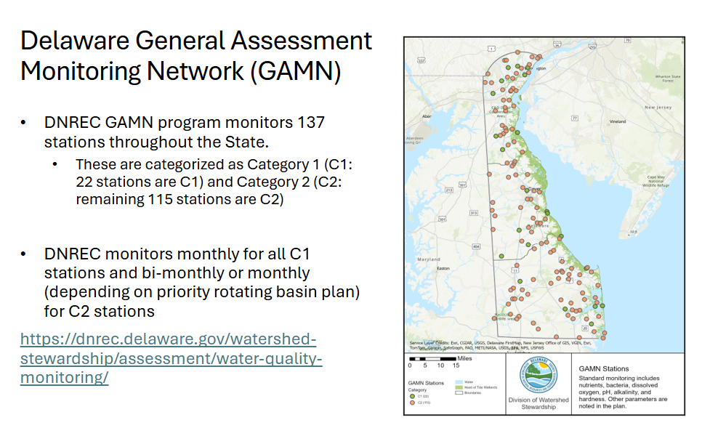
Water Quality Assessments

Slide 6
Water Quality Parameters Measured at GAMN Sites
Parameters | Parameters
Nutrients – N and P | Total Suspended Solids (TSS)
pH | Chlorophyll-a
Conductivity | Temperature
Salinity | Secchi Depth
Dissolved Oxygen | Carbon
Metals | Biological Oxygen Demand
Bacteria | Alkalinity
Chloride | Hardness

Slide 7
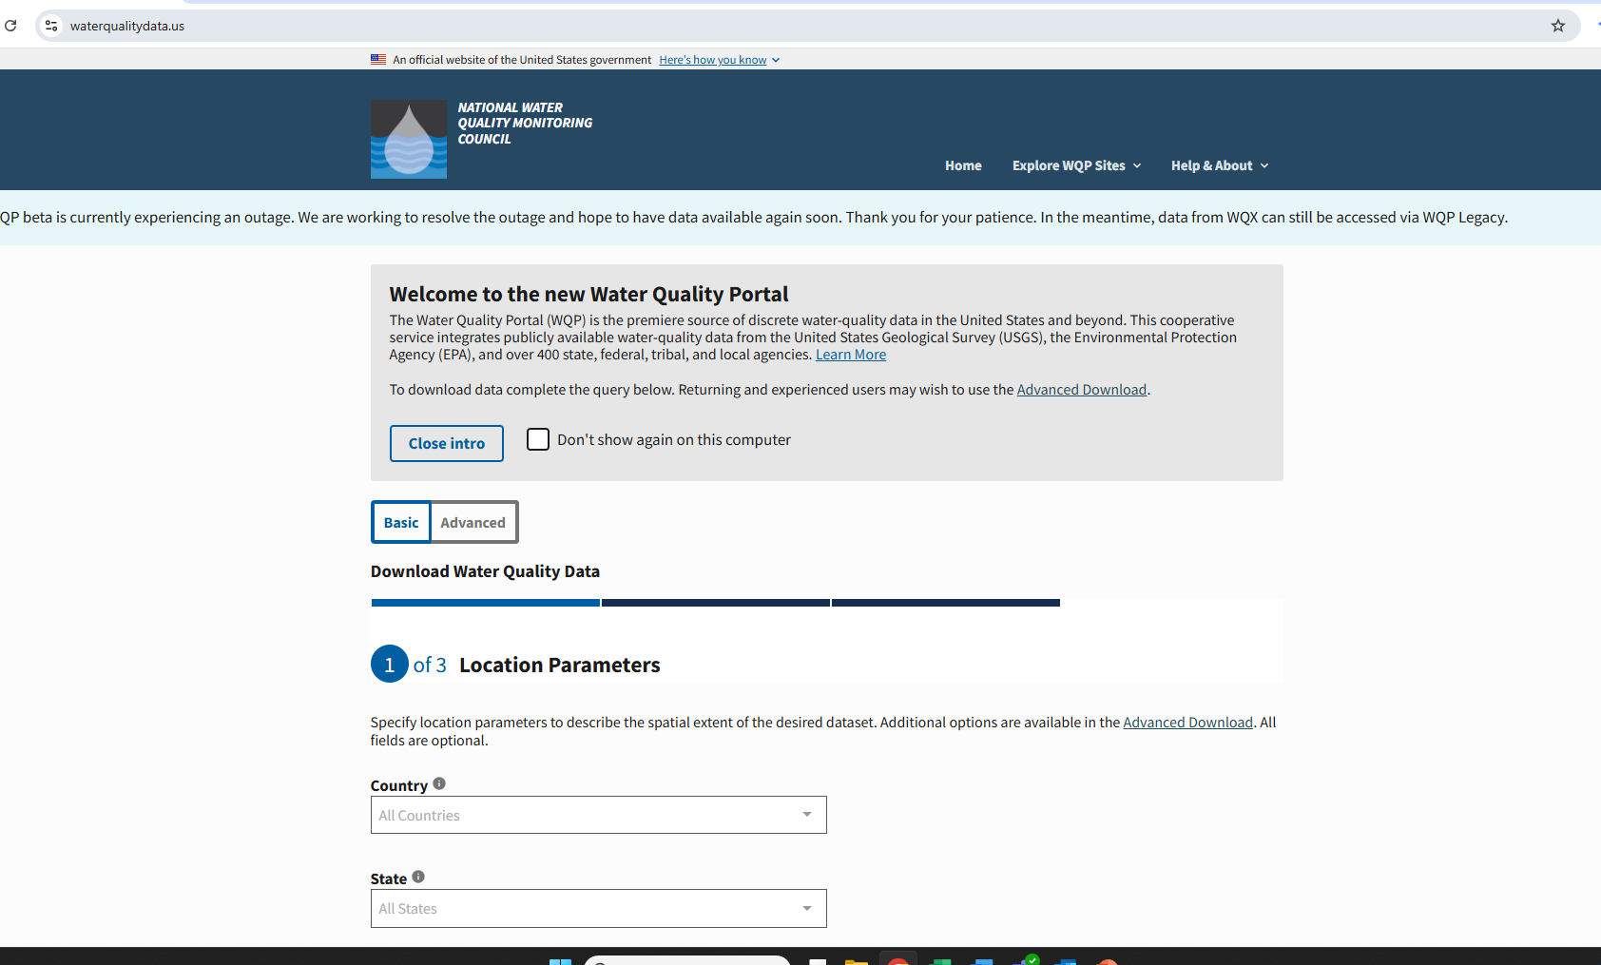
Where the data be saved after collection
https://www.waterqualitydata.us/
Some parameters are in Delaware Water Quality Portal as well
https://cema.udel.edu/applications/waterquality/

Slide 8
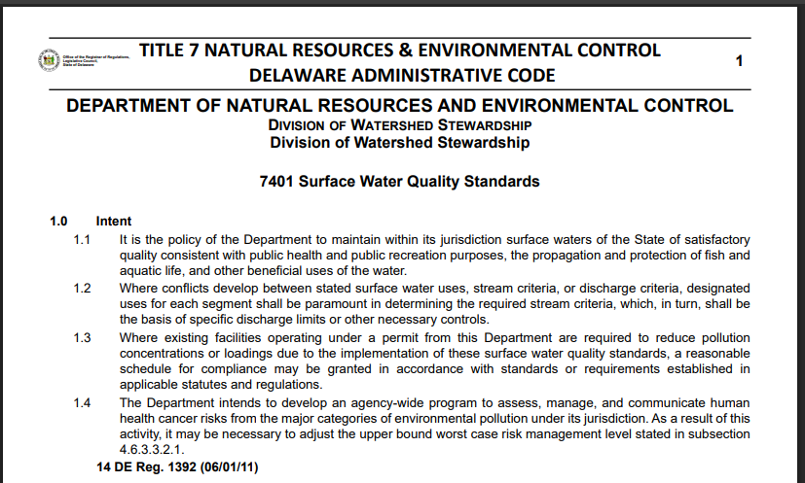
Conceptual Diagram – Data to Listing For Each Parameter
https://dnrec.delaware.gov/watershed-stewardship/assessment/standards/
Download Data
Perform Statistical Analysis
Compare output result with Delaware Water Quality Standard
Meeting Criteria/Standard
Not Meeting Criteria/Standard
List that Station

Slide 9
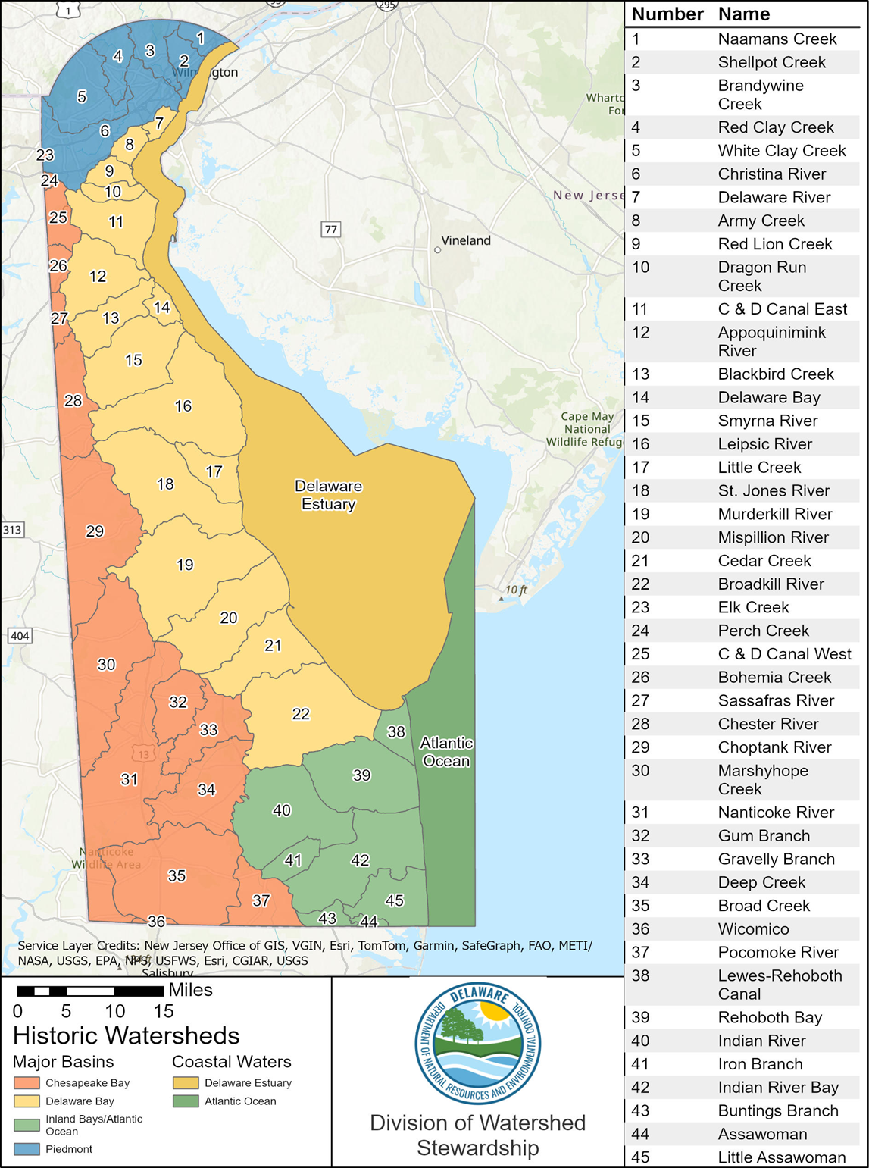
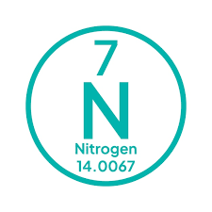
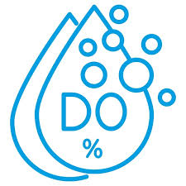

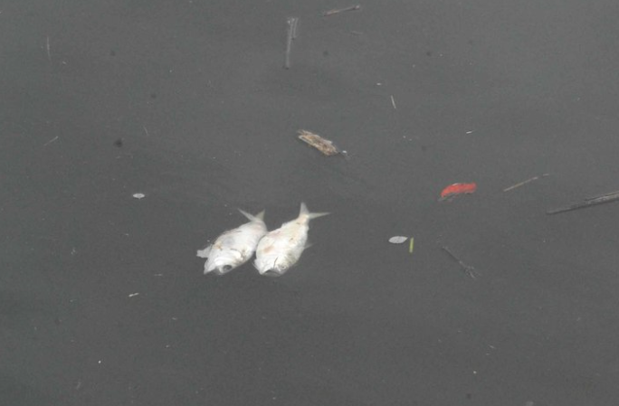
Fish, Shellfish, and Wildlife - Not Supporting the Designated Use

Slide 10
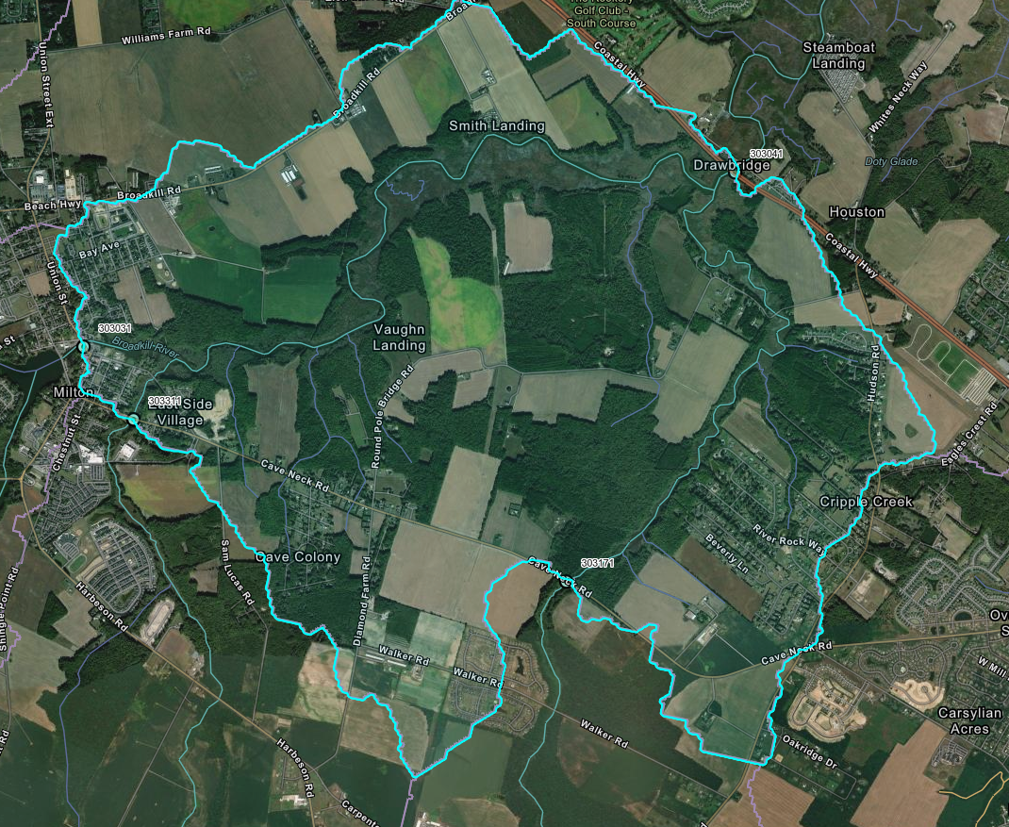
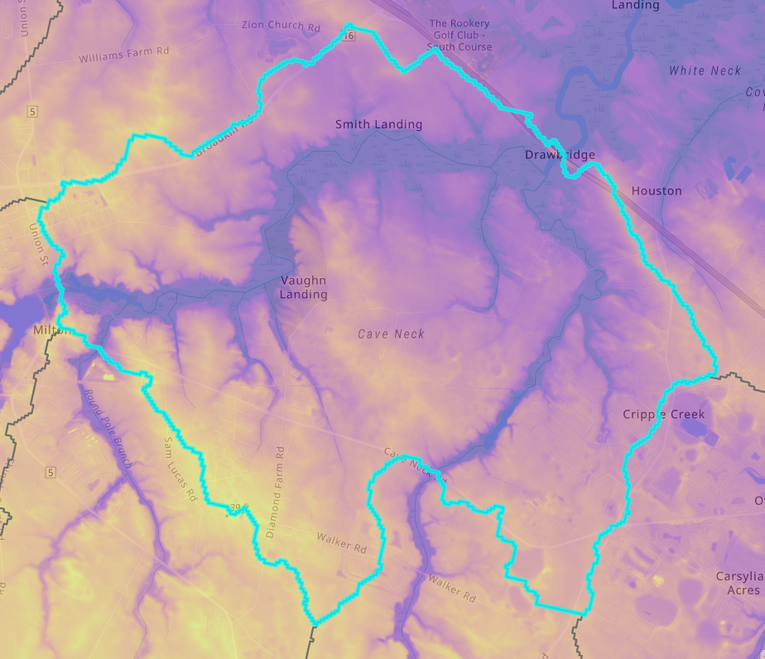
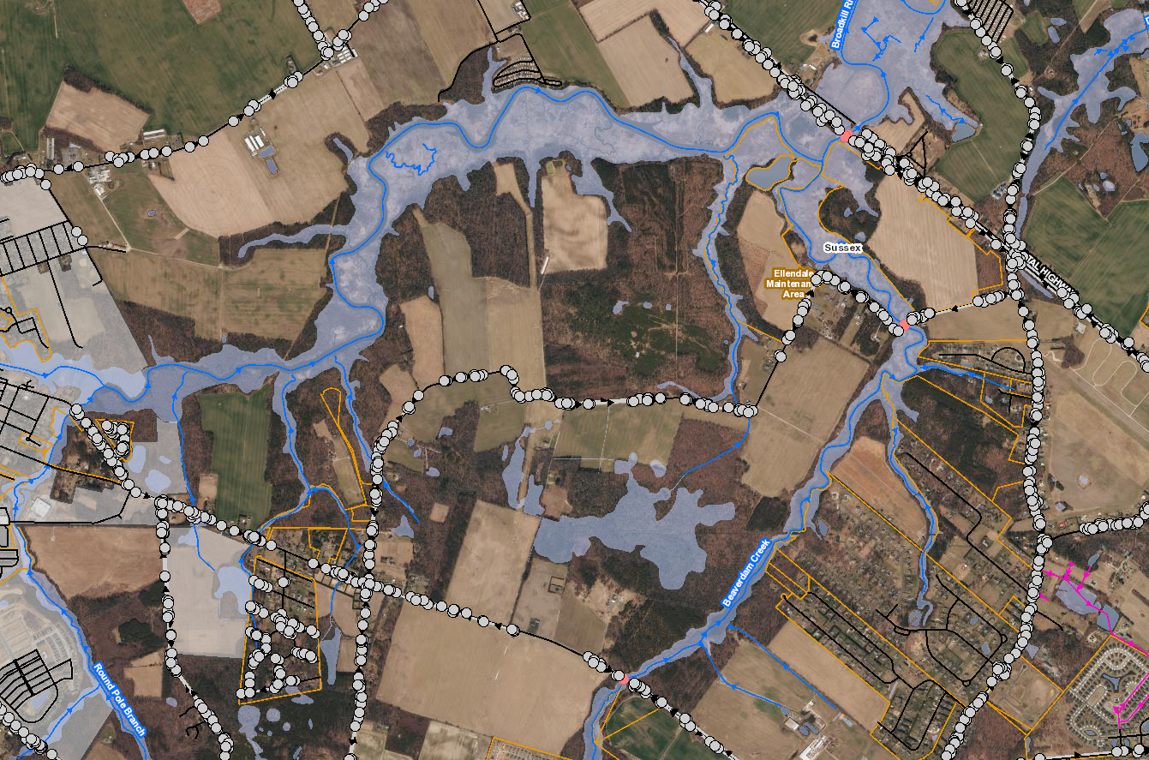
Fish, Shellfish, and Wildlife - Not Supporting the Designated Use

Slide 11
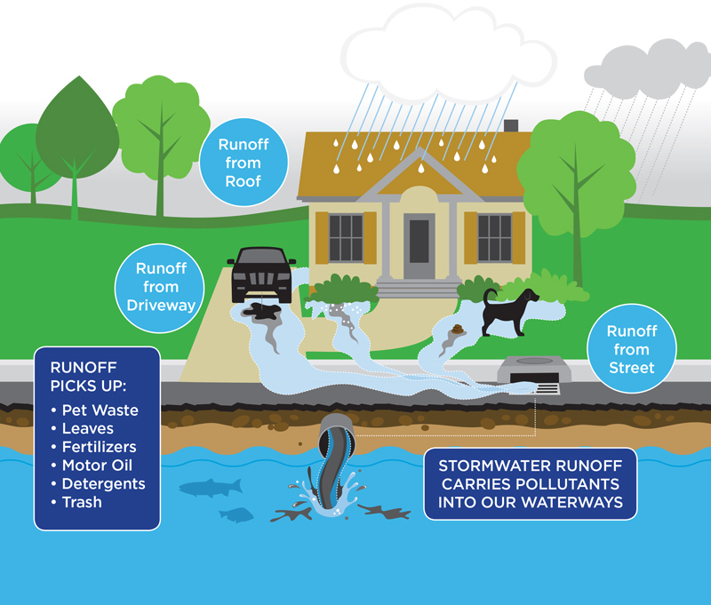
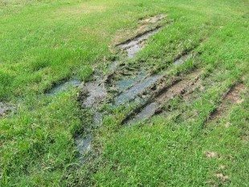
Primary Recreation- Not Supporting the Designated Use

Slide 12
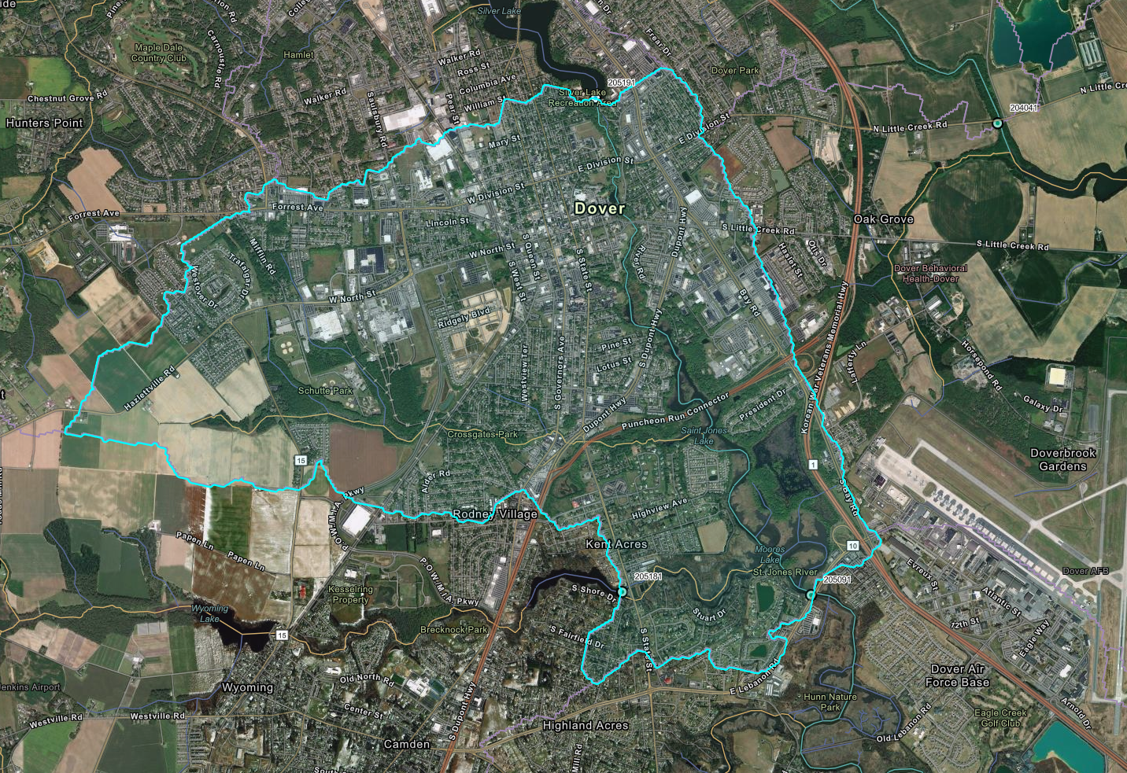
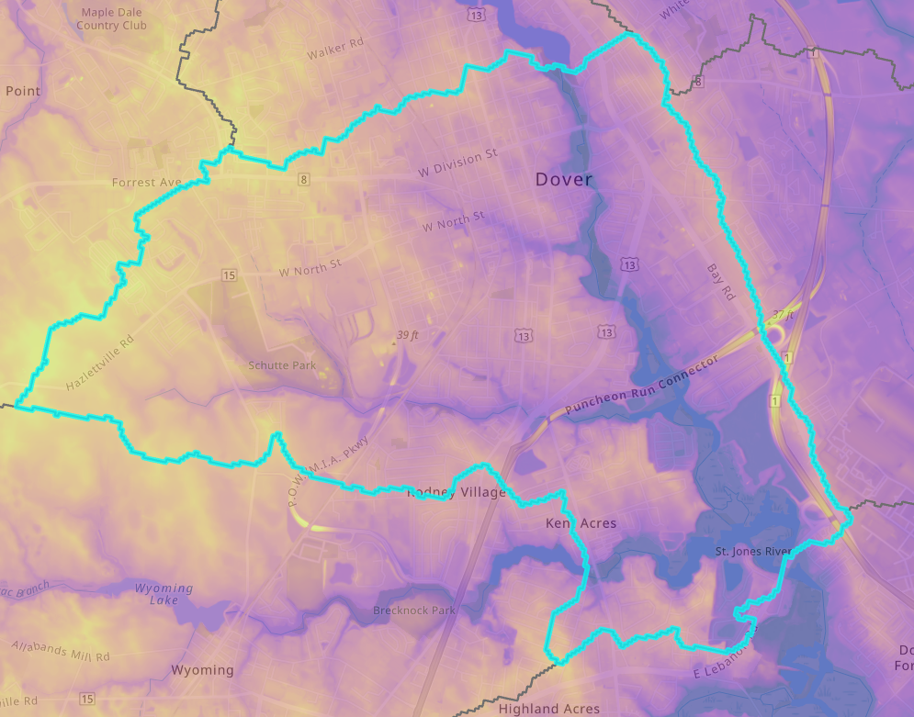
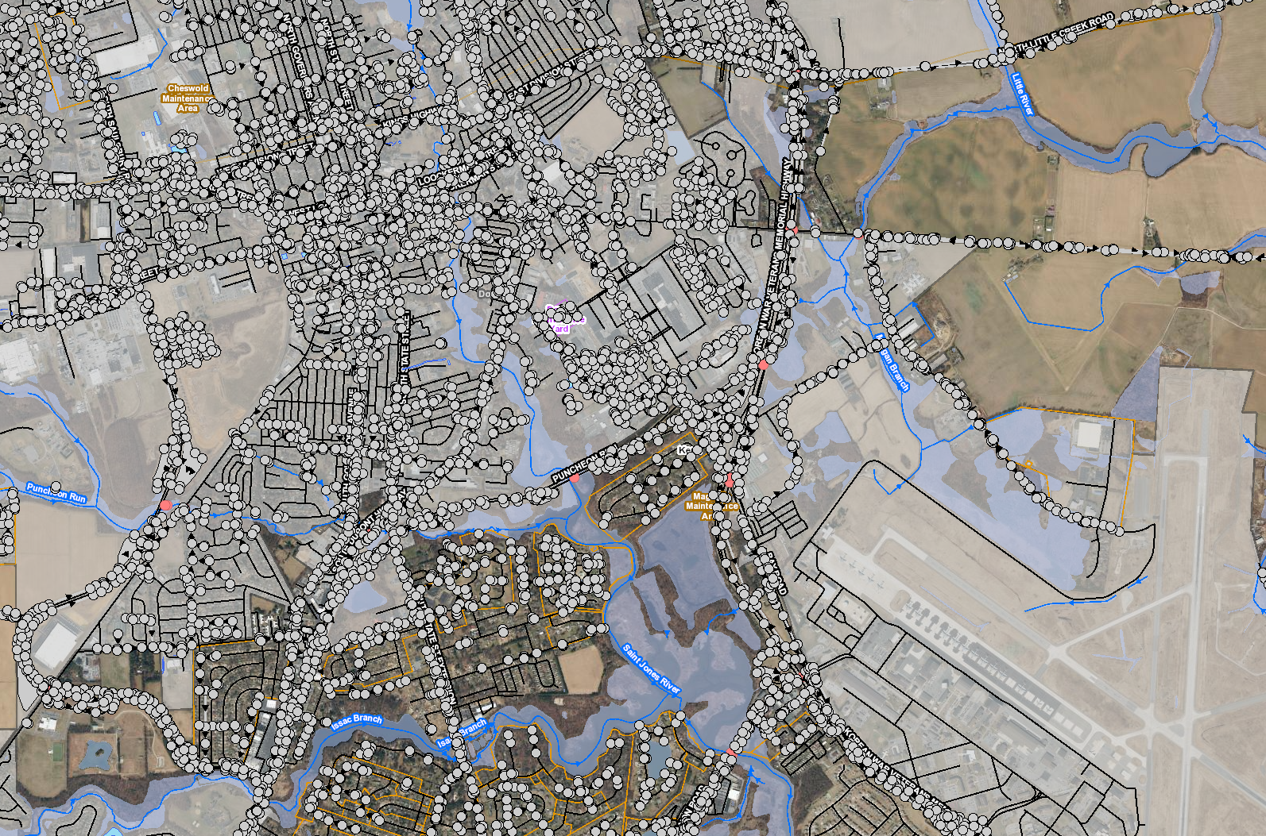
Primary Recreation- Not Supporting the Designated Use

Slide 13
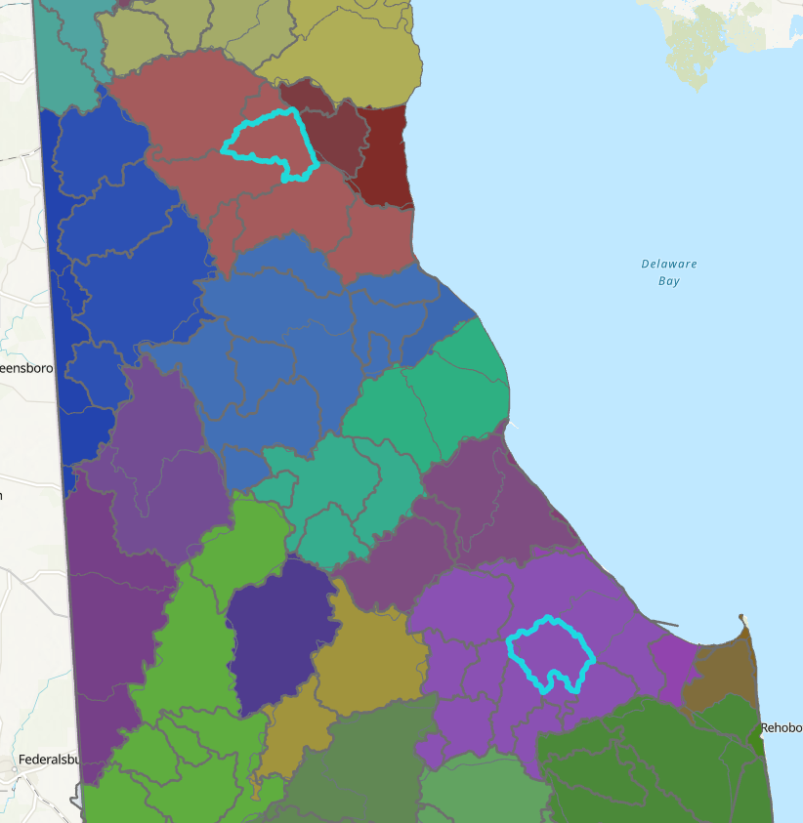
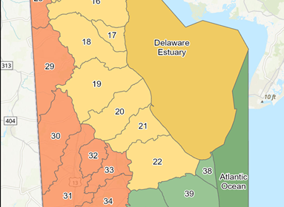
Nested Catchments – Connecting Land Use to Receiving Water

Slide 14
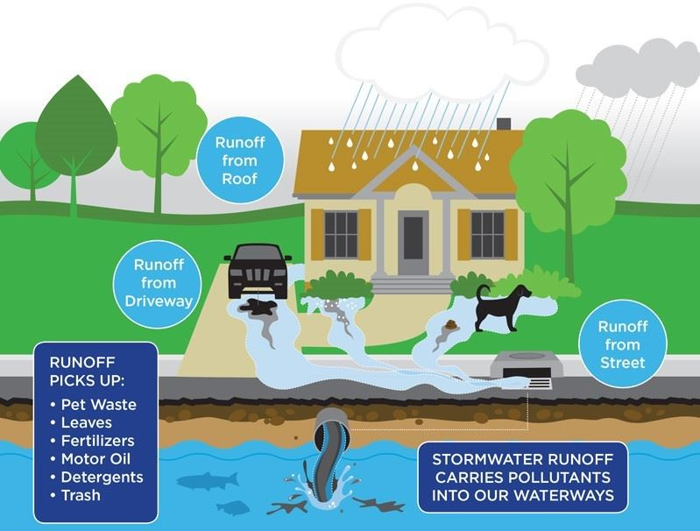
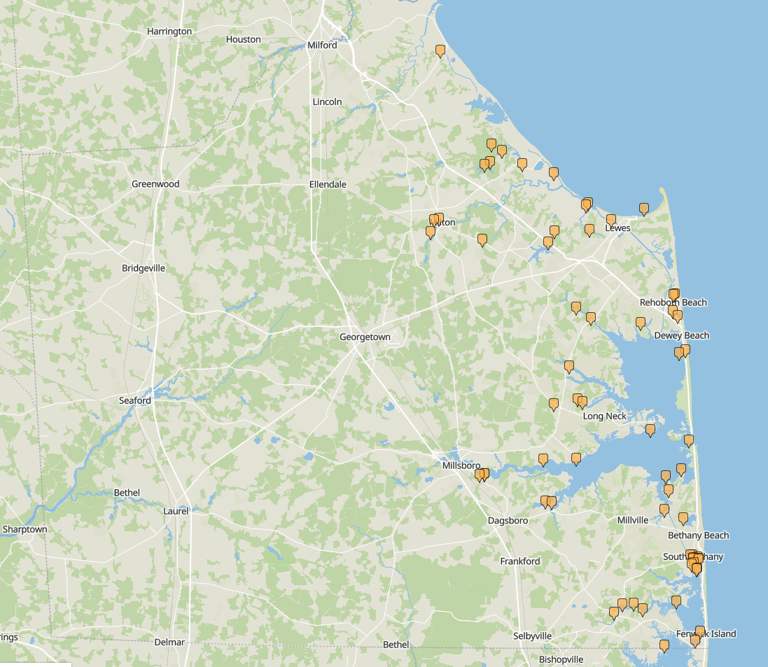
The Role of the Individual/Community
Voluntary BMPs at home
Citizen Science Monitoring Data

Slide 15
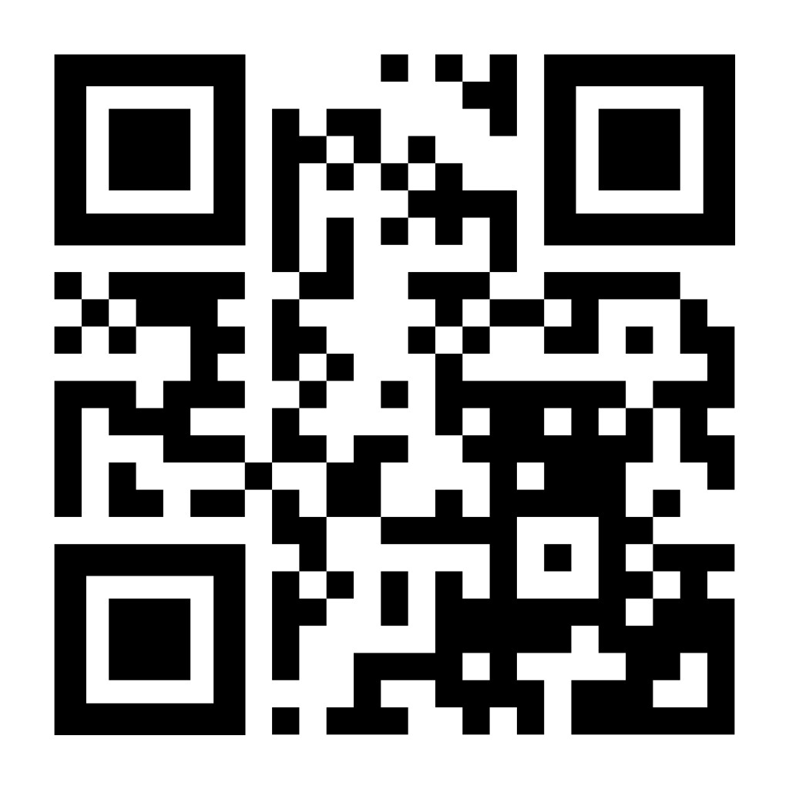
Thank You
Joshua Barth
Environmental Program Manager
Watershed Assessment Branch
Joshua.barth@delaware.gov
Helpful Information:
https://dnrec.delaware.gov/watershed-stewardship/assessment/water-quality-monitoring/

