Slide 1
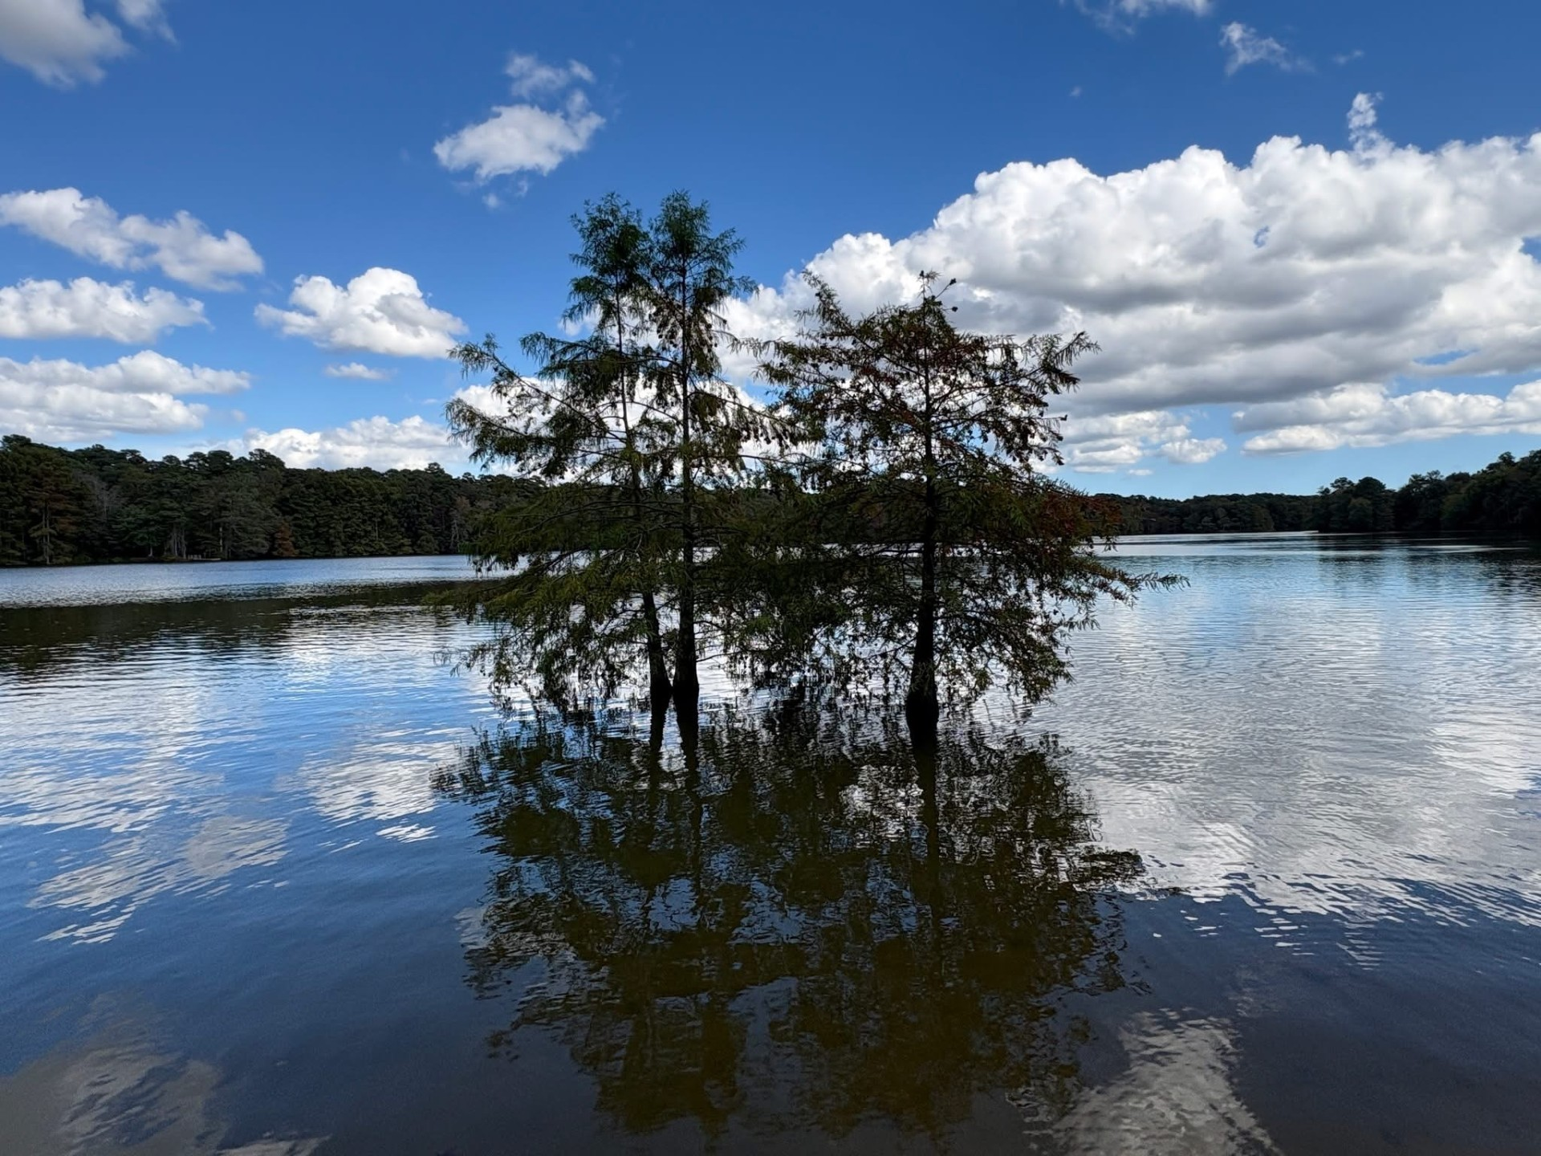

Non-Point Source Pollution and Water Quality
Steve Luell
Delaware Division of Fish and Wildlife

Slide 2
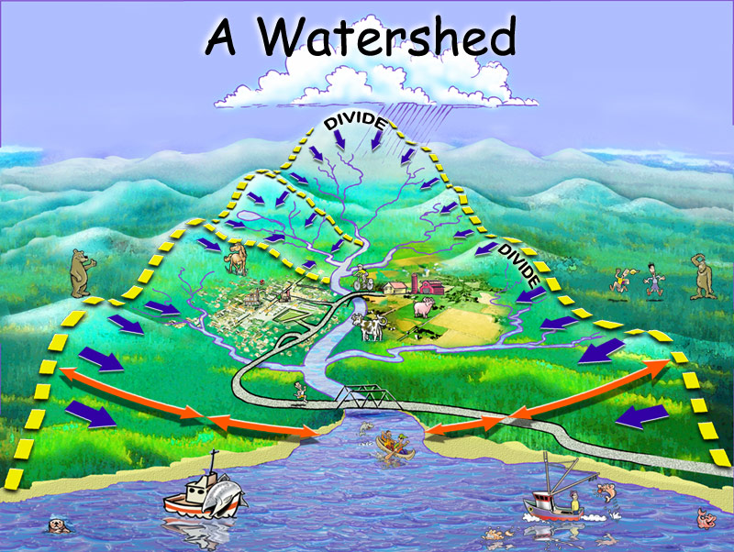
What is a Watershed?
An area of land based on topography in which all water, including sediments and pollutants, drains to a common body of water

Slide 3
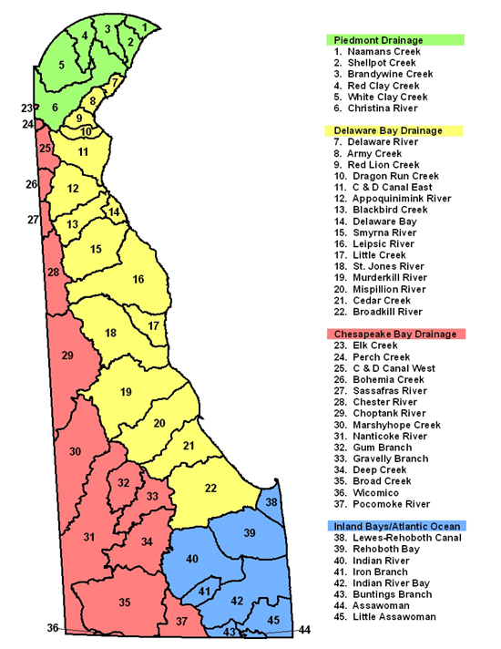
Delaware Watersheds
Delaware has 45 distinct watersheds
Divided into four larger drainage basins
  Piedmont
  Delaware Bay
  Chesapeake Bay
  Inland Bays/Atlantic Ocean

Slide 4
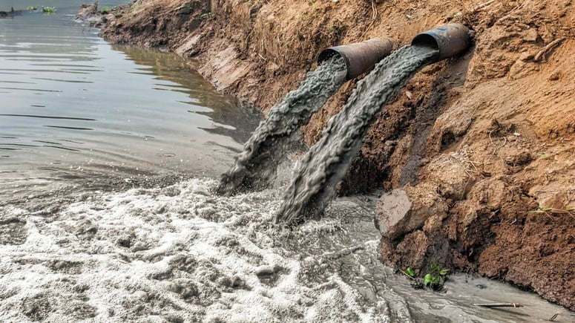
Pollution
The release or discharge of a substance into the environment (EPA)
Causes harm to the environment
  Can even include light and heat
Two main categories based on their sources

Slide 5
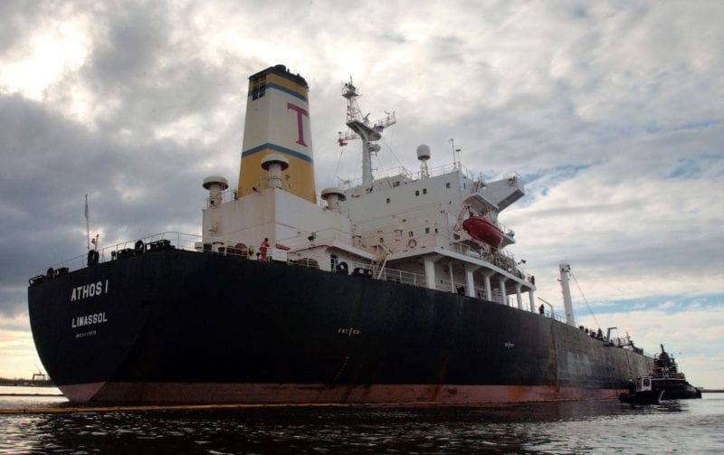
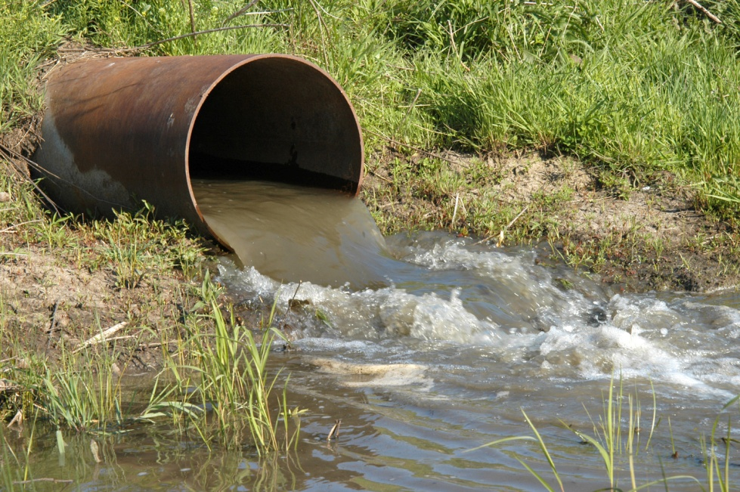
Point Source Pollution
Pollution that comes from a known source
  Examples: industrial plants, wastewater treatment plants, animal feedlots, underground mines, oil wells, and oil tankers
  Regulated by the Clean Water Act for over 50 years

Slide 6
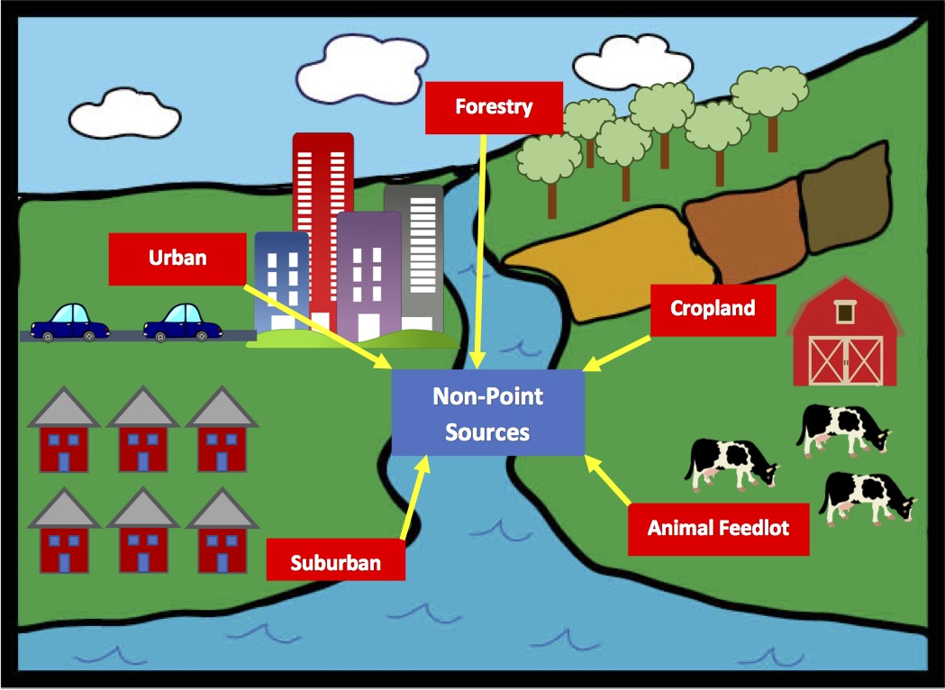
Non-Point Source Pollution
Pollution that generally results from stormwater runoff after rainfall
“People Pollution”
Leading causes of water pollution

Slide 7
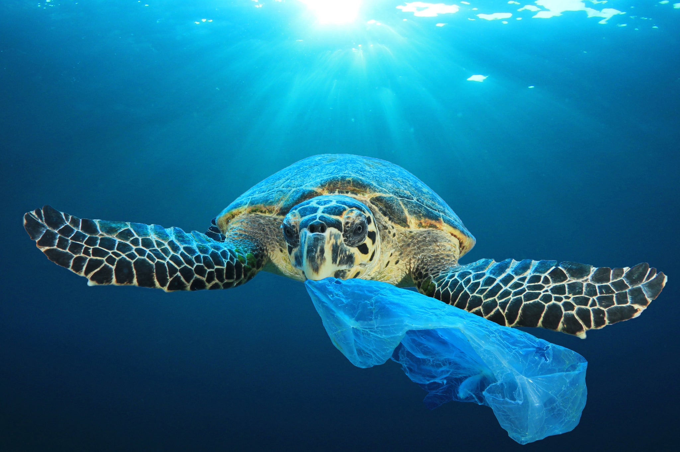
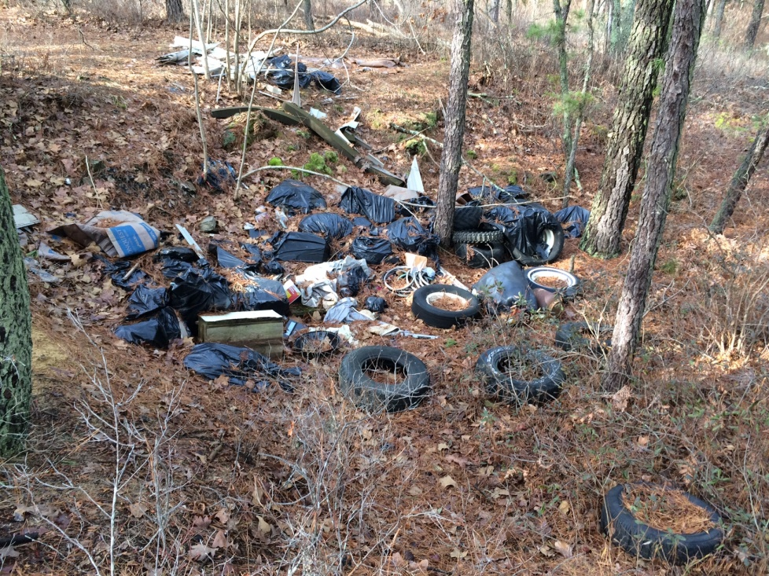
Litter and Debris
Solid wastes that have been incorrectly discarded
Can be consumed or entangle aquatic organisms
Steve Luell

Slide 8
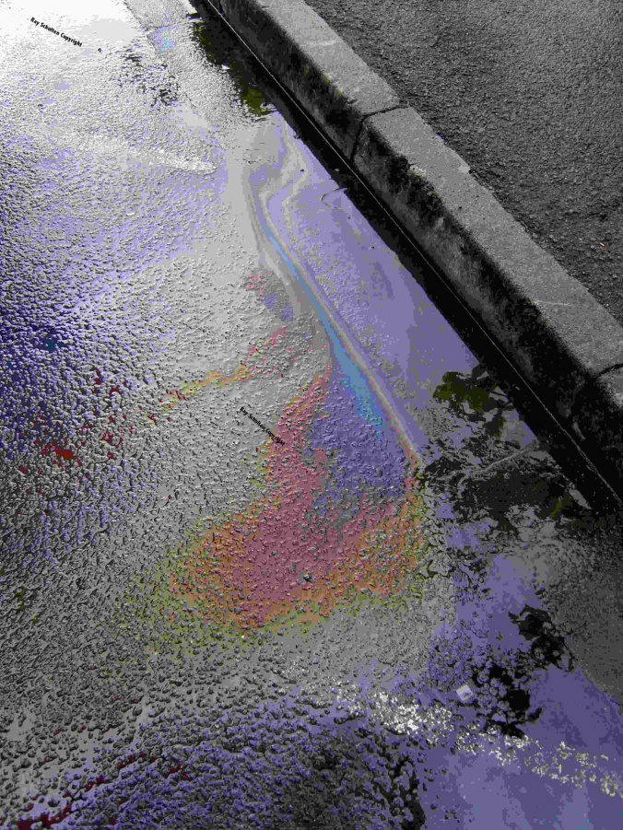
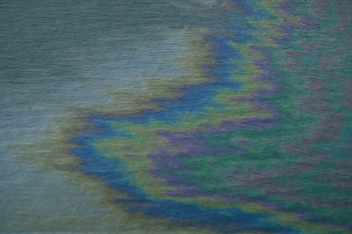
Oil
Many vehicles leak oil onto the roads
Runoff carries it into local storm drains, waterbodies and wetlands

Slide 9
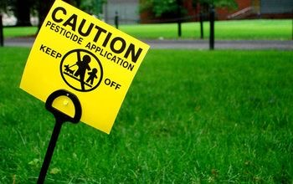
Pesticides
Enters the aquatic environment through:
  Runoff from residential properties and crop fields
  Drift (overspray) outside of treatment area

Slide 10
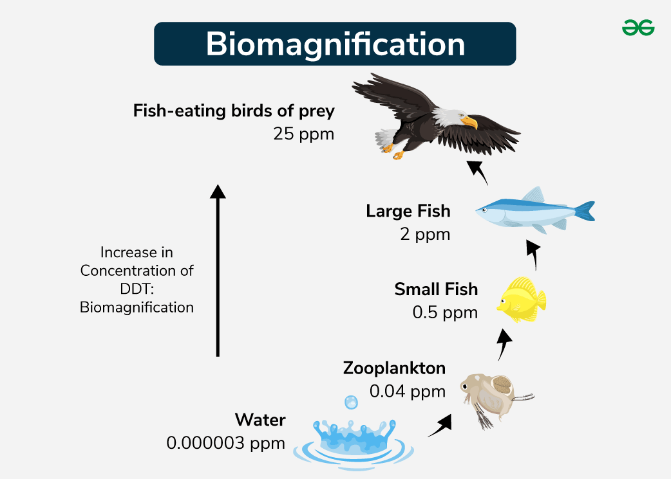
Pesticides
Biomagnification
  Toxins become concentrated in organisms as you move up the food chain

Slide 11
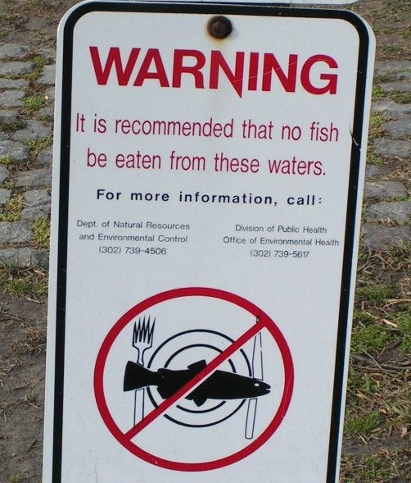
Pesticides
Pesticides and other contaminants necessitate Fish Consumption Advisories
  Recommendation to limit or avoid eating certain species of fish or shellfish caught from a specific body of water
  In Delaware, recommended not to eat more than one 8-oz. meal per week of any fish species caught in fresh, estuarine and marine waters

Slide 12
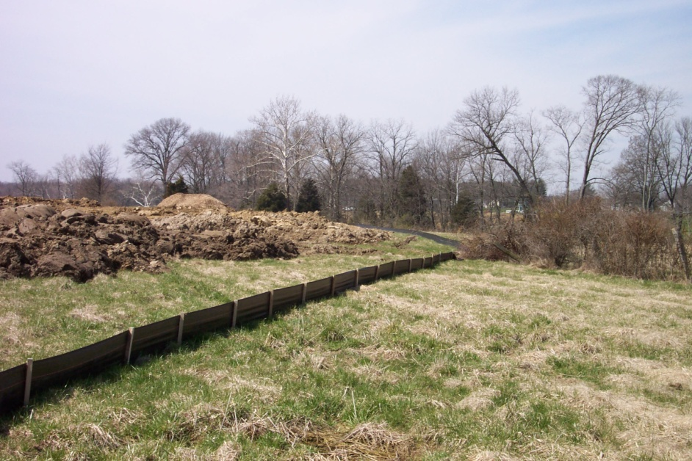
Loose Soil and Sediment
Erosion
  When soil is gradually worn away by flowing water or wind
  Common along streambanks and shorelines that lack vegetation
  Can also occur on construction sites and farm fields

Slide 13
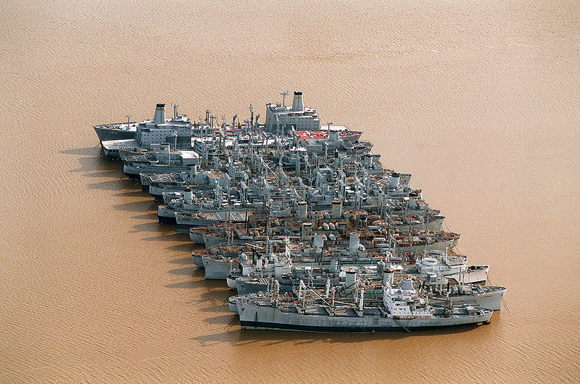
Loose Soil and Sediment
One of the leading causes of impaired waters
Causes turbidity
  Reduced dissolved oxygen
  Blocks sunlight

Slide 14

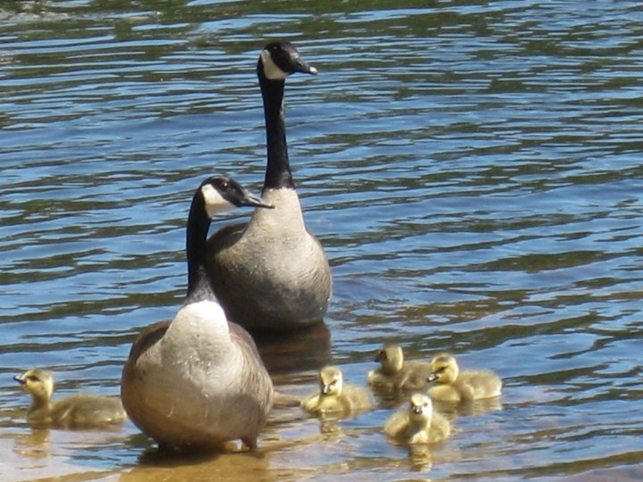
Animal Waste
Increases nutrient levels
  Causes algal blooms
Can contain bacteria and viruses
  Leads to closures of shellfish beds and bathing beaches
Steve Luell

Slide 15
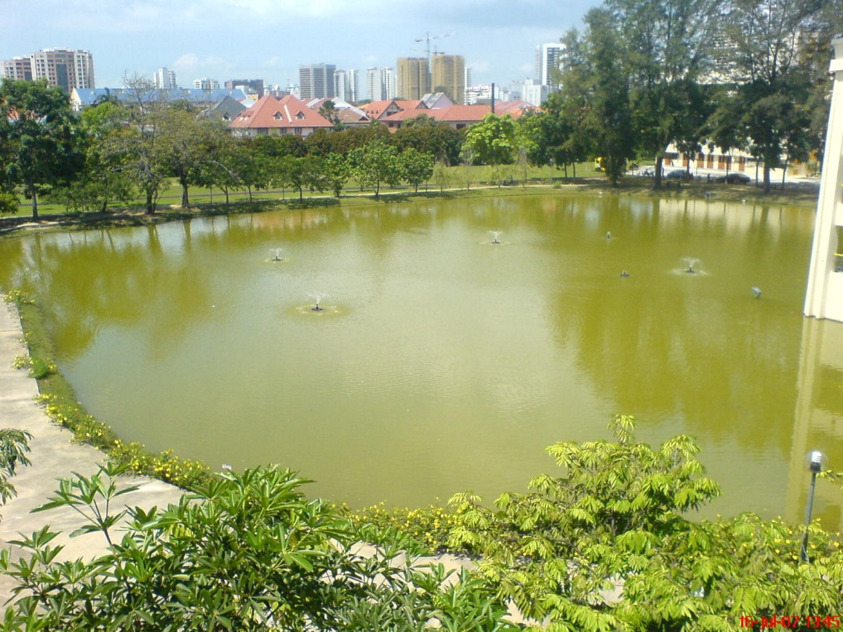
Fertilizer
Excess fertilizer from residential lawns and farm fields wash away in runoff
High levels of phosphorus and nitrogen can cause eutrophication

Slide 16
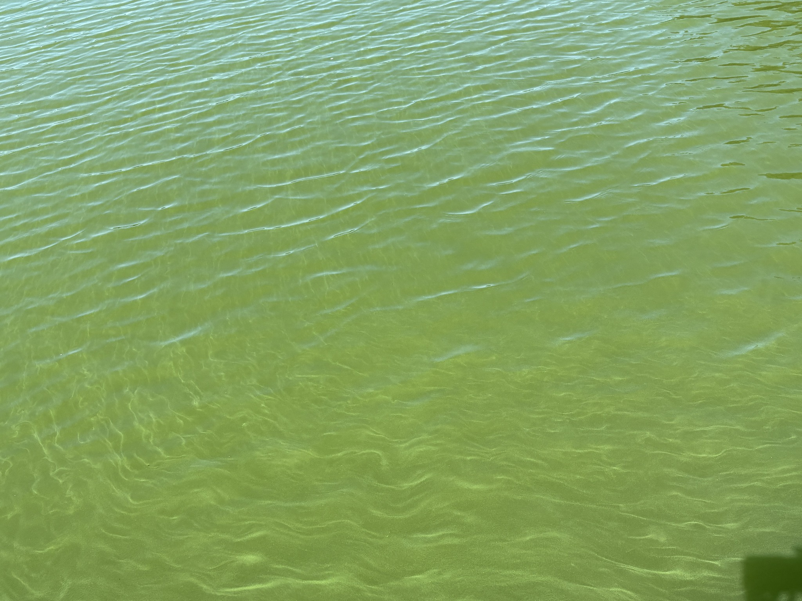
Eutrophication
Characterized by excess plant and algal growth due to increased availability of nutrients
Harmful algal blooms
  Limit light from reaching the bottom
  Reduce submerged aquatic vegetation (SAV) growth and cause die-offs
  Microbes breaking down dead algae use up dissolved oxygen and can cause fish kills
Steve Luell

Slide 17
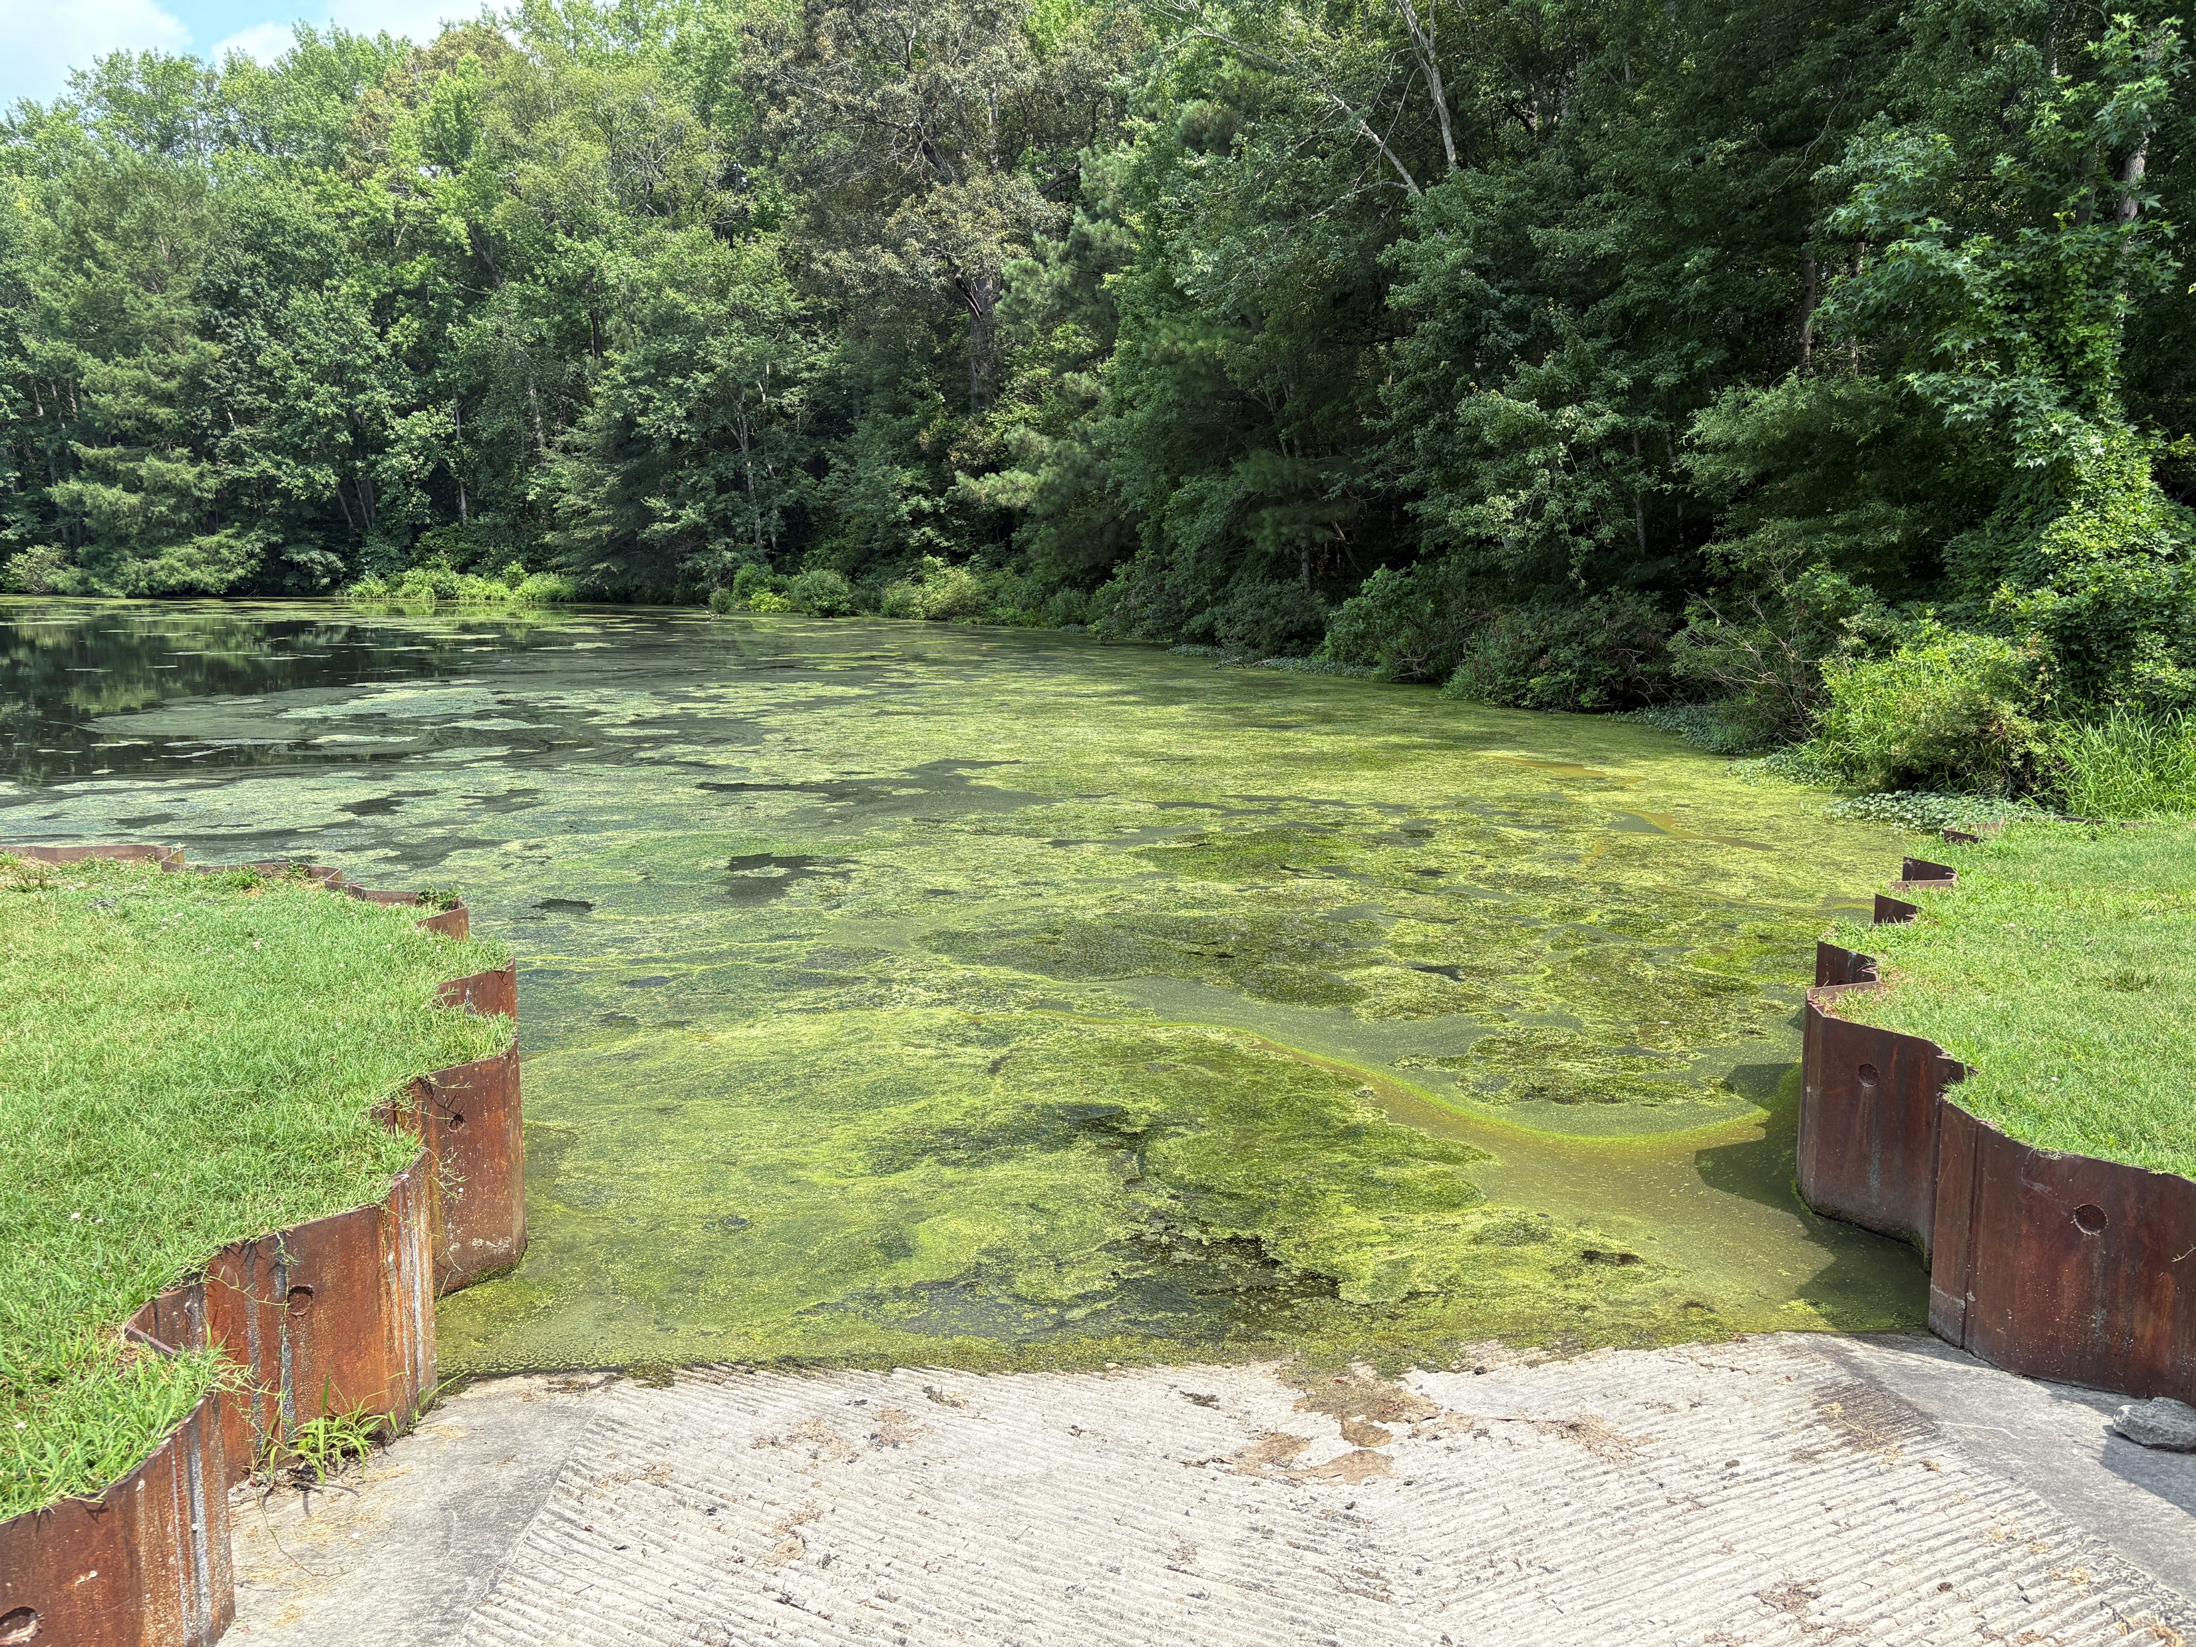
Eutrophication
Characterized by excess plant and algal growth due to increased availability of nutrients
Filamentous algae
  Strands form large mats
  Trap gases and float to surface
  Can cause fish kills as they decompose
Steve Luell

Slide 18
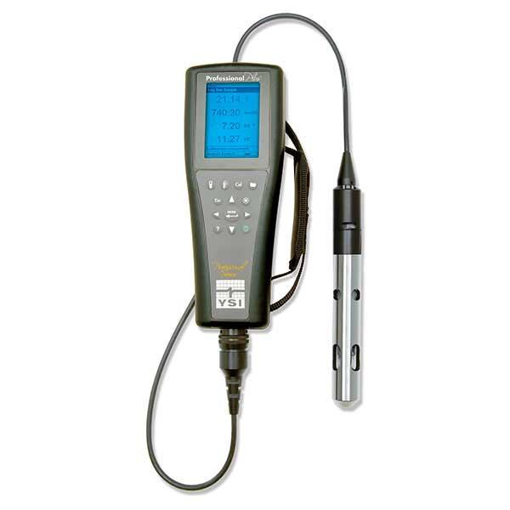
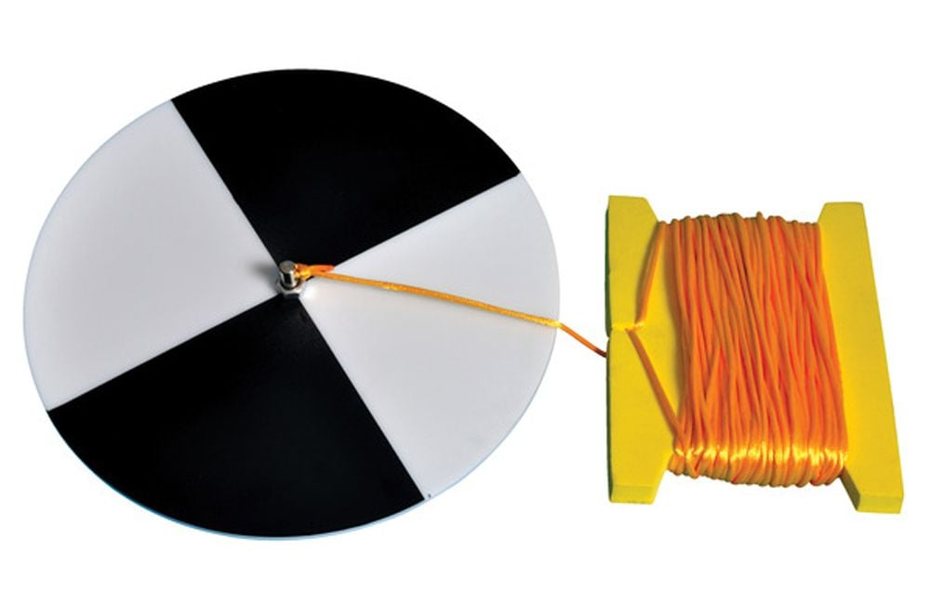
Water Quality Monitoring
There are different ways to determine if a freshwater stream or river is polluted
  Measure dissolved oxygen and pH using a water quality meter
  Measure turbidity using a Secchi disk
  Bacterial counts
  Benthic macroinvertebrate surveys

Slide 19
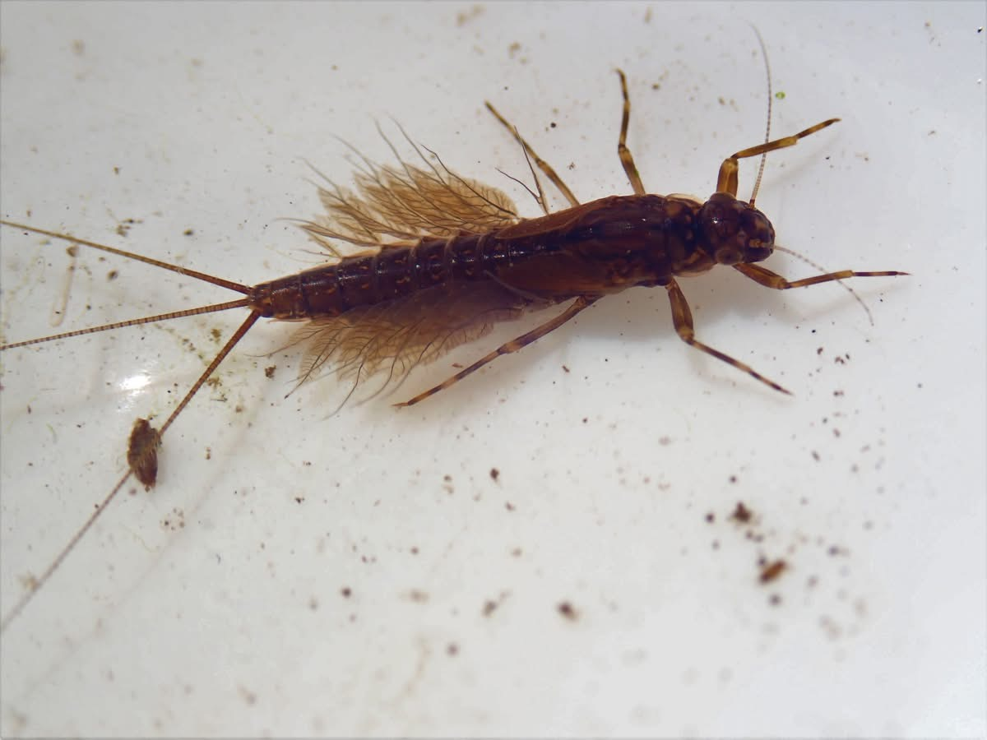
Benthic Macroinvertebrates
“Benthic” – bottom dweller
“Macro” – seen with the naked eye
“Invertebrates” – animals without a backbone
Steve Luell

Slide 20
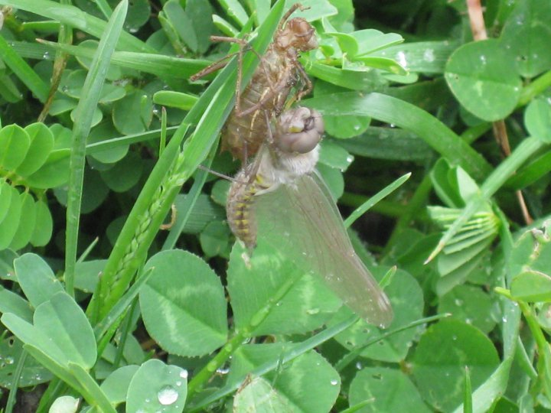
Benthic Macroinvertebrates
Bioindicators
  Living organisms that indicate the health of an ecosystem
Live in same part of stream for most of their lives
Some are more sensitive to pollution than others
Can easily be seen
Important part of the aquatic food web
Steve Luell

Slide 21
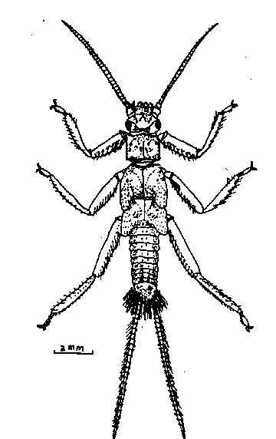
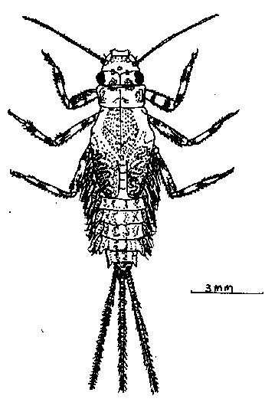
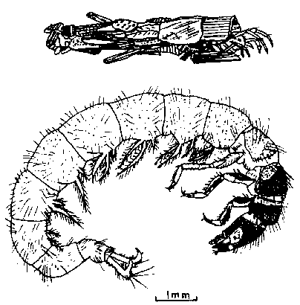
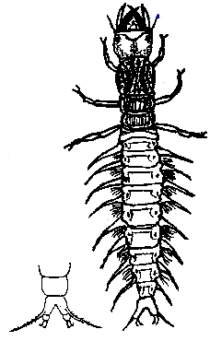
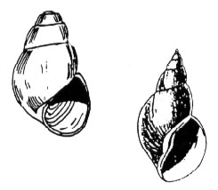
Pollution Intolerant Macroinvertebrates
Sensitive to pollution
Indicate good water quality
Stoneflies
Mayflies
Caddisflies
Hellgrammites
Gilled Snails

Slide 22

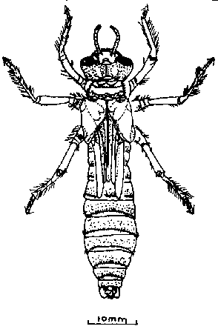
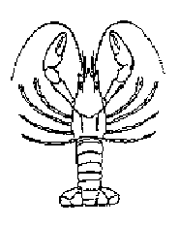
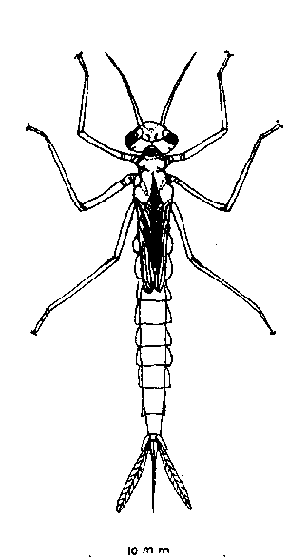
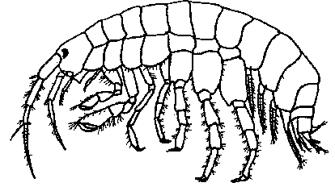
Less Sensitive to Pollution
Somewhat sensitive to water pollution
Indicate fair water quality
Crane Flies
Dragonflies
Damselflies
Crayfish
Scuds

Slide 23
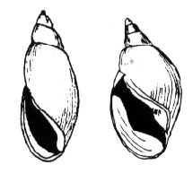
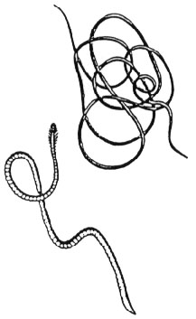
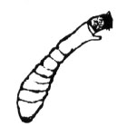
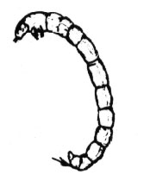
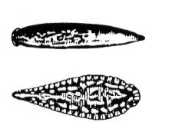
Pollution Tolerant Macroinvertebrates
Tolerant to pollution
Indicate poor water quality
Lunged Snails
Black Flies
Midges
Aquatic Worms
Leeches

Slide 24
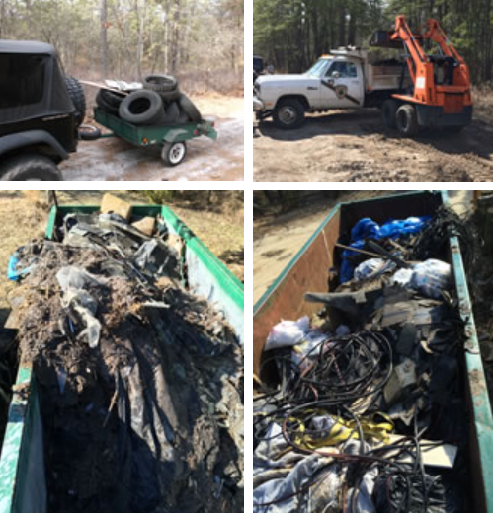
Water Pollution Solutions
Education and Outreach
  Spread awareness of the issues
Public Involvement
  Organize cleanups and train volunteers in stream monitoring

Slide 25
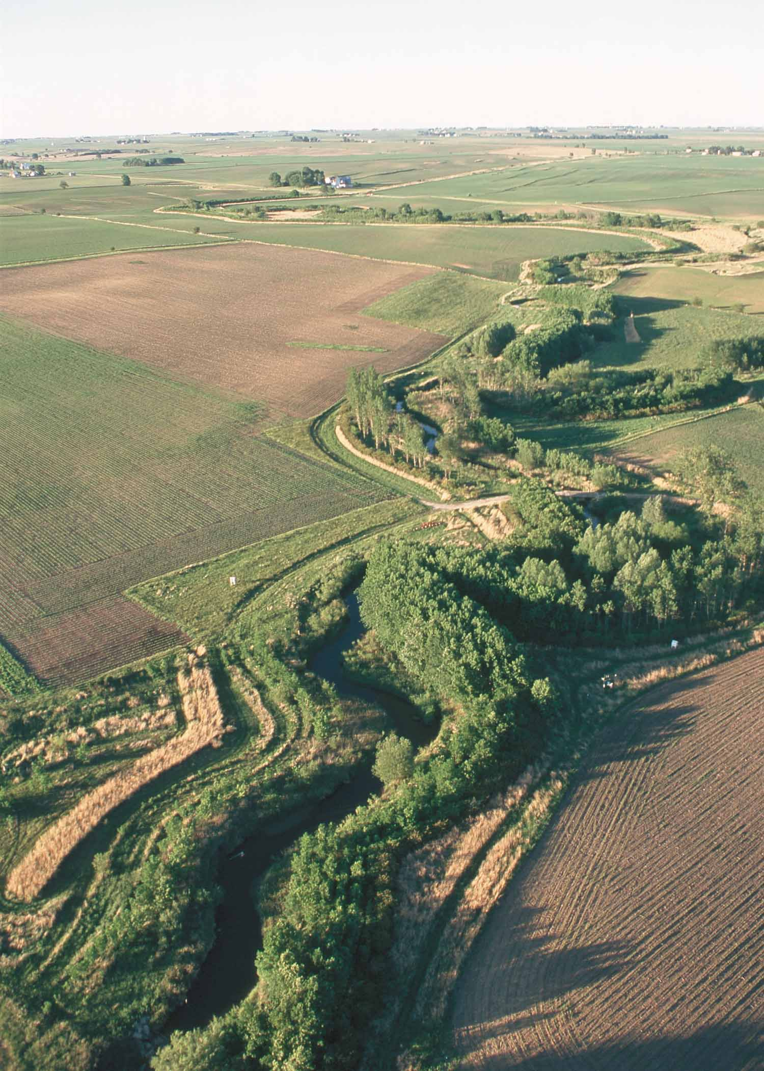
Water Pollution Solutions
Establish soil conservation measures
Avoid applying fertilizer 24 hours before rain
Match fertilizer application with plant nutrient needs
Reduce use and runoff of plant nutrients and pesticides
Follow pesticide labels for correct application
Plant buffer zones of vegetation
Establish regulations to improve water quality

Slide 26
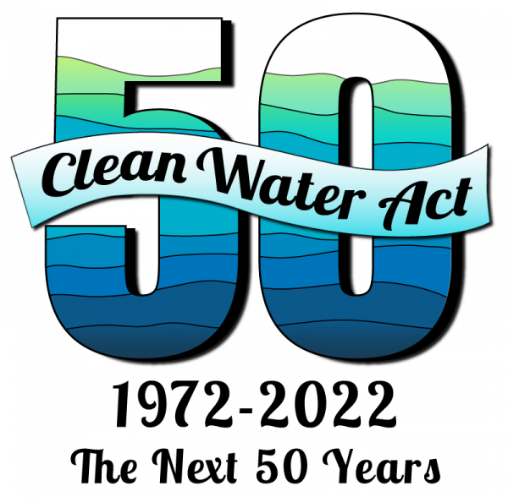
Clean Water Act
Established in 1972 and amended in 1977 and 1987
Primary federal law for governing water pollution
Regulates discharges of pollutants into U.S. waters
  “Navigable waters”
Defines point source and non-point source pollution
Controls pollution by means such as wastewater standards
Requires states to establish total maximum daily loads (TMDLs)
  Maximum amount of a pollutant a waterbody can receive while still meeting water quality standards

Slide 27
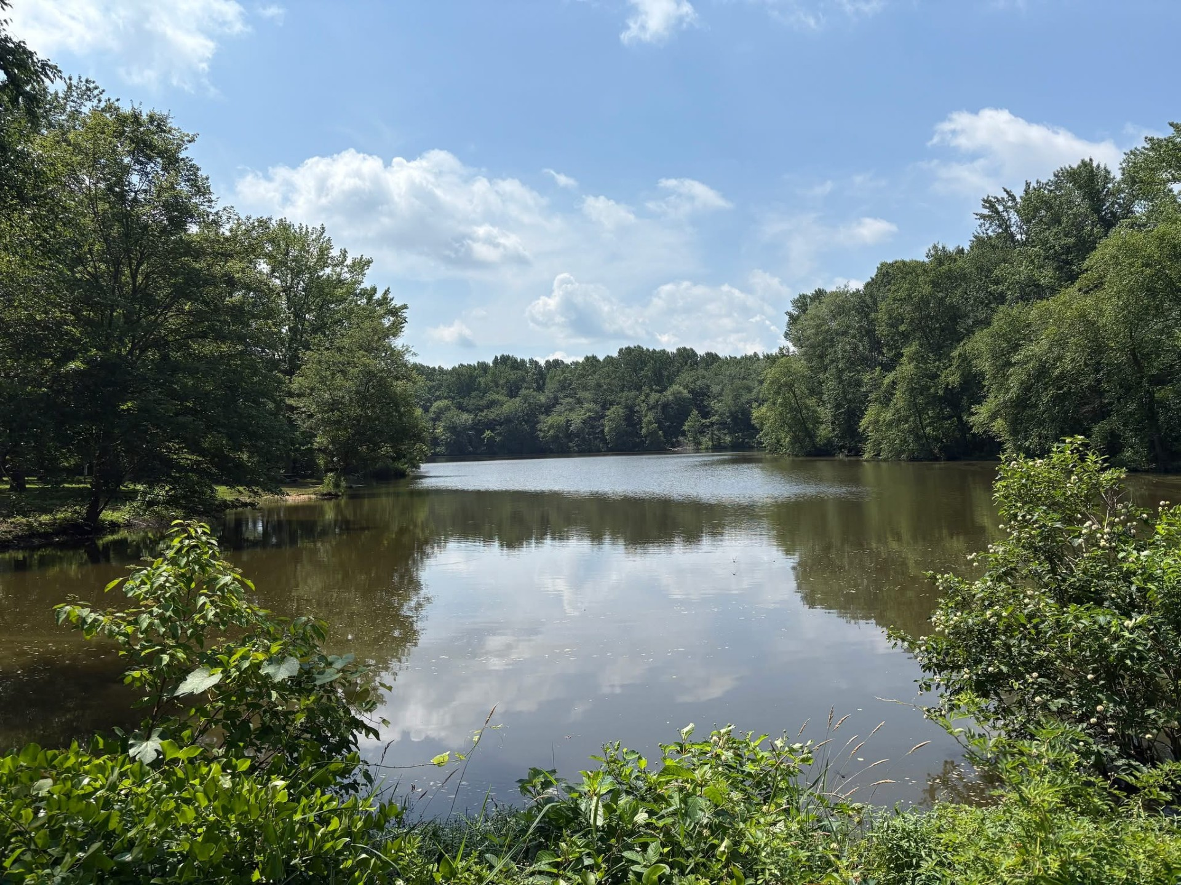
Questions?

