Slide 1
Nonpoint Source Pollution Mitigation in Stormwater
Envirothon Training
January 24, 2026
Ashley Barnett

Slide 2
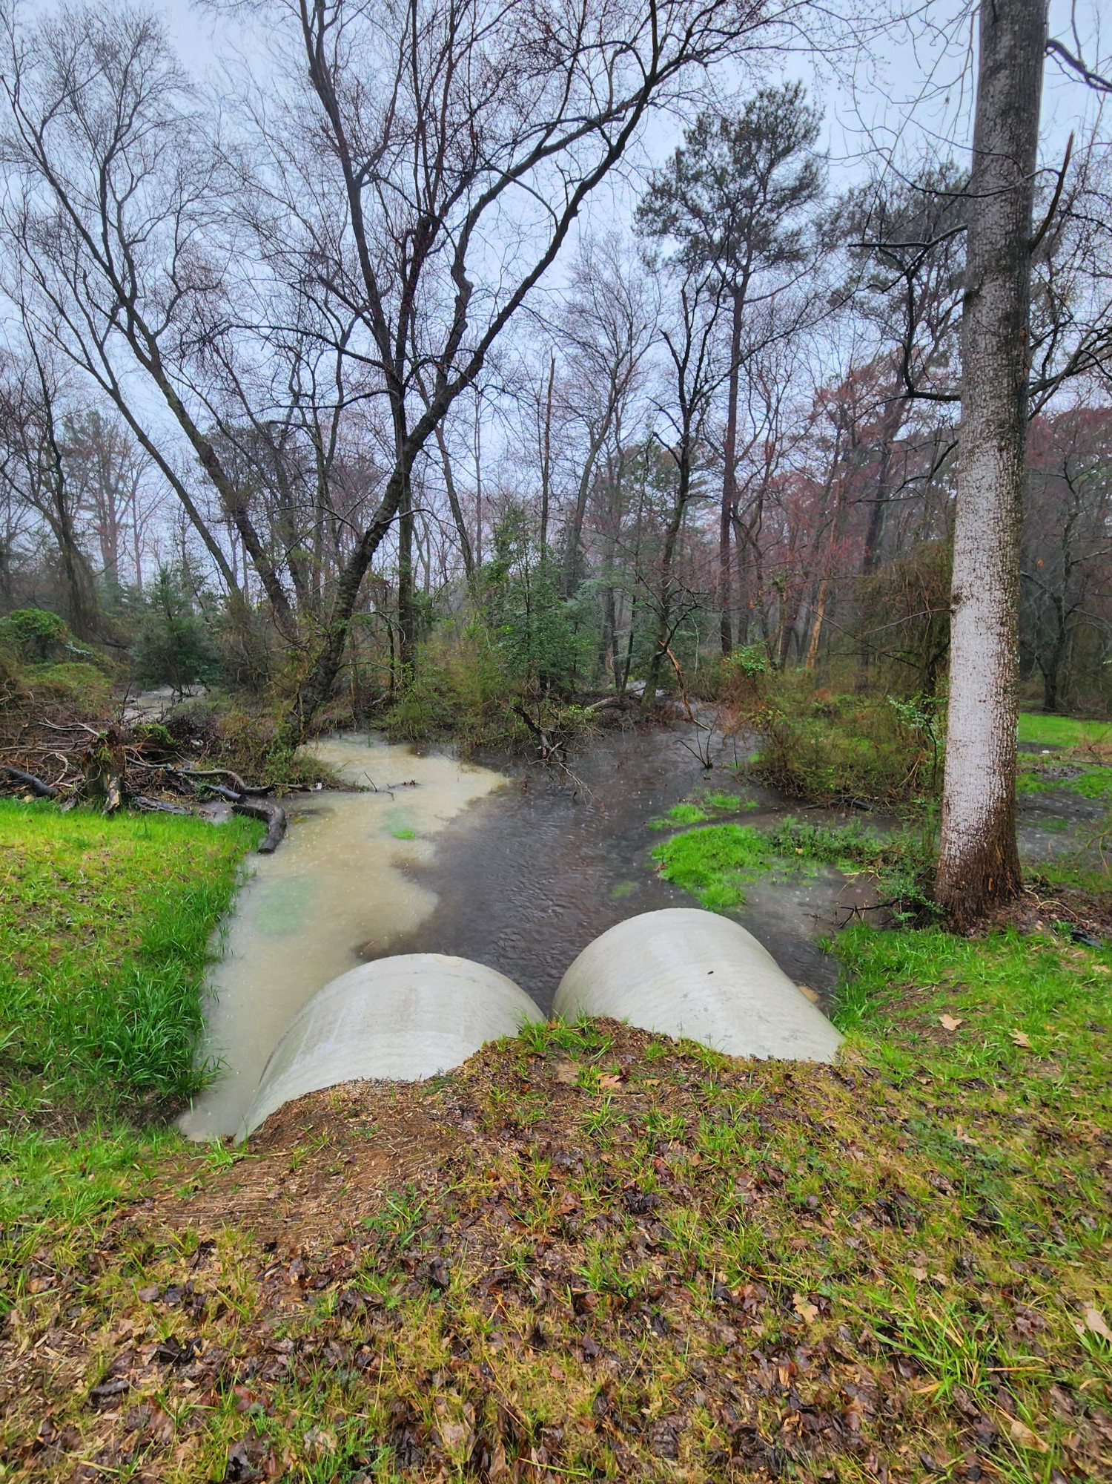
What is Stormwater?
“the runoff of water from the surface of the land resulting from precipitation, or snow or ice melt.”

Slide 3
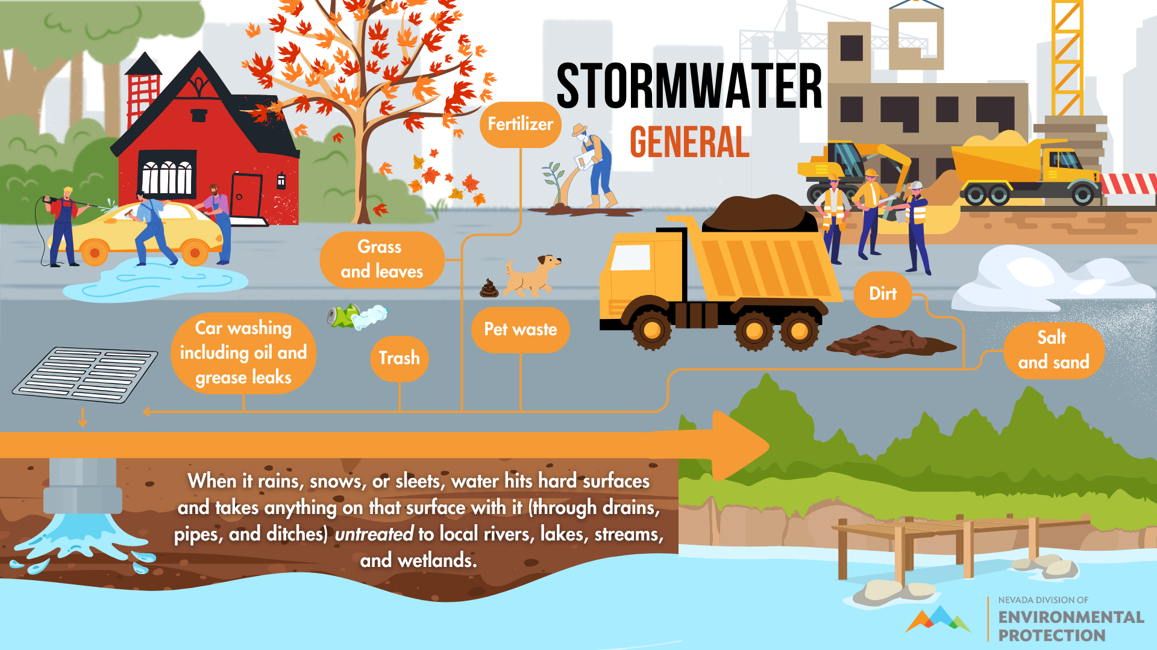
Keep It Simple
Avoid jargon. Use plain English.
Explain complicated concepts with examples.
Include design elements like lists, photos, charts and icons.
Notes:
What are some sources of NPS pollution?
Point out road salt ahead of upcoming snow storm

Slide 4
Best Management Practices (BMPs)
Practices & procedures to prevent or reduce the discharge of pollutants and manage runoff
Examples:
    Structural and non-structural controls
    Treatment requirements
    Operating procedures and practices to control runoff
Notes:
What can we do to mitigate nonpoint source pollution as to relates to stormwater? We can implement what are called “best management practices”

Slide 5
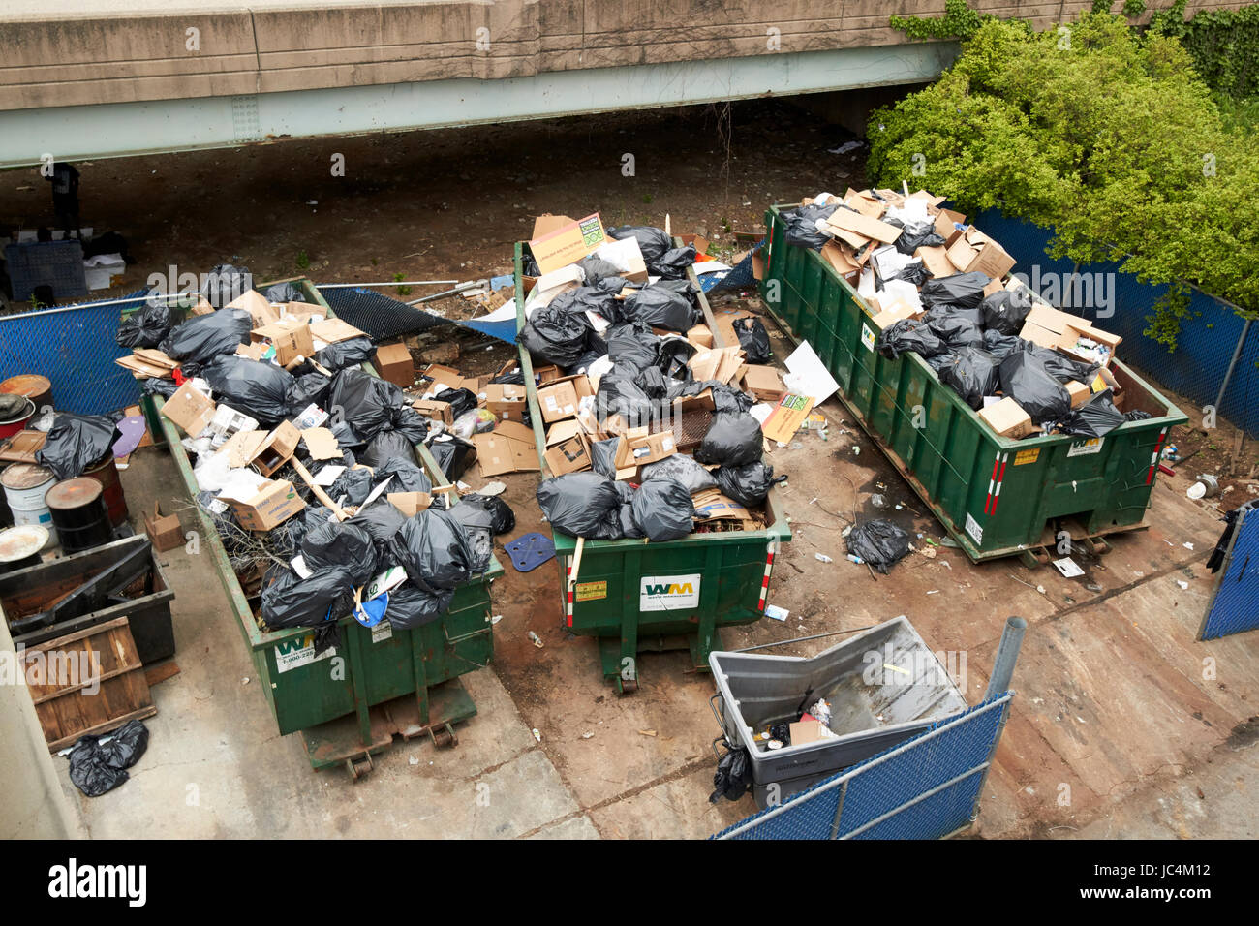
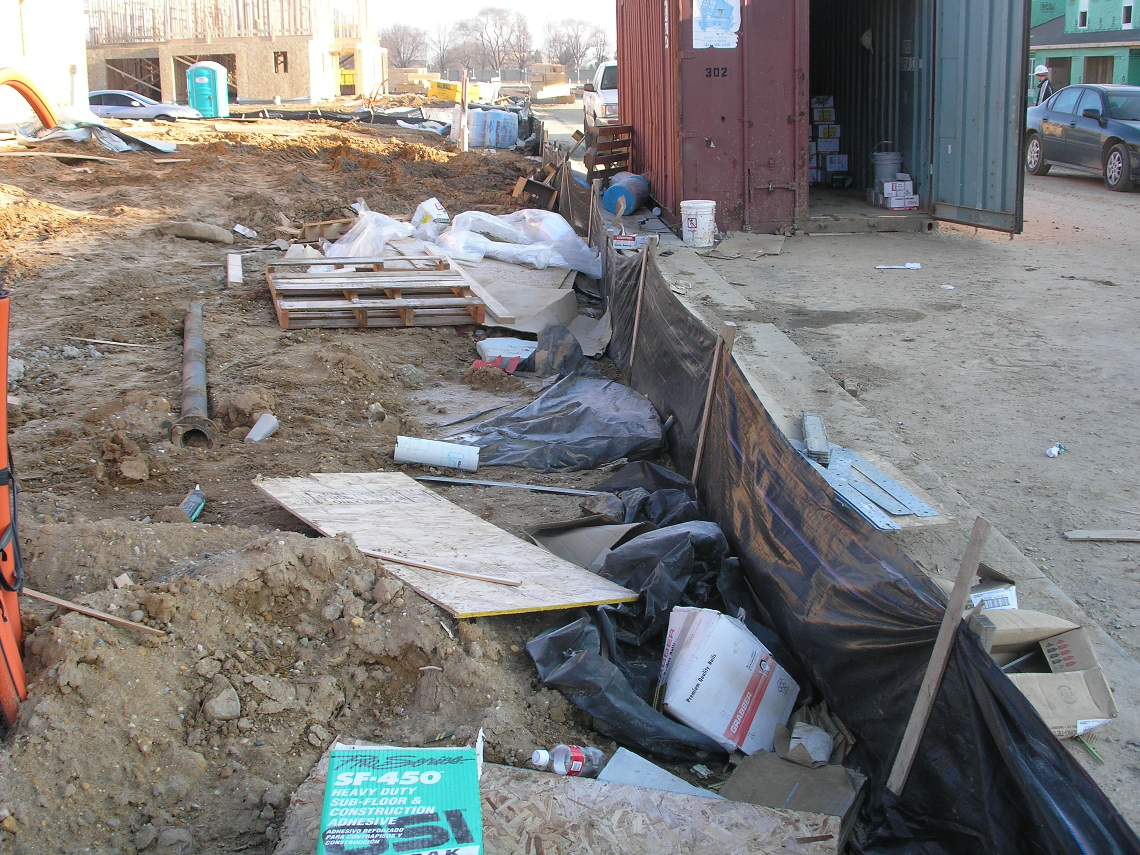
Pollution Prevention Best Management Practices (BMPs)
Waste Management
Vehicle maintenance and washing
Spill control and response
Notes:
Point out BMPs: silt fence, dumpsters

Slide 6
Stormwater Best Management Practices (BMPs)
Detention Practices
Filtering Practices
Wetlands
Wet Ponds
Soil Amendments
Proprietary Practices
Source Controls
Afforestation
Infiltration
Bioretention
Permeable Pavement
Vegetated Roofs
Rainwater Harvesting
Restoration Practices
Rooftop Disconnection
Vegetated Channels
Sheet Flow to Open Space
Notes:
Managing water quantity and improving water quality

Slide 7
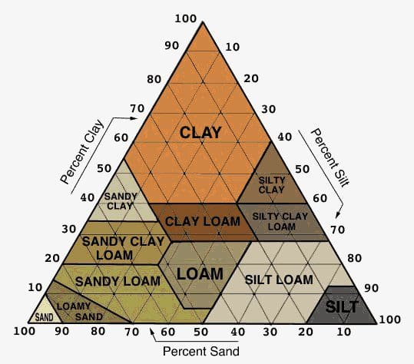
BMP Design Variants
Land use
  % pervious (water can pass through)
  % impervious (water cannot pass through)
  Size of drainage area
Soil conditions
Observed pollution risks
  Proximity to water body
Notes:
Land use-is pervious land being converted to impervious

Slide 8
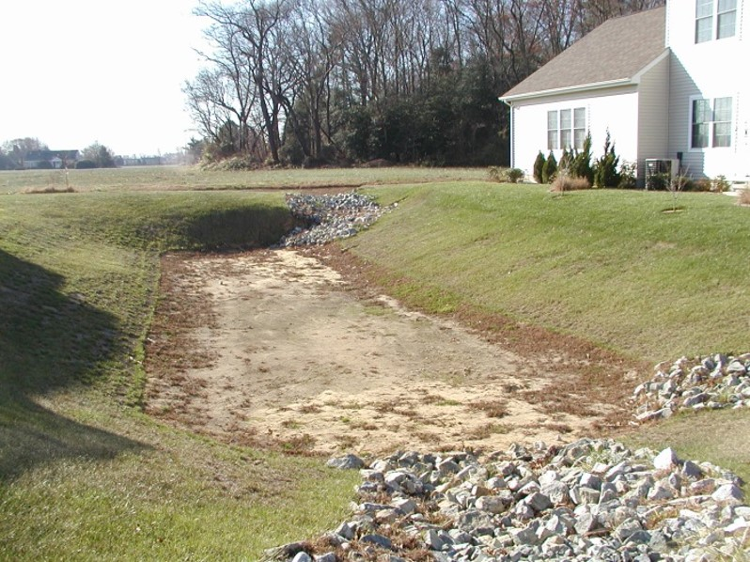
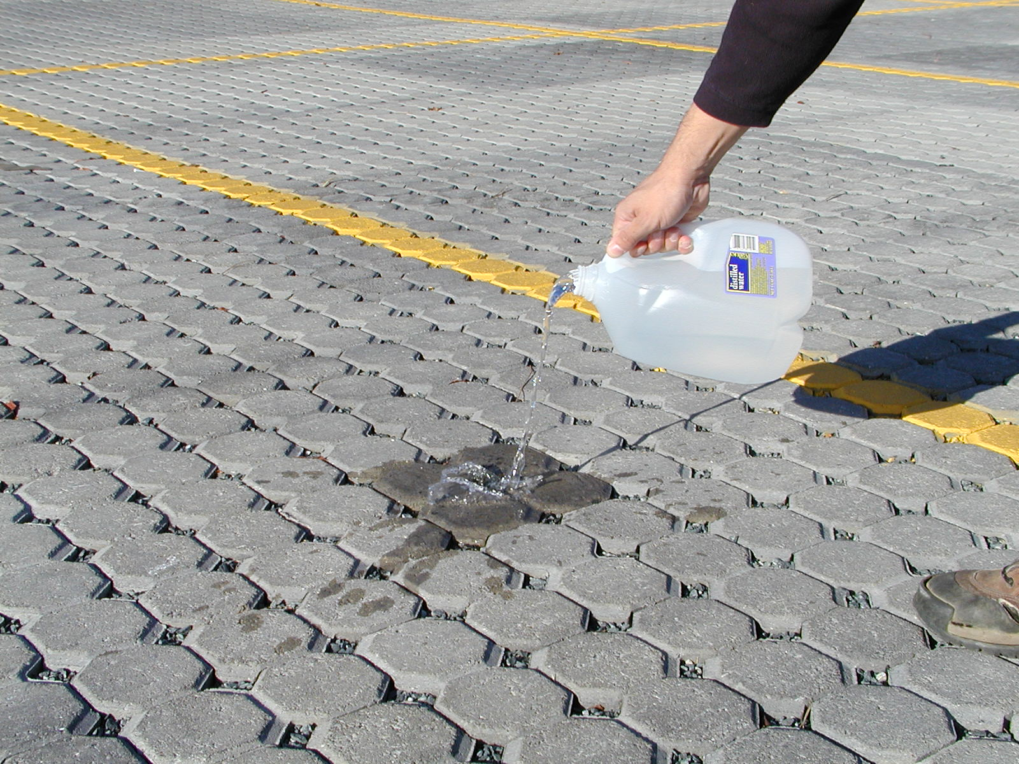
Infiltration
Porous Pavement
Infiltration Basin
Notes:
Infiltration practices capture and temporarily store runoff before allowing it to infiltrate into the soil over several days. They are impoundments created by excavation or creation of berms or small dams. They are flat bottoms and if they have an outlet, it should be located above the required infiltration volume to allow for stormwater to absorb into the ground instead of flow out of the basin. Runoff gradually infiltrates through the bottom and sides of the basin, ideally within 72 hours. It is very important to keep sediment and other debris out of the bottom to prevent clogging. Infiltration practices work best in areas with permeable sandy soils.
Design variants include:
Infiltration basins, infiltration trenches, porous pavement. The practice utilized should consider the drainage area to the BMP; for example, a large drainage area would overwhelm an infiltration trench (5-10acre drainage area) and an infiltration basin should be used.

Slide 9
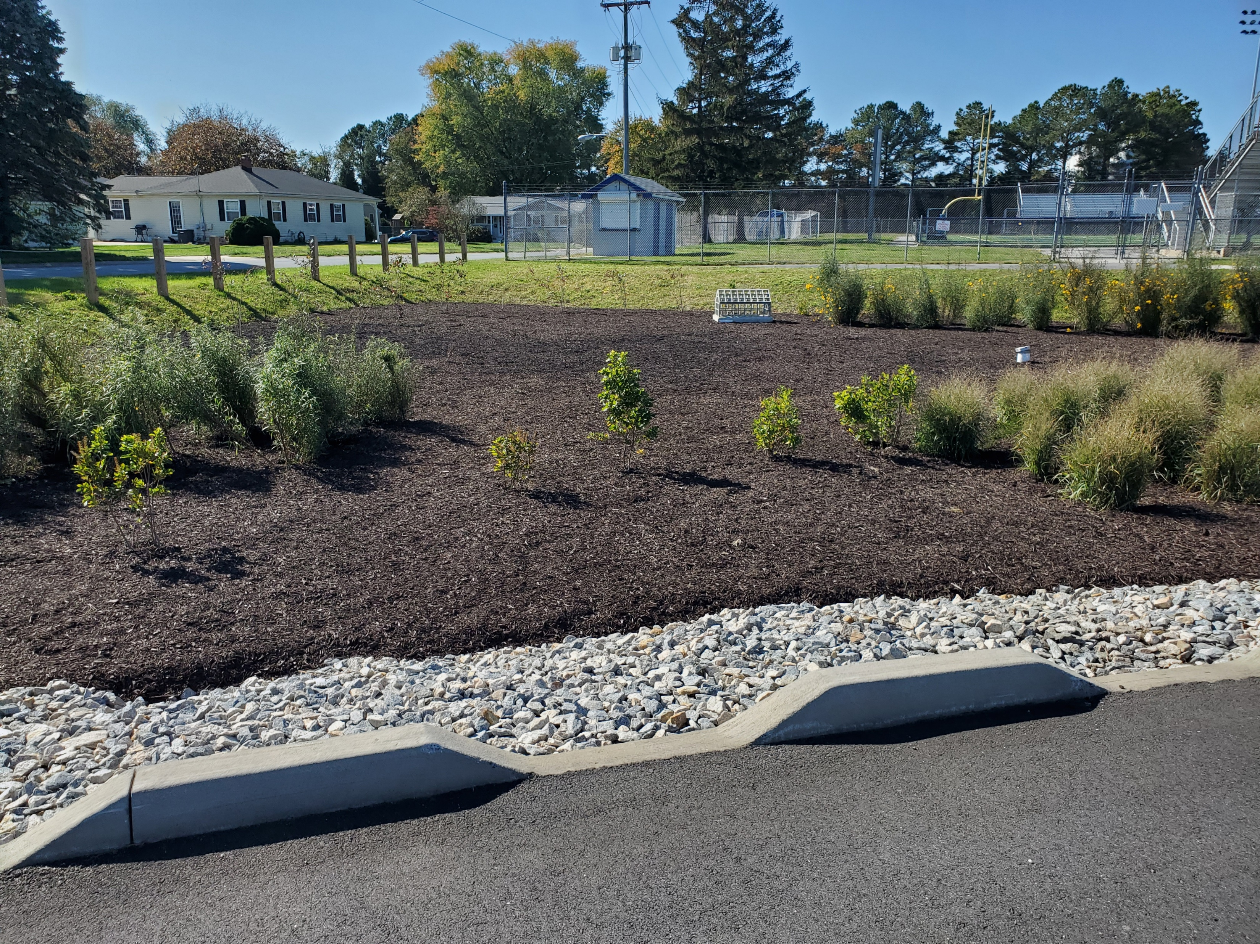
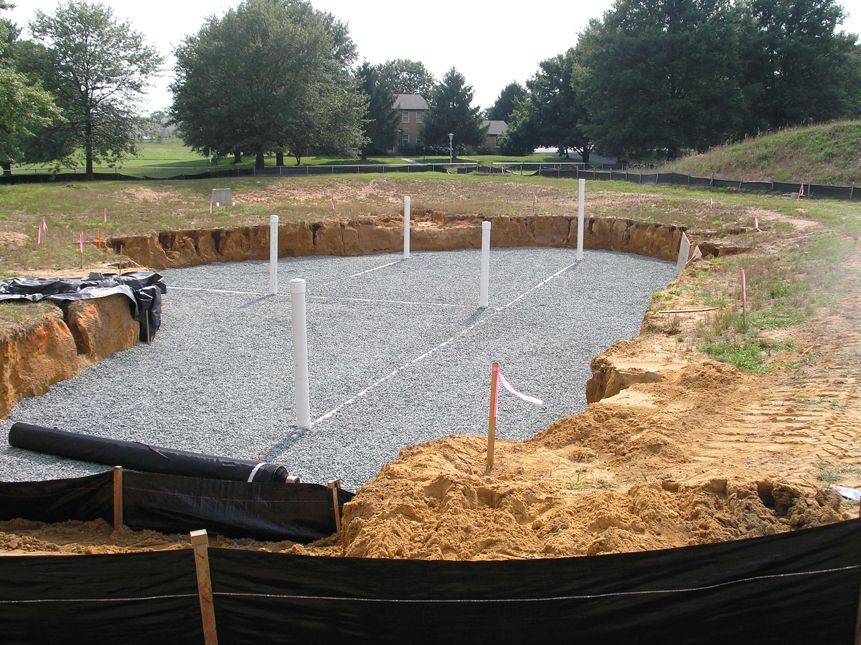
Bioretention
Notes:
Bioretention systems treat runoff on sites where there is adequate soil infiltration capacity and where the runoff volumes that do not infiltrate do not present a safety or flooding hazard. Typically, these practices are found in parking areas with or without curbs, traffic islands, or areas that receive runoff from impervious areas (such as a parking lot). They can be designed with an underdrain that connects to a conveyance system. Bioretention's are very versatile in their use, but they require routine maintenance due to the various layers of material (underdrain stone, filter media, mulch, plants and grasses).
In the image on the right, you can see a bioretention that is in the middle of construction. Note the white underdrain pipes and the underdrain stone. Filter media would be placed next, followed by mulch and plantings.

Slide 10
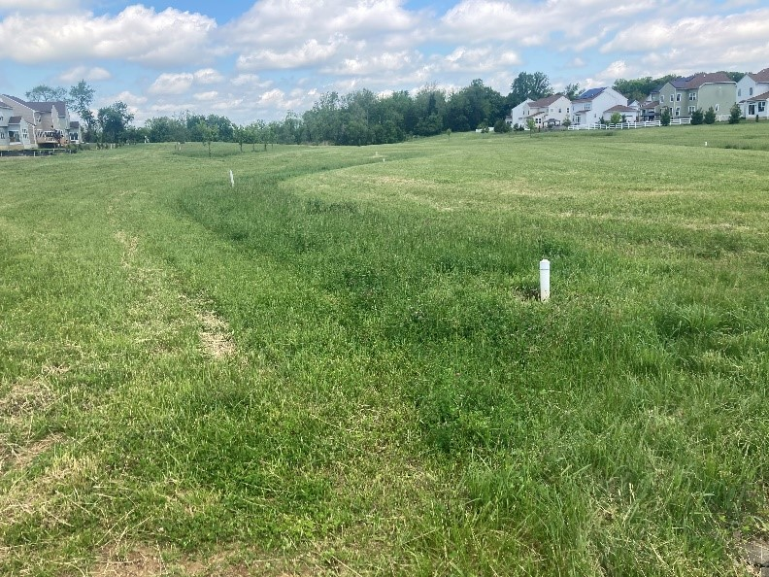
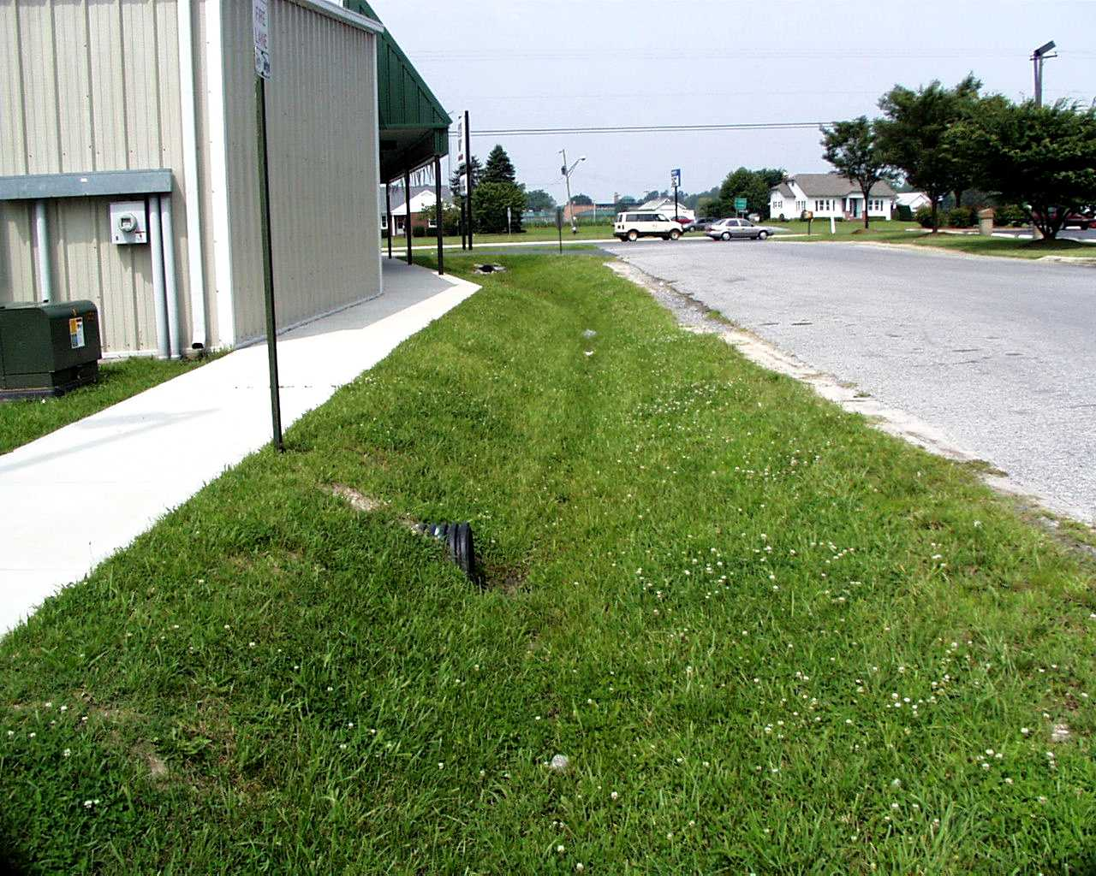
Vegetated Channels
Notes:
Vegetated channels are designed to capture and treat runoff through infiltration, filtration, or temporary storage. They are lined with grass or another erosion resistant plant species to reduced flow velocity and allow runoff to infiltrate into the groundwater. Vegetation prevents erosion, filters sediments, and provides nutrient uptake.
Explain how water flows through the practices pictured

Slide 11
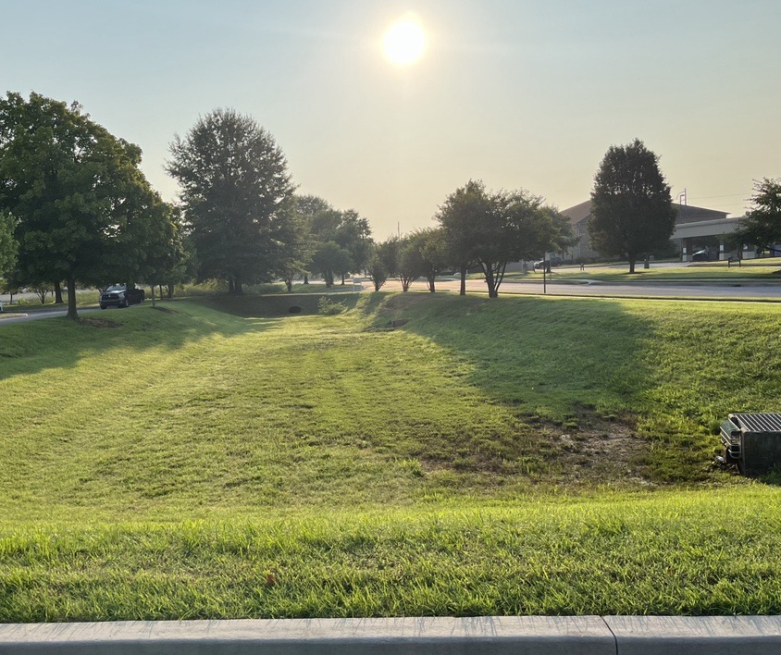
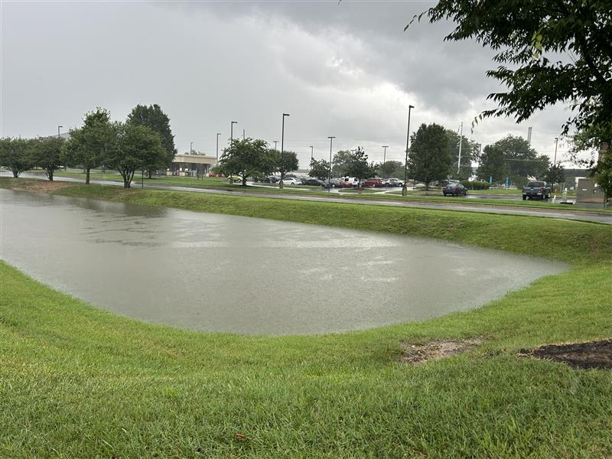
Detention Practices (Dry Pond)
Notes:
Detention basins are designed to temporarily hold runoff during storm events to ensure that the post development peak discharge rate is equal to the predevelopment rate and to protect downstream channels from erosion.
So what does that mean? Basically, if you build a house on land that was previously an open field, you must ensure that the rate of stormwater discharge leaving the site does not change even though the land cover has. Roofs and driveways do not let the rain seep into the ground like it would on an open field. The water runs off faster than an open field as well. So we construct BMPS, like this dry pond, to store runoff temporarily and allow it to be released slower, like it did in the pre development condition.
They are designed to have an outlet structure with a fixed “orifice” that regulates the flow of water leaving the basin, which allows solids and associated pollutants time to settle out over a 24 hour window.
Pictured here is the same pond, during two very different weather events. Dover received a large amount of rain in a small window of time, and this dry detention basin did its job of temporarily holding all of this stormwater.

Slide 12
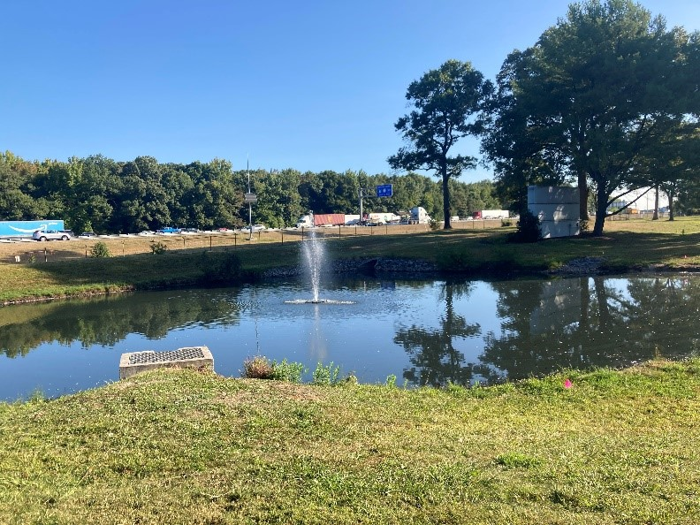
Wet Pond
Notes:
Wet ponds, also known as retention ponds, are designed to maintain a permanent pool of water and temporarily store runoff, which is released at a controlled rate. Ponds allow particulates to settle and can provide biological uptake of pollutants such as nitrogen and phosphorus. Runoff from each new storm event enters the wet pond and partially displaces pool water from previous storms. The pool also acts as a barrier to re-suspension of sediments and other pollutants deposited during prior storms. They are a popular BMP in residential communities and are best suited for larger drainage areas.
When sized properly, they have a residence time that ranges from many days to several weeks, which allows numerous pollutant removal mechanisms to operate.

Slide 13
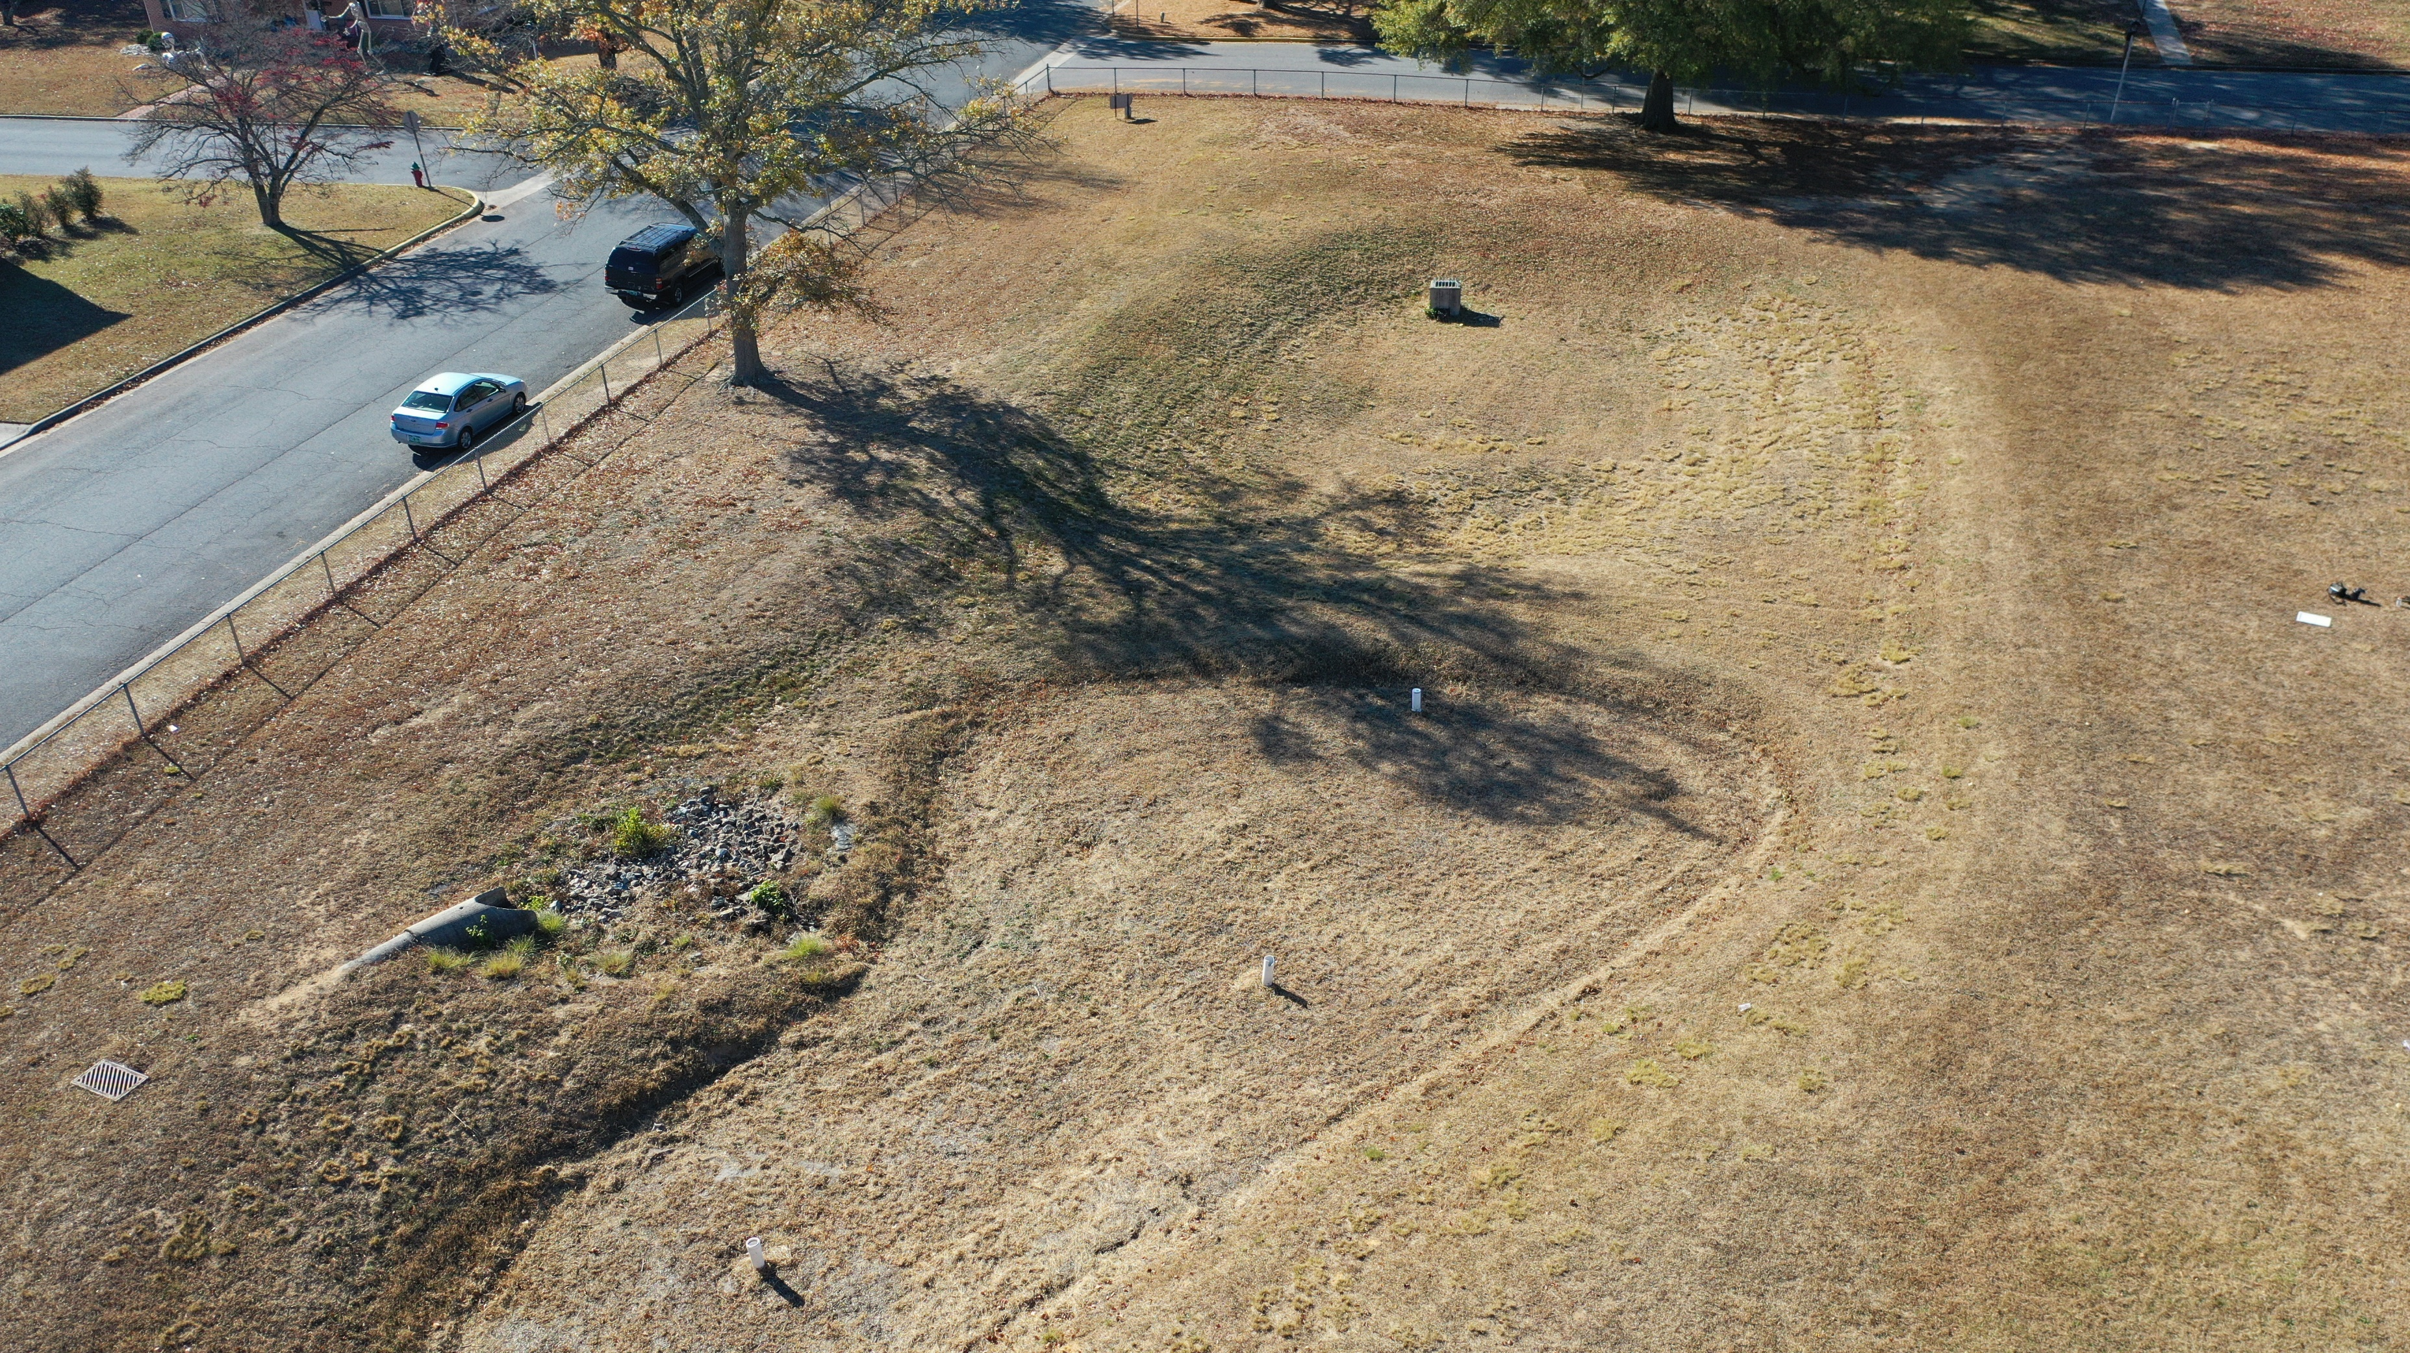




Inspect a BMP
Notes:
Like anything, BMPs have life spans and need routine maintenance to keep them functioning as designed. DNREC completes maintenance inspections on many BMPs found statewide, including the one pictured here.
This facility consists of 2 BMPs, a bioretention discharging into a dry pond. The arrows on the screen indicate the direction that the stormwater flows through the system. Water enters the BMP through the inlet drain, and empties out onto something called a forebay (rocks) and then enters the bioretention facility. Do you notice anything missing from the bioretention facility? (plantings). Water then flows into the dry detention basin, exiting the facility through the outlet structure.
Now we will take a closer look at the specific elements of this facility, as we do a maintenance inspection.

Slide 14
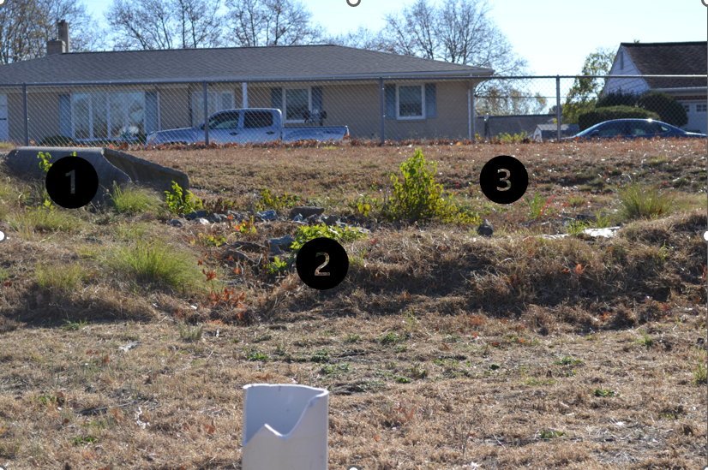
Inspect a BMP
Notes:
[1] This piped inlet is immediately upstream of the bioretention basin.
[2] A channel has started to form due to the erosion of the berm that separates the bioretention and inlet. If erosion occurs, the area should be repaired with seed and straw matting.
[3] Trash/litter is a common occurrence within BMPs and should be removed regularly.

Slide 15
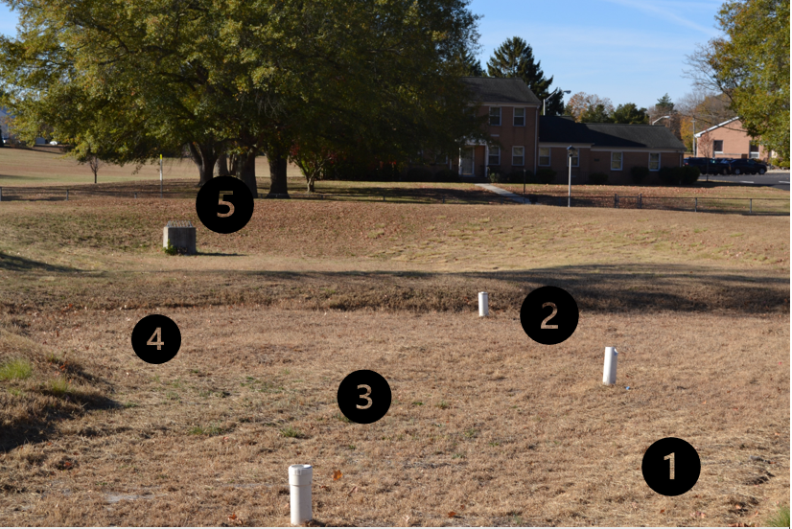
Inspect a BMP
Notes:
[1] Now we are in the bioretention.
[2] The vertical PVC pipes, or cleanouts, are access points to inspect and clean the underground drainage network. It is critical for the functionality of this facility that the cleanouts be intact and watertight. In this example, several have cracked and are missing caps. A few have broken below grade and must be unearthed, cleaned, and repaired.
[3] The Operations and Maintenance Plan for this BMP specifies a 3” mulch layer along the bottom.
This should be refreshed annually.
[4] The landscaping in this BMP has either been removed or died. Reinforcement plantings should be installed annually per the approved Landscape Plan.
[5] The outlet structure is designed to regulate flow leaving the system. The next slides will review this structure.

Slide 16
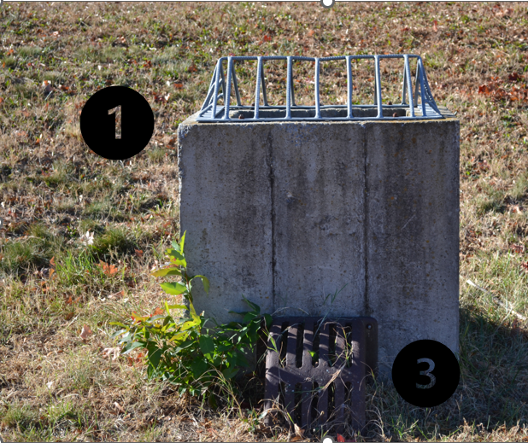
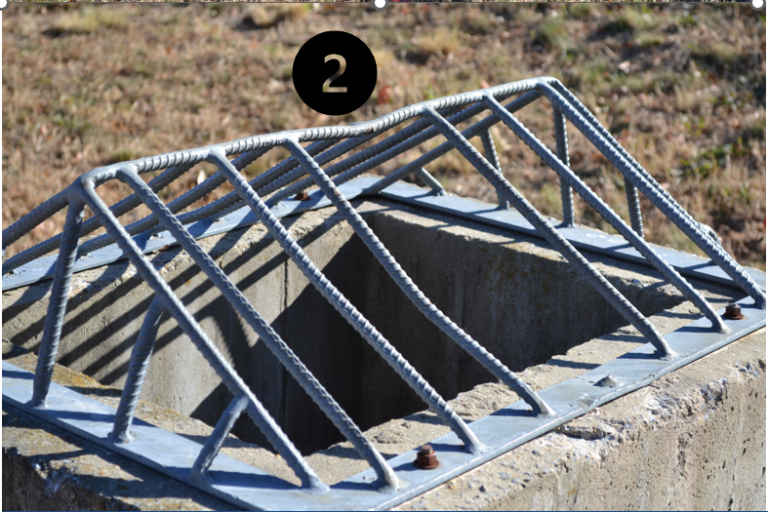
Inspect a BMP
Notes:
[1] This is a closer look at the outlet structure, which regulates the flow of water leaving the system. The grate atop the structure is commonly referred to as a trash rack and is meant to screen out debris from entering the structure. The grate on the side of the box is referred to as an orifice protection grate and serves a similar function.
[2] This trash rack has a broken bar on the far side and should be repaired or replaced. After large rainfall events, it is common for these grates to be clogged with debris.
[3 ] The orifice is what specifically is enabling the basin to dewater effectively.

Slide 17
Questions?

