Slide 1
Watershed Influences
Aireal Vickers, City of Dover – Environmental Scientist

Slide 2
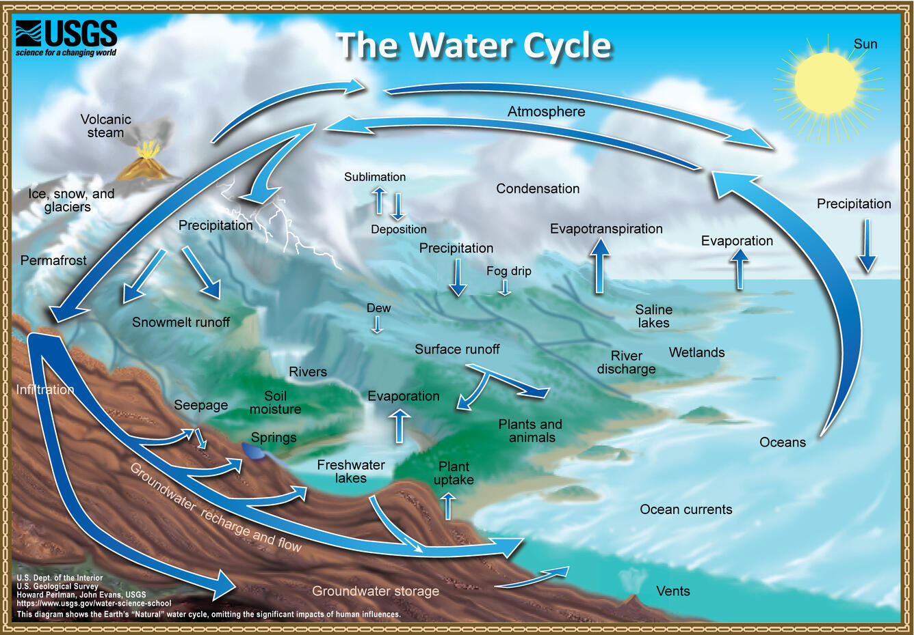
The Water Cycle
3 Phases
Contents
  Solid
    ice
  Liquid
    Rain
  Gas
    Evaporation
Air
Clouds
Bodies of water
  Oceans
  Lakes
  Streams
Vegetation
Snow
Glaciers

Slide 3
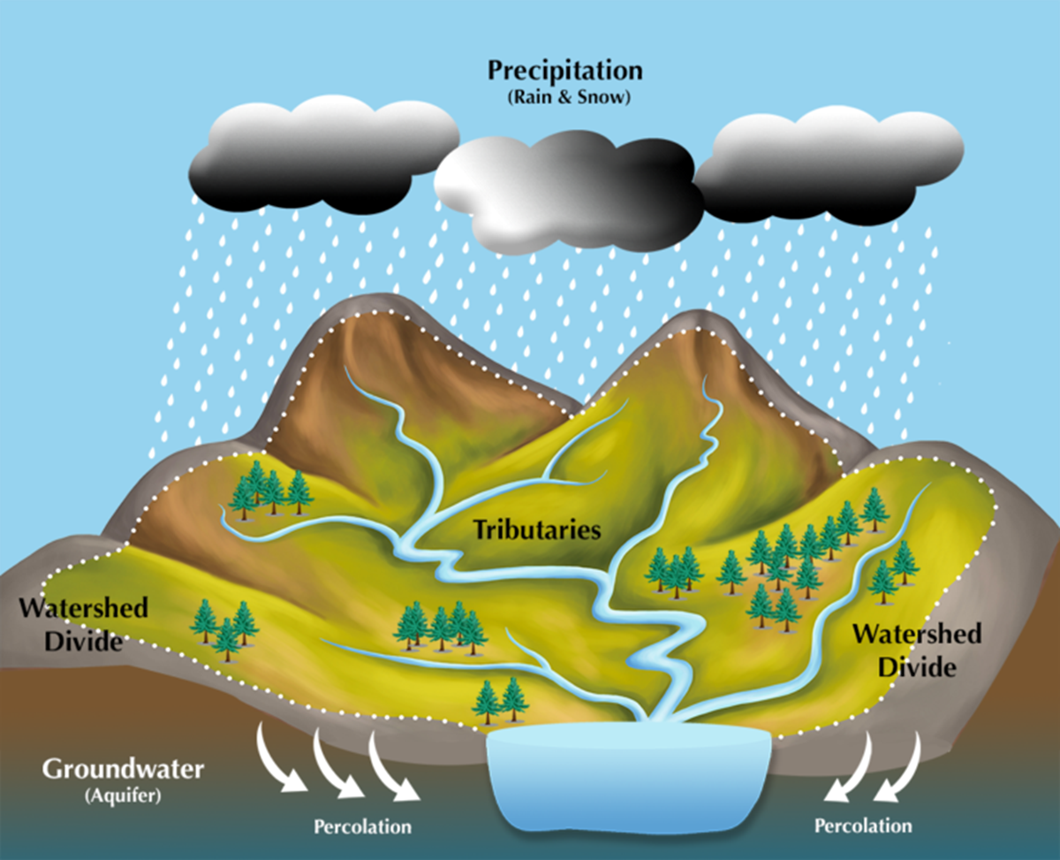
Watershed
An area of land that all surrounding water drains into

Slide 4
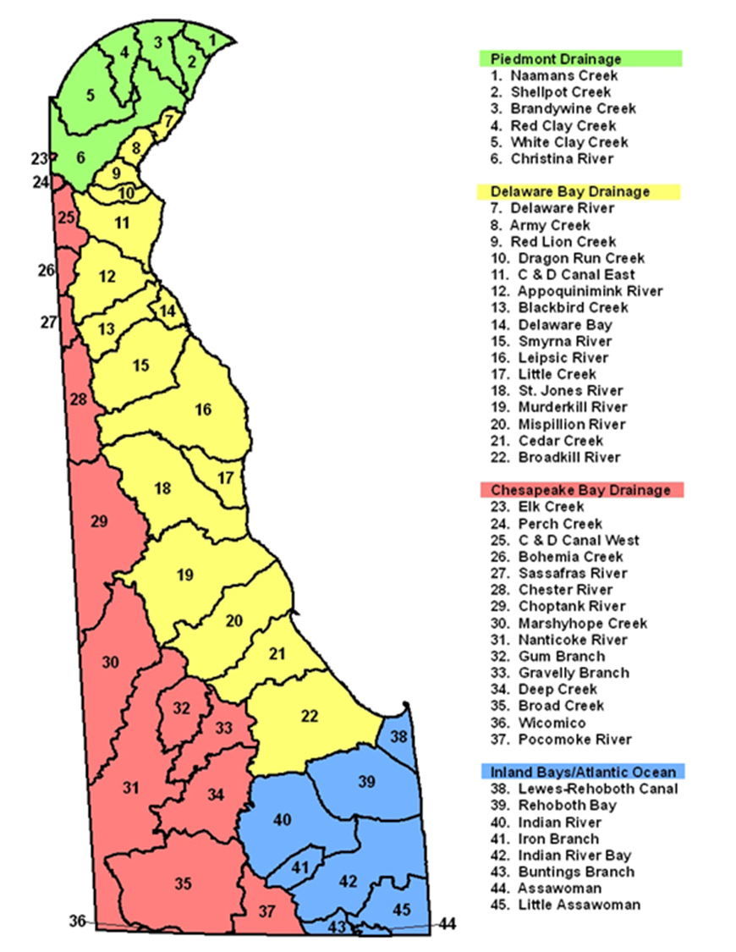
Delaware Watersheds
Delaware has 4 main watersheds
  Piedmont
  Delaware Bay
  Chesapeake Bay
  Inland Bays / Atlantic Ocean
Sussex Academy Elementary School
  Broadkill River (#22)
  https://delawarewatersheds.org/watershed/?wsid=22
See which watershed you live in
  https://www.wrc.udel.edu/wp-content/publications/Watershedaddress030806_reduced.pdf
Learn more about Delaware Watersheds

Slide 5
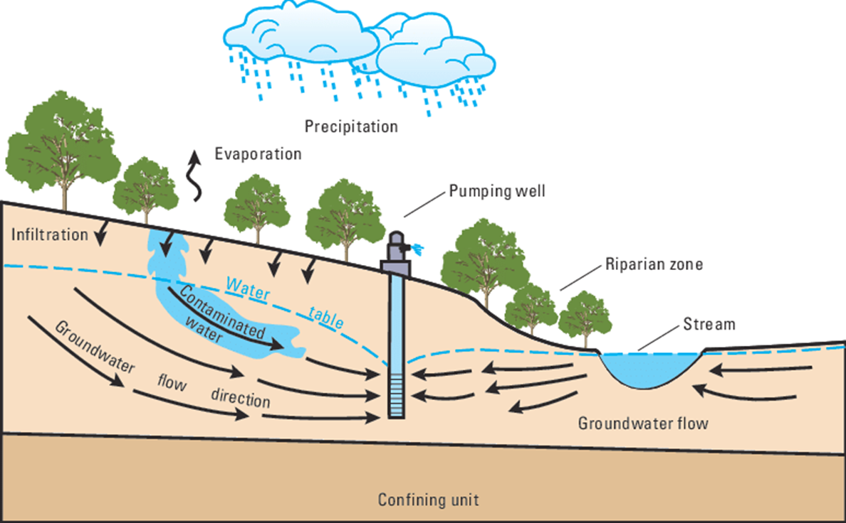
Groundwater Movement
Groundwater moves from areas of high pressure to low pressure
Groundwater can flow into…
Oceans
Rivers (gaining streams)
Wetlands
Lakes
More about Groundwater Flow and a Quiz

Slide 6
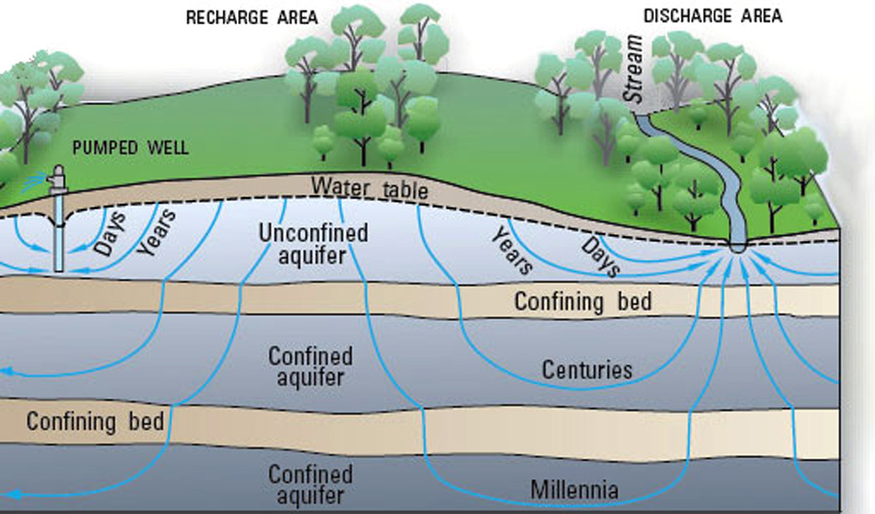
Aquifers
What is it?
2 Types
An aquifer is a layer of rock and/or sediment that creates a chamber
This chamber is where groundwater is found
Precipitation “recharges” the aquifer when water has been pumped out
Not all aquifers have the same recharge rate
Confined
The layer is made of rock or clay
Is impenetrable
Unconfined
The layer is made of sediment
Is penetrable
https://education.nationalgeographic.org/resource/aquifers/

Slide 7
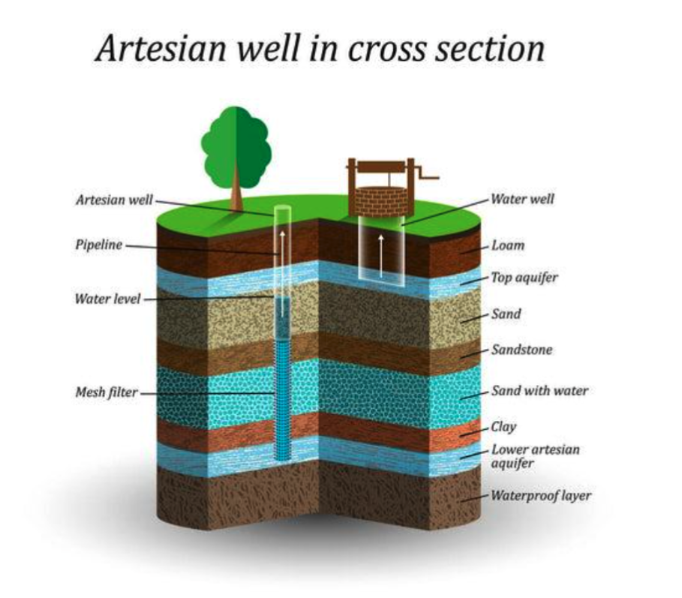
Wells
What are they?
2 Types
These are used to access groundwater in aquifers
Artesian Well
  Aquifer IS pressurized
  A pump IS NOT needed
Water Well
  Aquifer IS NOT pressurized
  A pump, or bucket, IS needed

Slide 8
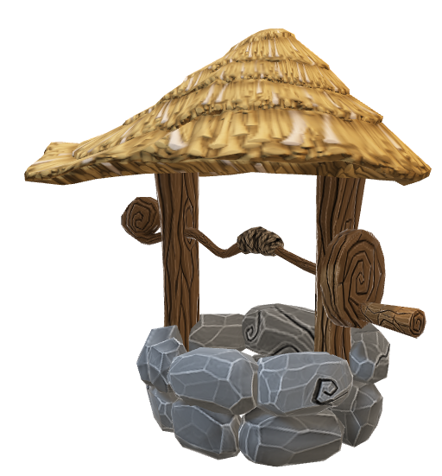

How Are Wells Made?
3 Methods
Dug
  Made by hand
  Can only be done if ground is soft
  Uses a shovel and/or a pickaxe
Drilled
  How most modern wells are made
  Uses a drill rig
  Can be used on soft or rocky soil types
  Can drill a well more than 1000 ft below the surface
Driven
  A skinny pipe with a screen on the end for filtration is driven into the ground
  Can be used in soft ground including sand and gravel
  Closer to the surface
  Runs the risk of contamination
How does a well become contaminated?
When a well is close to the surface it runs the risk of surface pollutants and contaminated runoff Infiltrating

Slide 9
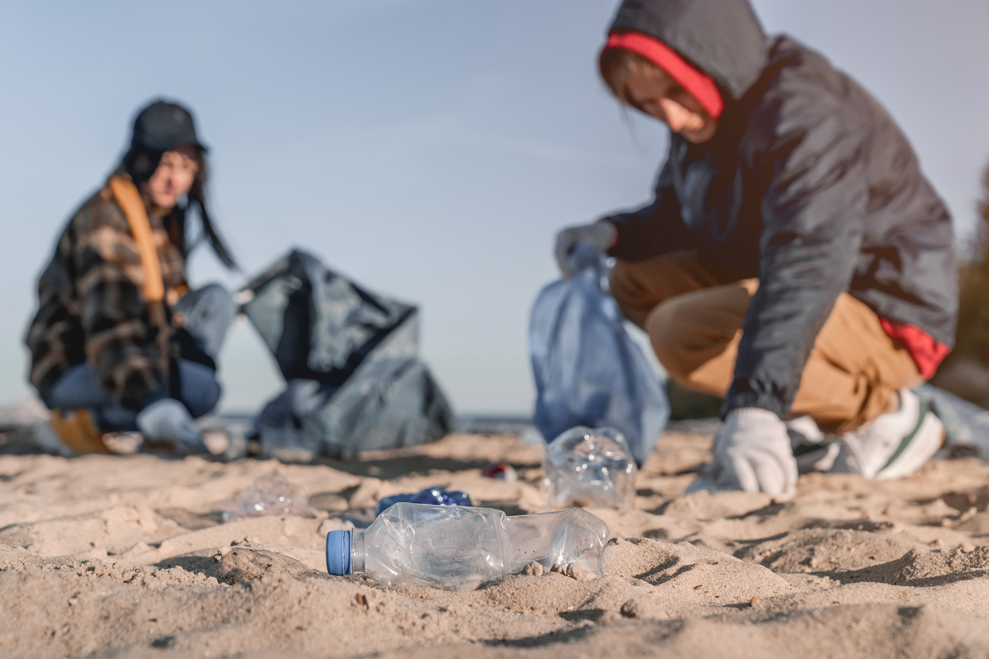
Pollution
The release or discharge of a substance into the environment (US EPA)

Slide 10
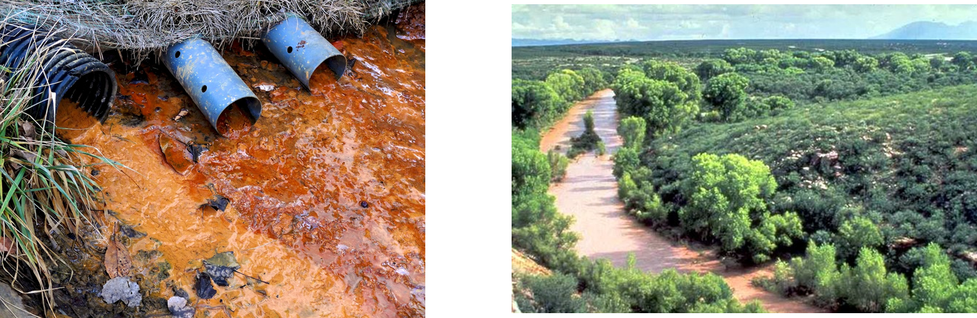

Types of Pollution
You can “point” with one finger
You would need multiple hands to point at it
Point Source
Non-Point Source

Slide 11

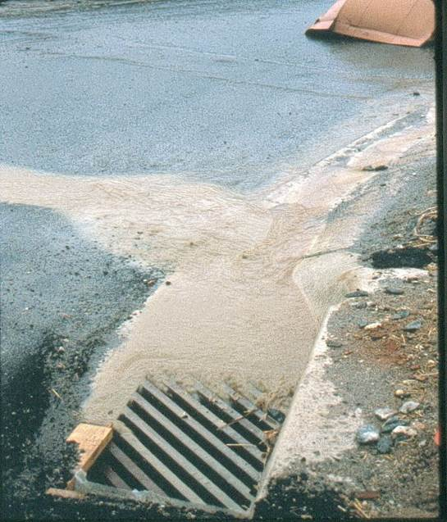
What Type of Pollution is This?
Point Source!
(Point or Non-Point)

Slide 12
How Does Land Use Impact Pollution & Water Quality?
Consider development, agriculture, roads, etc.

Slide 13
Land Use & Water Quality in Georgetown, DE
Land Use
Water Use
Primary Recreation
Secondary Recreation
Fish
Aquatic Life & Wildlife
Industrial Water Supply
Agricultural Water Supply
*In freshwater segments
Swimming or water skiing
Boating or fishing
Learn More at https://delawarewatersheds.org/watershed/?wsid=22

Slide 14
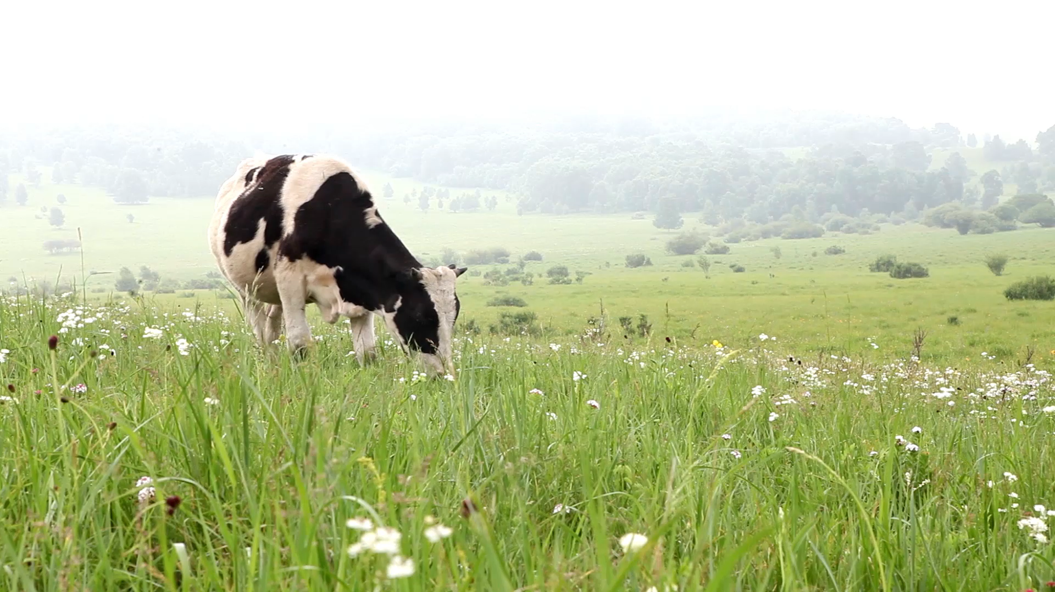
Why This Impacts Water Quality
Depends on the watershed’s Total Maximum Daily Load (TMDL) of pollutants
In agriculture…
  Runoff from farms can contain high amounts of nutrients (N and P) from fertilizers or manures
    High amounts of nutrients in the water can cause algal blooms which also will lower the dissolved oxygen (DO) levels in the water.

Slide 15

TMDLs in the Broadkill River Watershed
What are TMDLs?
Broadkill River’s TMDLs
TMDL: Total Maximum Daily Load(s)
TMDLs= total pollutant load that a waterbody can receive without violating water quality standards
Section 303(d) of the Clean Water Act require states to develop TMDLs for impaired waterbodies.
Non-point source (NPS) nutrients including
  Nitrogen (N)
  Phosphorus (P)
  Nutrients can cause algal blooms which can lead to Low dissolved oxygen (DO) levels
Bacteria (enterococcus)
  Bacteria can cause illness and infection

Slide 16

How to Determine if a Stream/River is Polluted
Chemistry
  pH
  Dissolved oxygen (DO)
Macroinvertebrates
  Can indicate poor or excellent water quality
Bacteria
Physical factors
  Turbidity

Slide 17
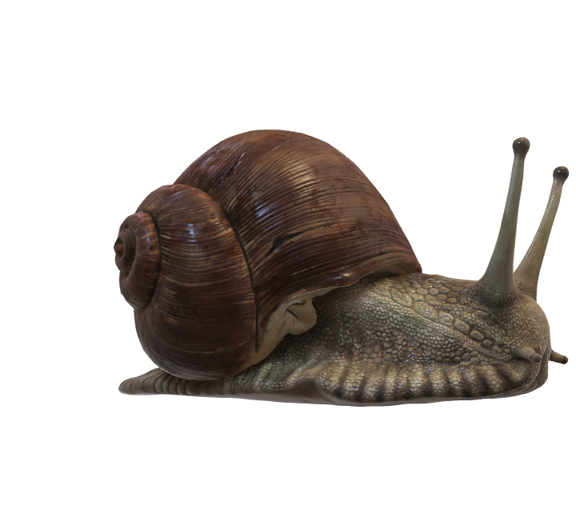
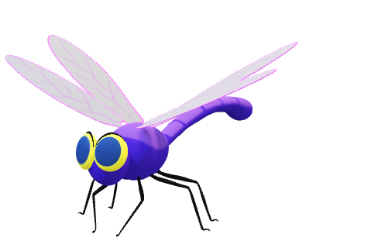
Macroinvertabrates
“Macroinvertebrates are small organisms without a backbone that are visible to the naked eye and large enough to be easily collected.” – EPA
Insect larvae are the most common macroinvertebrates in aquatic systems
They indicate the health of a waterway
There are some that are more pollution tolerant while others are pollution sensitive

Slide 18
Leech
Orb Snail
Planarian
Blood Midge Larvae
Aquatic Worms
Cranefly Larva
Scuds
Damselfly Larva
Dragonfly Nymph
Stoneflies Larvae
Caddisflies Larvae
Mayflies Larvae
Pollution Tolerant
Pollution Intermediate
Pollution Sensitive

Slide 19

Which Stream is Healthier?
Stream A
Stream B
List of macroinvertebrates in streams and their pollution tolerance

Slide 20
BMPs
Best management Practices

Slide 21
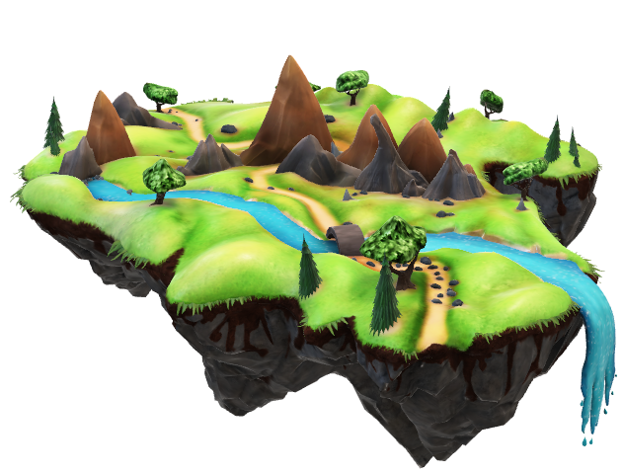
Best Management Practices (BMPs)
Public Education
Education about proper residential car washing
Public Involvement
Stream cleanup and monitoring
Construction
Illicit Discharge Detection and Elimination
An ordinance prohibiting illicit discharges
A plan to address illicit discharges
Filter Socks
Post-Construction
Grass swales
Programs to ensure long-term maintenance of BMPs
Pollution Prevention / Good Housekeeping
Spill response and prevention plan
  See more examples of the 6 types of BMPs

Slide 22
What Type of BMP is it?
1
To prevent illegal dumping, a town starts a recycling program for batteries, electronics, and oil.
2
To allow for easier access for future maintenance, a construction company dictates a 20ft easement around grass swales.
3
The Conservation District partners with the City to host a planting event in the local wetland.
Illicit Discharge Detection and Elimination
Post-Construction
Public Education & Outreach
Public Involvement & Participation
Illicit Discharge Detection & Eliminination
Construction Activities
Post Construction Activities
Pollution Prevention & Good Housekeeping
Public Involvement & Participation

Slide 23

Let’s Do an Activity!
Visit the link below and explore how the amount of rainfall effects the amount of water that turns into runoff vs infiltrates the ground in the different land covers.
  https://runoff.modelmywatershed.org/
Tip: Georgetown is currently low to mid-developed
Soil type plays a HUGE role in the infiltration rate of water
  Using the link below, explore why the infiltration rate may differ upon land uses!
    https://coast.noaa.gov/data/digitalcoast/pdf/qnspect-hydrologic-soils.pdf
    Sussex Academy Elementary is Group A
Explore how land use can influence the amount of runoff and/or infiltration an area is capable of.

