Slide 1
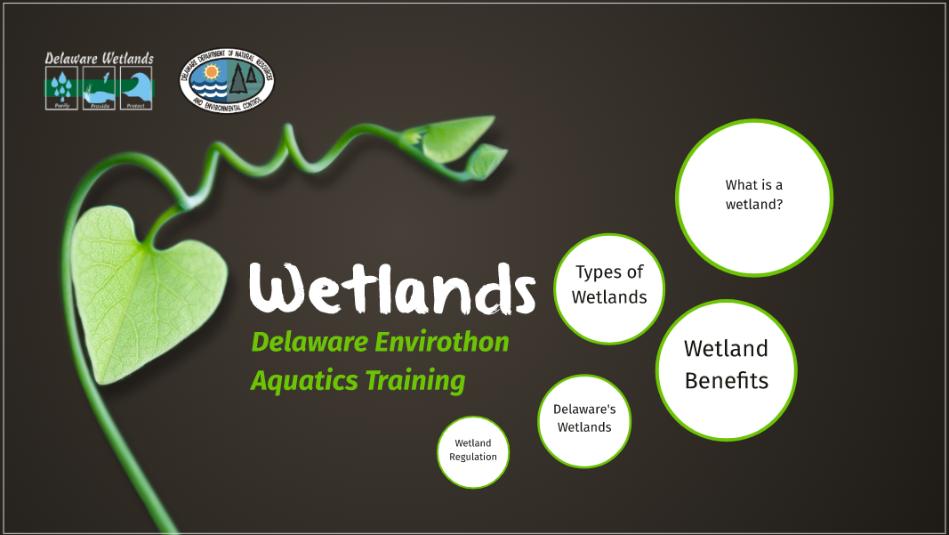

Slide 2
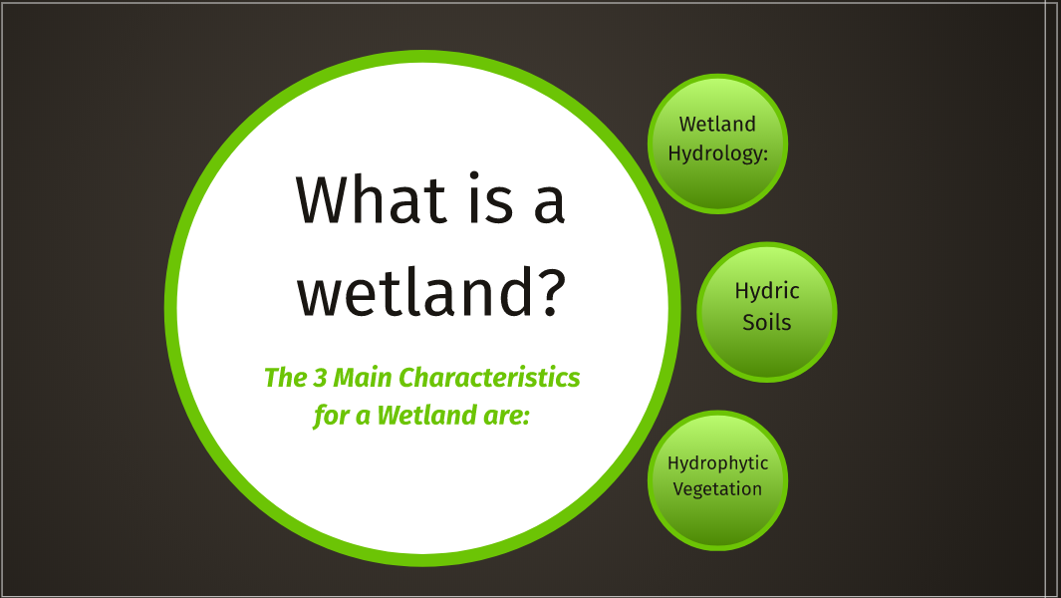

Slide 3
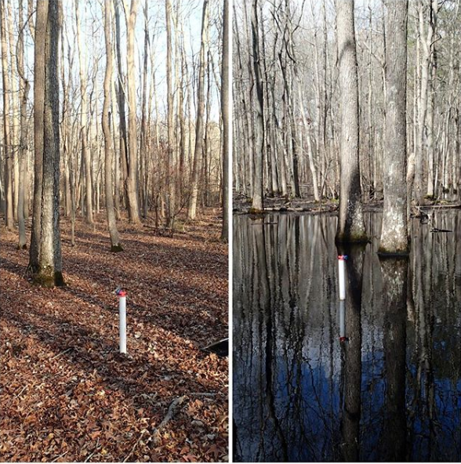
Wetland Hydrology
Water at or above the surface for >2 weeks
Wetlands are usually wetter in the winter/spring, and dryer in the summer/ fall
Notes:
Water does not always have to be present, wetter spring/winter, dry summer fall

Slide 4
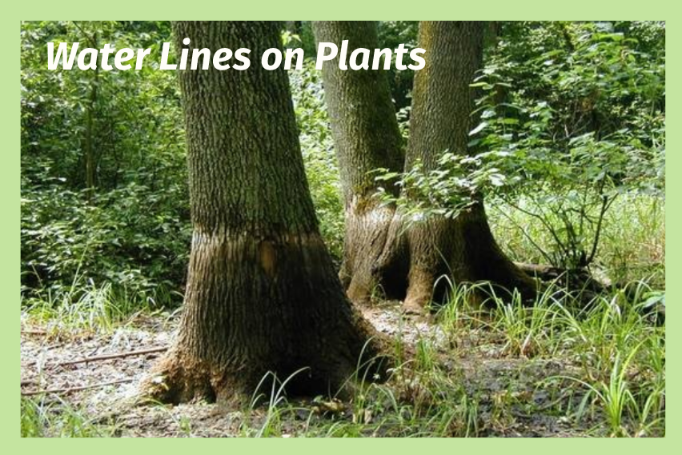
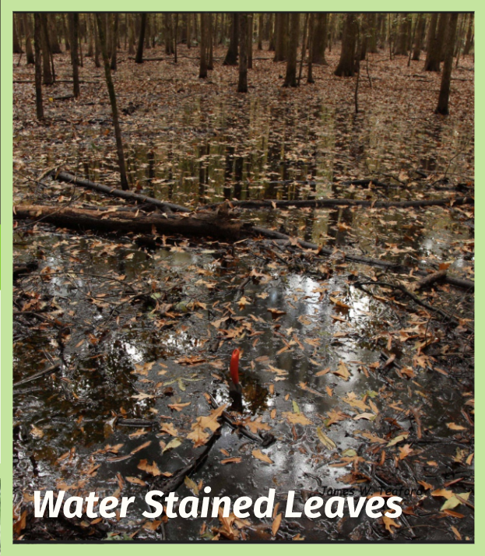
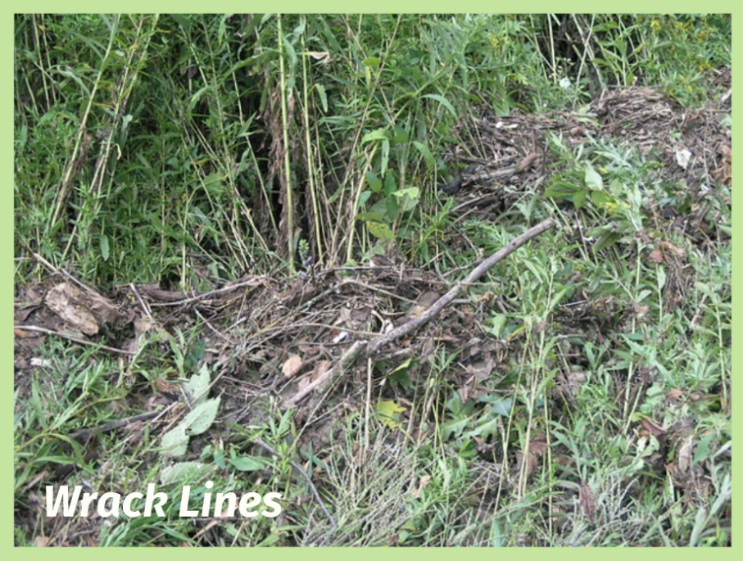
Wetland Hydrology
Evidence of water
Notes:
Water does not always have to be present, wetter spring/winter, dry summer fall

Slide 5
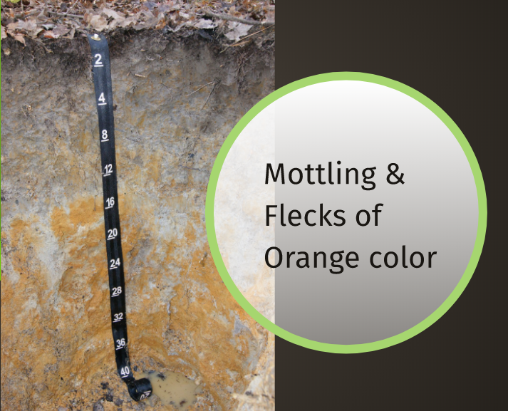
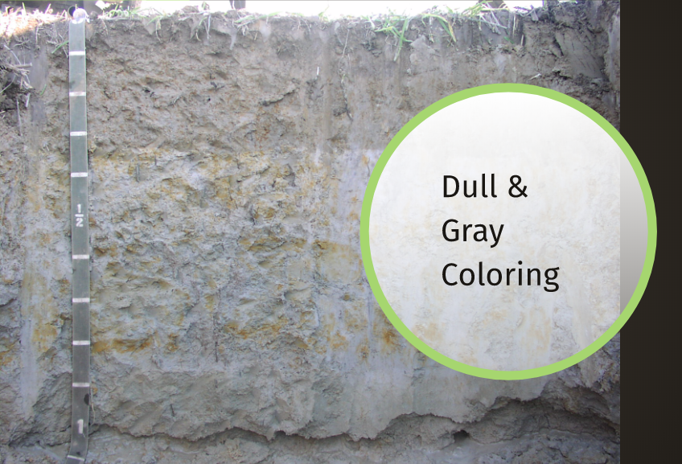
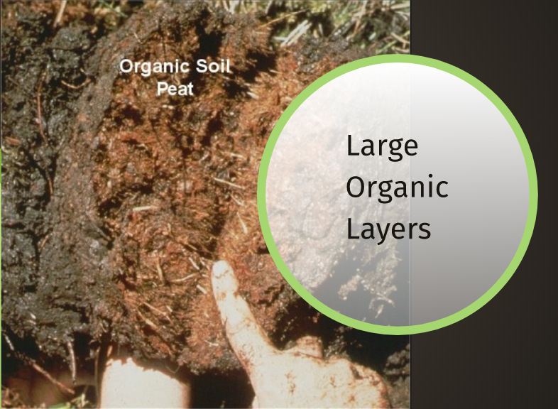
Hydric Soils
"formed under conditions of saturation, flooding, or ponding long enough during the growing season to develop anaerobic conditions in the upper part" (Federal Register: July 13, 1994)

Slide 6
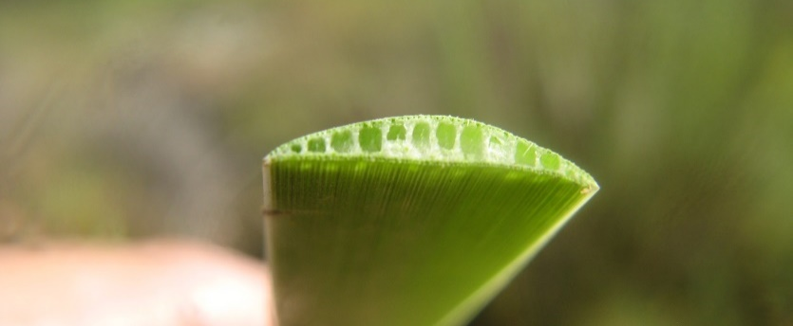
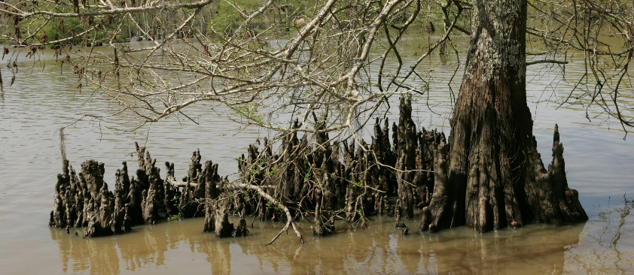
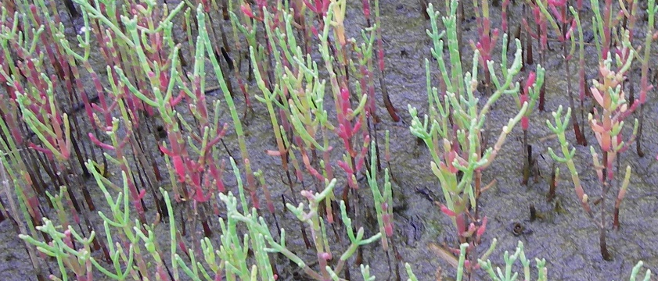
Hydrophytic Vegetation
Hydrophytic vegetation are plants that thrive in wet conditions and can handle water around its roots during the growing season.
Aerenchyma (Photo Credit: San Elijo Conservancy)
Bald cypress knees (Photo Credit: USFWS)
Salt tolerance (Photo Credit: DNREC - WMAP)

Slide 7
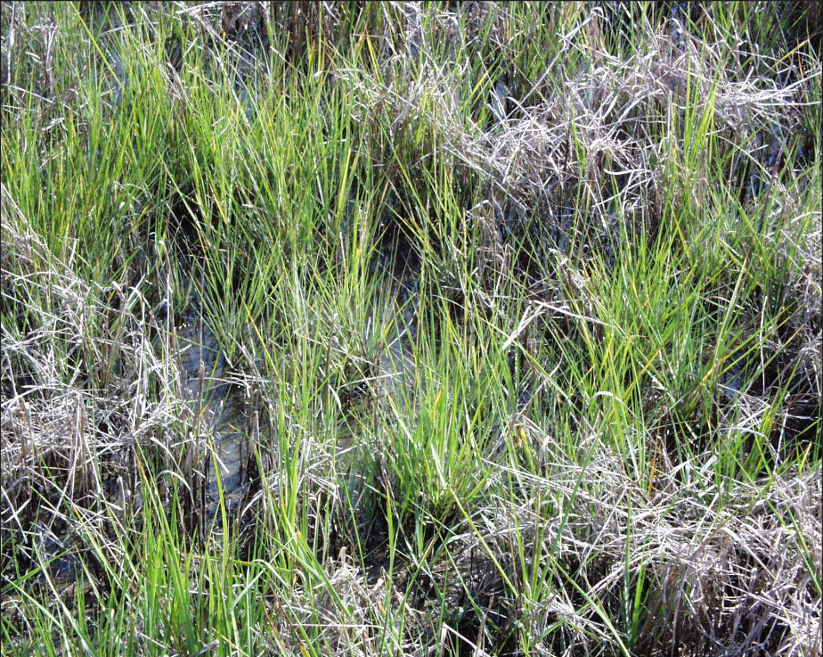
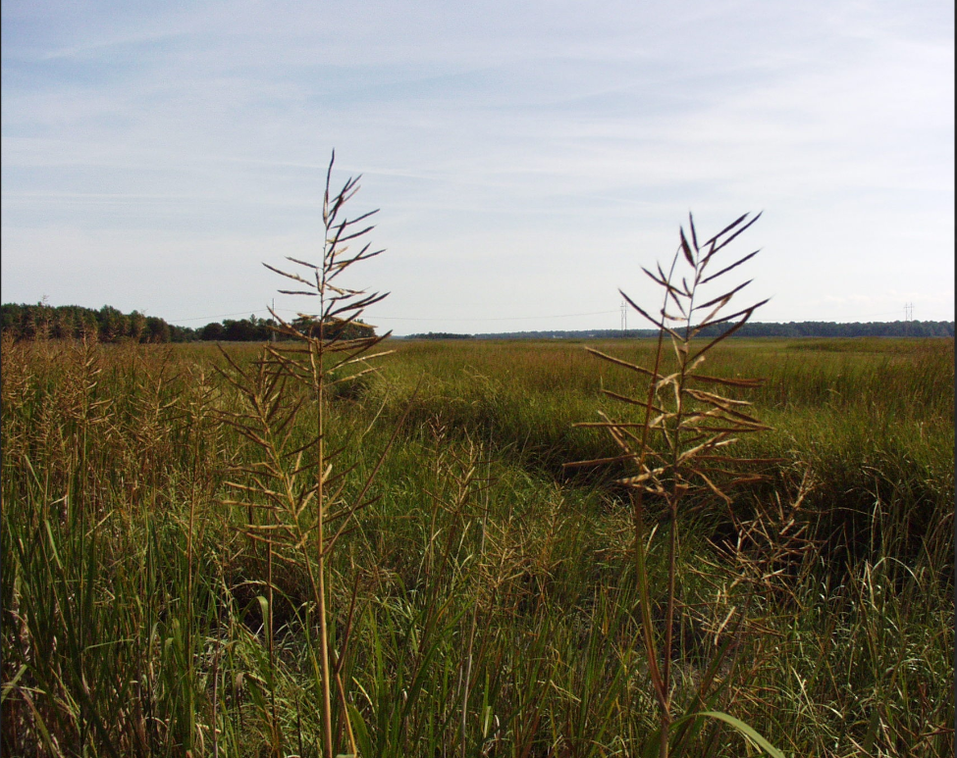
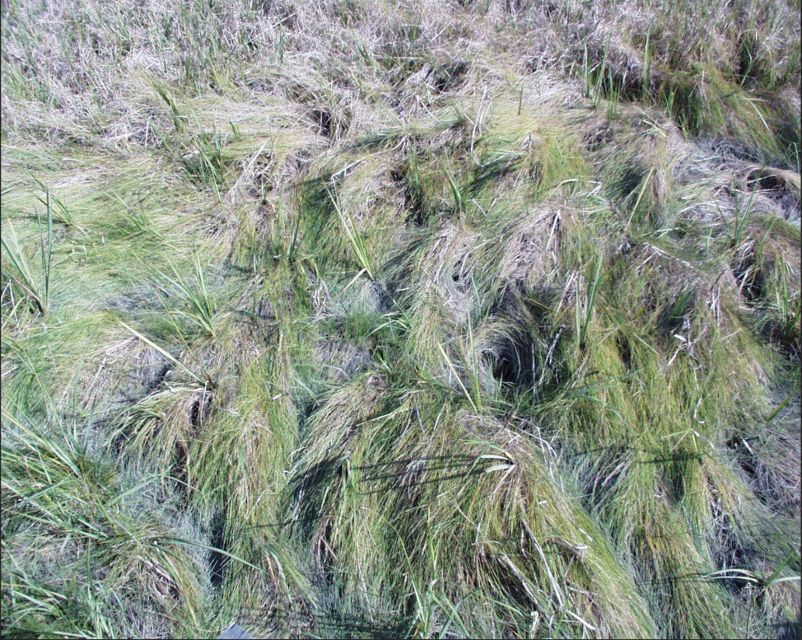
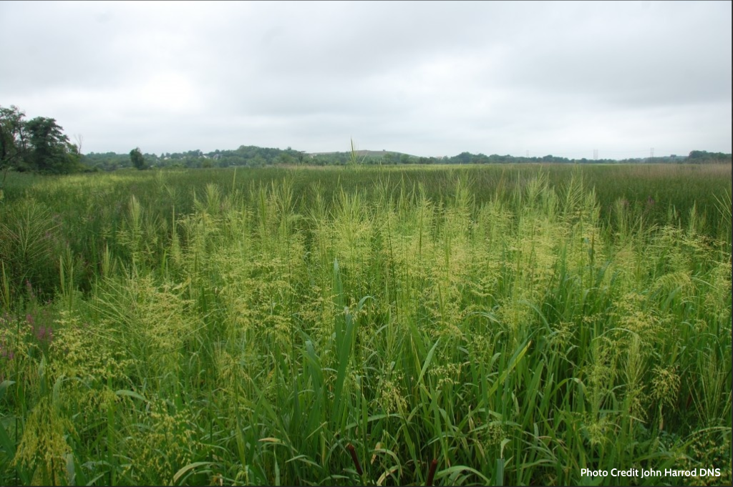
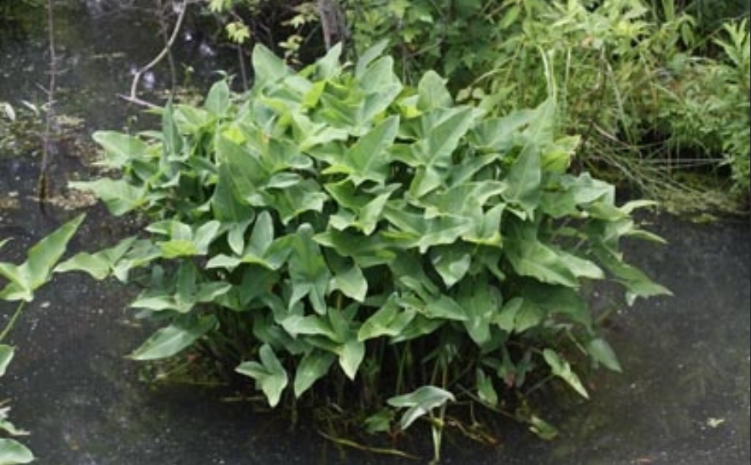
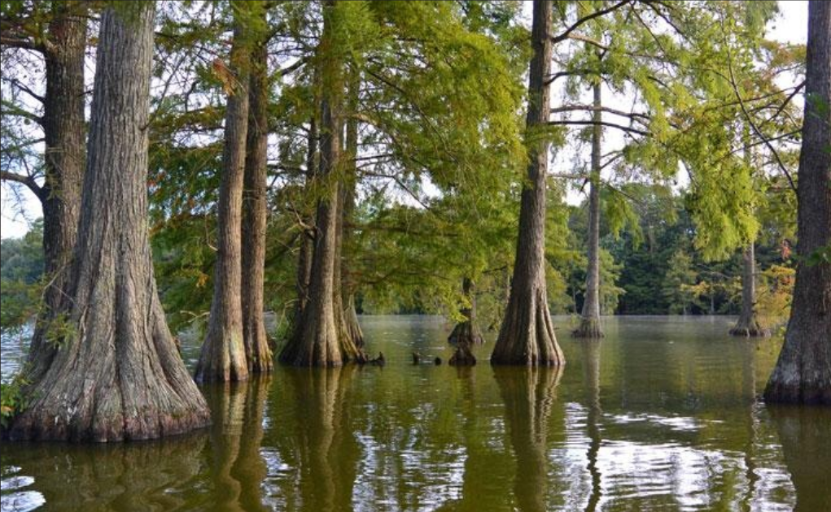
Native Plants
A plant that is a part of the balance of nature that has developed over hundreds or thousands of years in a particular region or ecosystem. Only plants found in this country before European settlement are considered to be native to the United States.
Note: The word native should always be used with a geographic qualifier (that is, native to Delaware[for example]). (NRCS Website)
Peltandra virginica (Green arrow arum)
Taxodium distichum (Bald cypress)
Spartina cynosuroides (Big cordgrass)
Spartina patens (Saltmeadow cordgrass)
Zizania aquatica (Annual wildrice)
Spartina alterniflora (Smooth cordgrass)
Notes:
Salt/brackish marshes. Tall/ short alterniflora, Delaware has the northern most stand of natural bald cypress trees

Slide 8
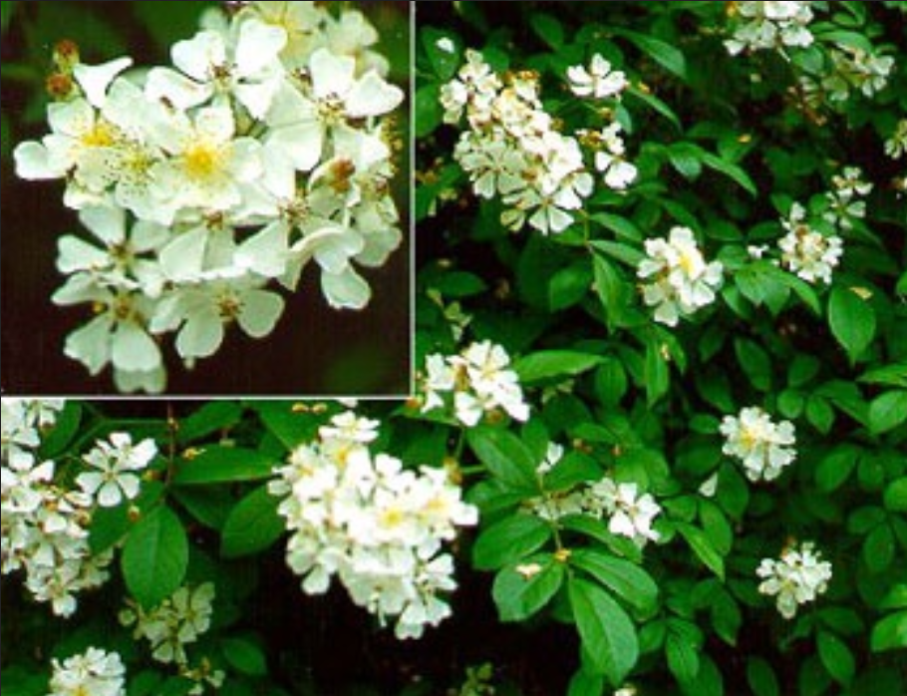
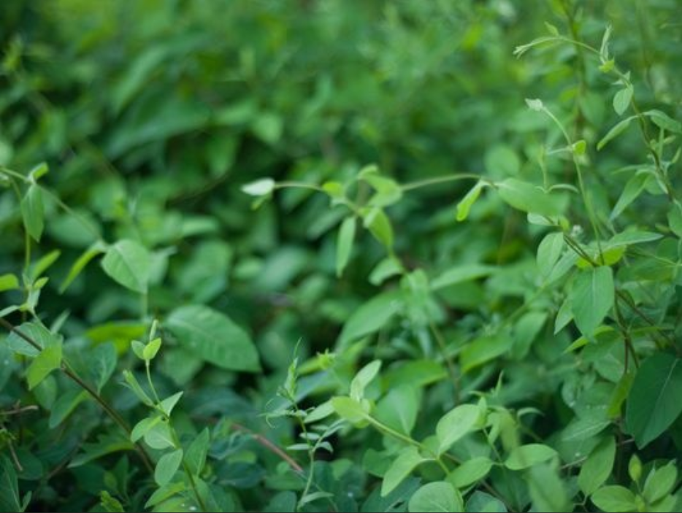
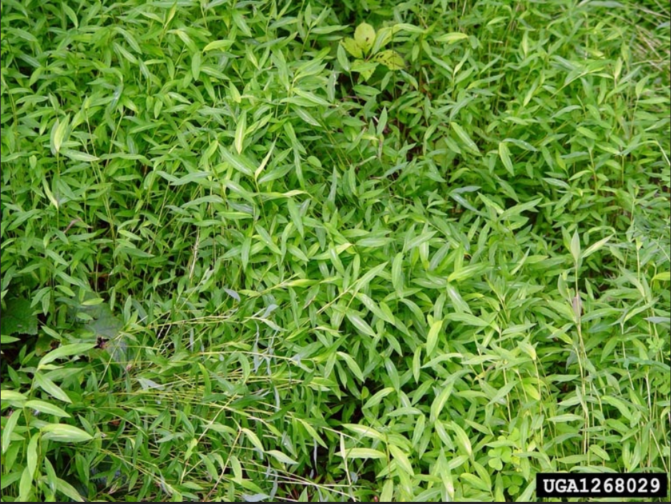
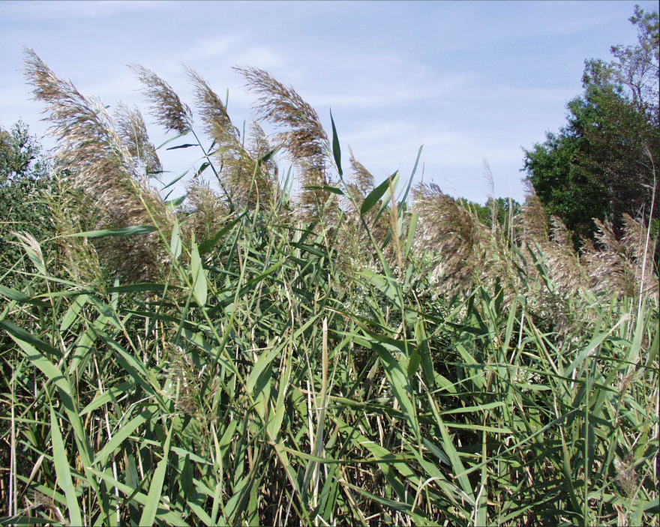
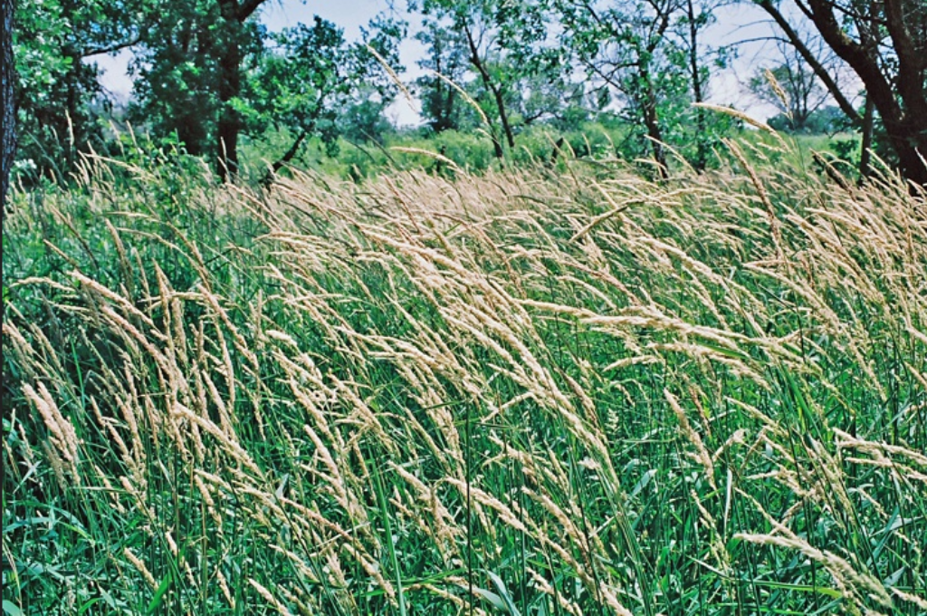
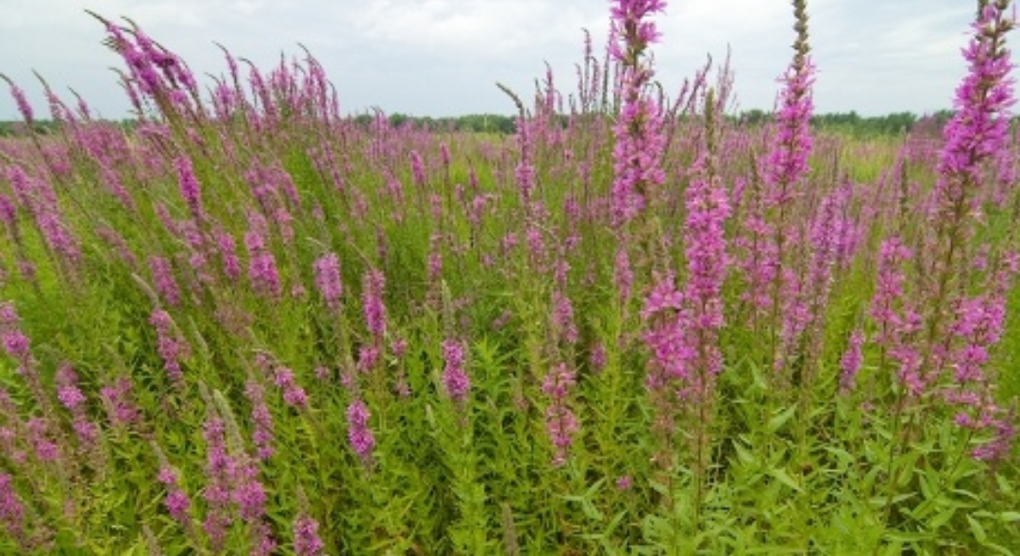
Invasive Plants
An invasive species is defined as a species that is
non-native (or alien) to the ecosystem under consideration and
whose introduction causes or is likely to cause economic or environmental harm or harm to human health.
(Presidential Executive Order 13112 (February 1999))
Rosa multiflora (Multiflora rose)
Phalaris arundinacea (Reed canarygrass)
Lonicera japonica (Japanese honeysuckle)
Microstegium vimineum (Japanese stiltgrass)
Lythrum salicaria (Purple loosestrife)
Phragmites australis (Common reed)
Notes:
Why is phrag bad?/ stilt grass looks like small bamboo, forms thick carpets in freshwater areas/

Slide 9
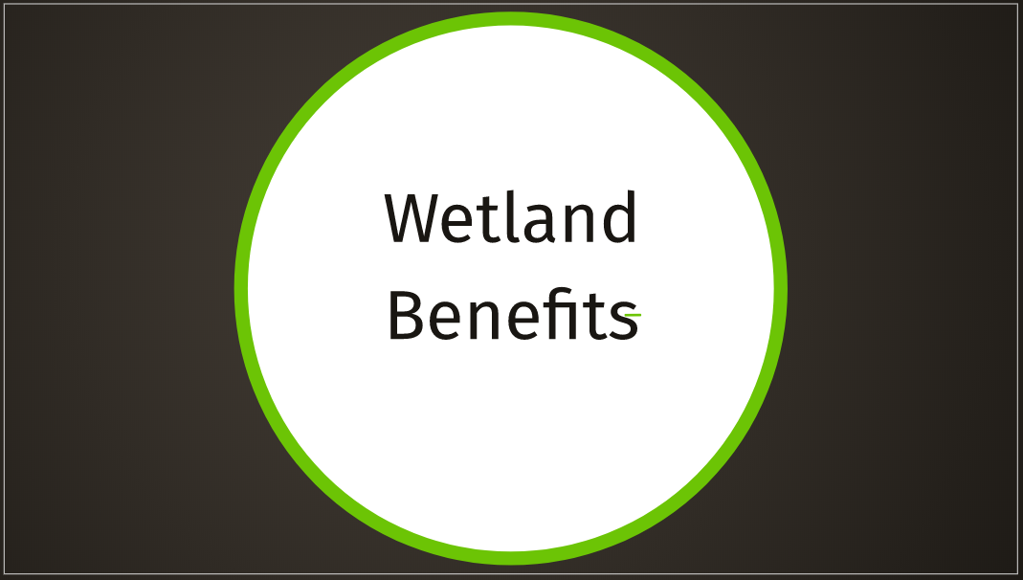
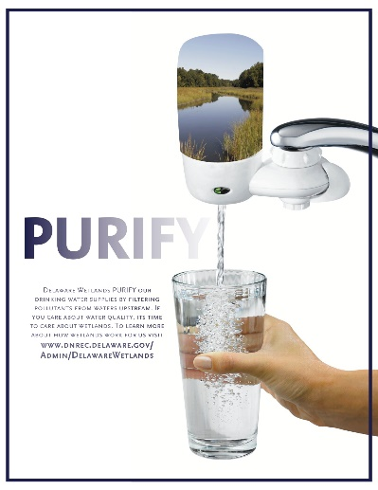

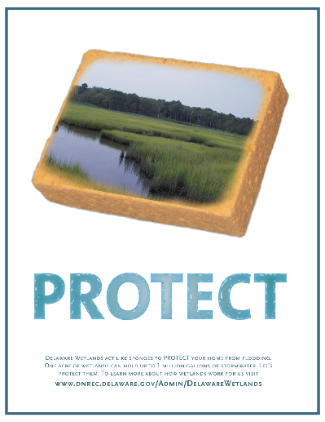

Slide 10
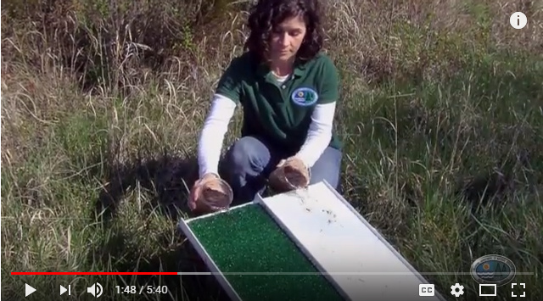
Wetlands 101 Video: 3 Ps

Slide 11
Wetland Types & Ways to Classify
Freshwater Wetlands Video
Notes:
From general to specific

Slide 12
Plants

Slide 13
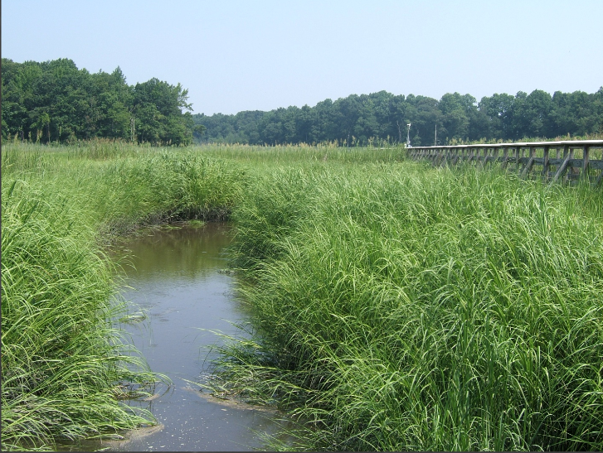
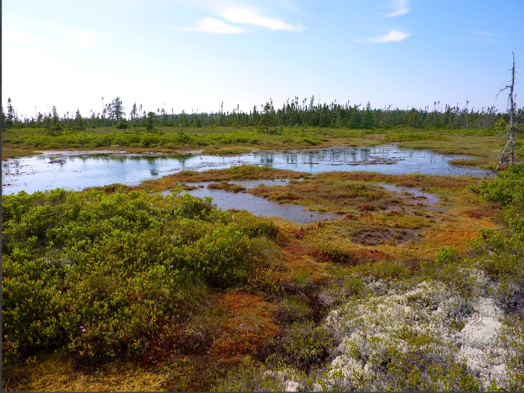
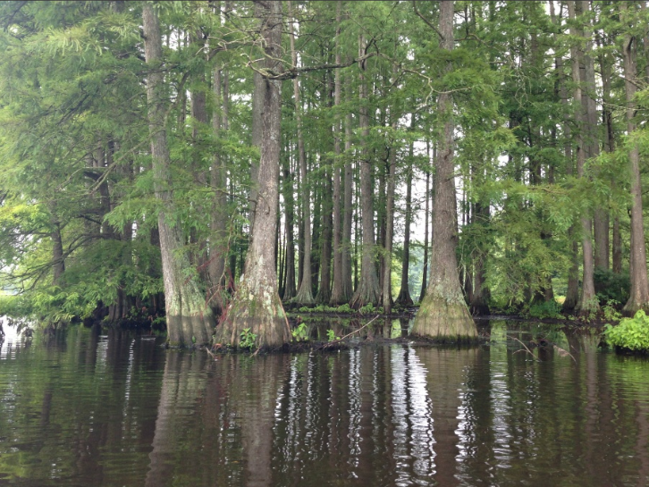
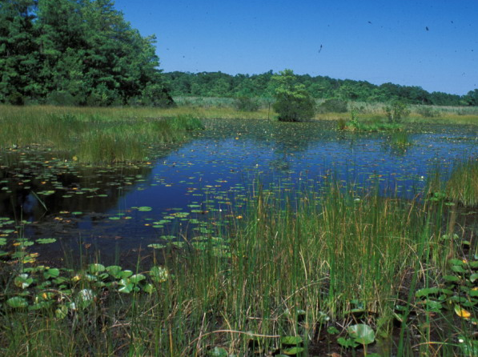
Dominant Vegetation Type
Marsh: grasses
Bog: shrubs, mosses & lichens
Fen: grasses & mosses
Swamp: trees & shrubs
William A. McAvoy

Slide 14
Cowardin

Slide 15
Cowardin Classification (USFWS)
Classifies by:
Where the wetland lies within a landscape
Dominant vegetation type
Whether the water present is seasonal, permanent, etc.
5 Cowardin Wetland Types
Marine (M)
Estuarine (E)
Riverine (R)
Lacustrine (L)
Palustrine (P)
Notes:
Marine – open ocean & high-energy coastline, greater than 30ppt / Lacustrine – depressions or lakes / palustrine – wetlands dominated by trees, shrubs, emergent, salinity is below .5ppt / riverine – has a channel and less than .5ppt

Slide 16
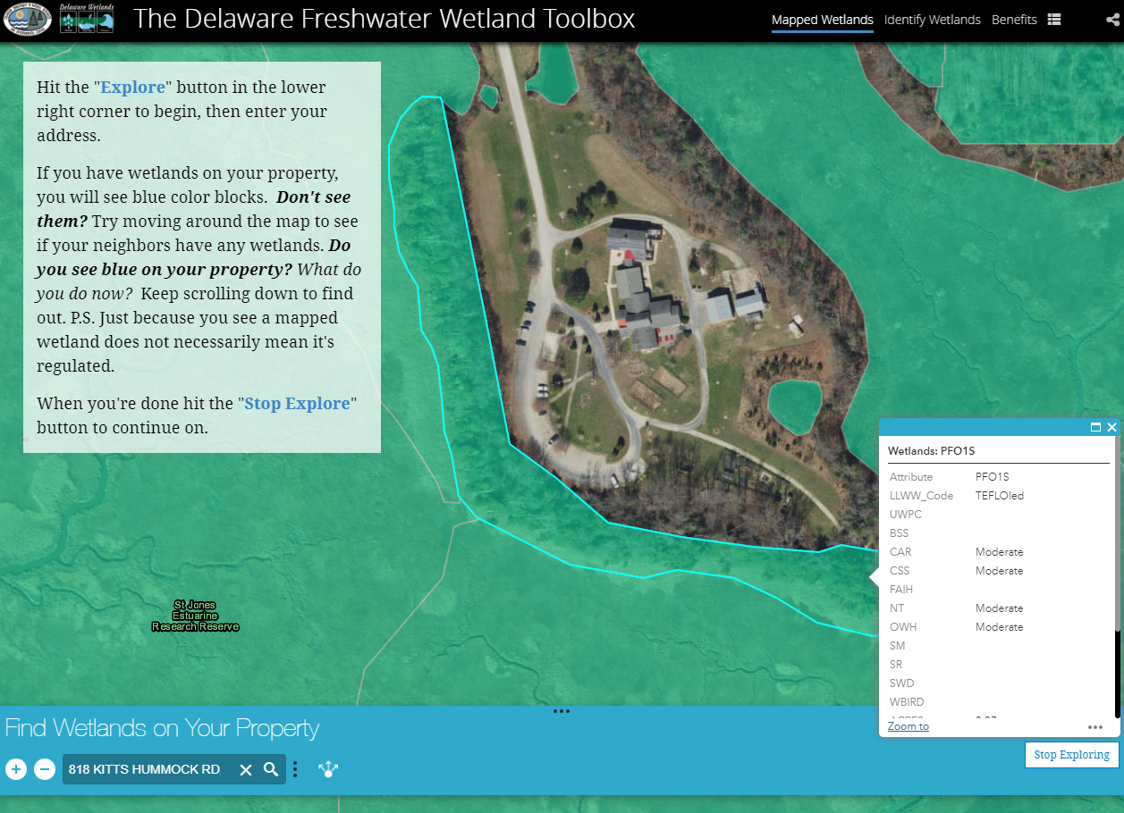
5 Cowardin Wetland Types
Marine (M)
Estuarine (E)
Riverine (R)
Lacustrine (L)
Palustrine (P)
de.gov/wetlandtoolbox
Notes:
LLWW, look up the differences between cowardin and LLWW

Slide 17
Tidal & Non-Tidal

Slide 18
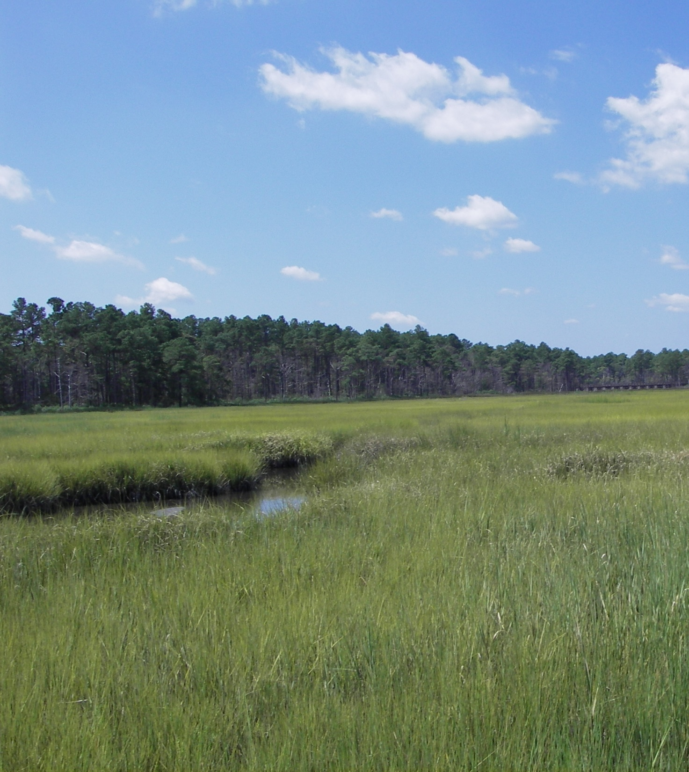
Tidal Wetlands
commonly referred to as marshes
occur along the shoreline where oceans, bays, rivers, and streams meet the land
range from freshwater to saltwater
water is pushed in and out daily by tidal cycles
Saltmarsh

Slide 19
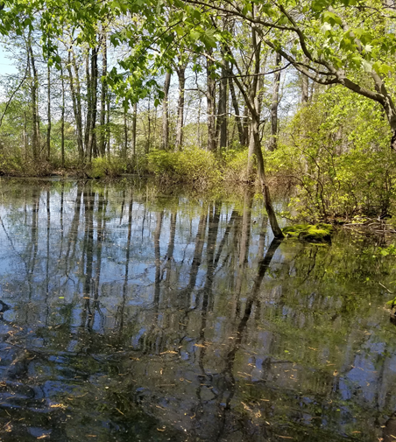
Non-Tidal Wetlands
mostly freshwater,
found around inland areas
fed by rain, snow, or groundwater
usually covered with water during the winter and spring and dry during the summer or fall months
Coastal Plain Pond Depression

Slide 20
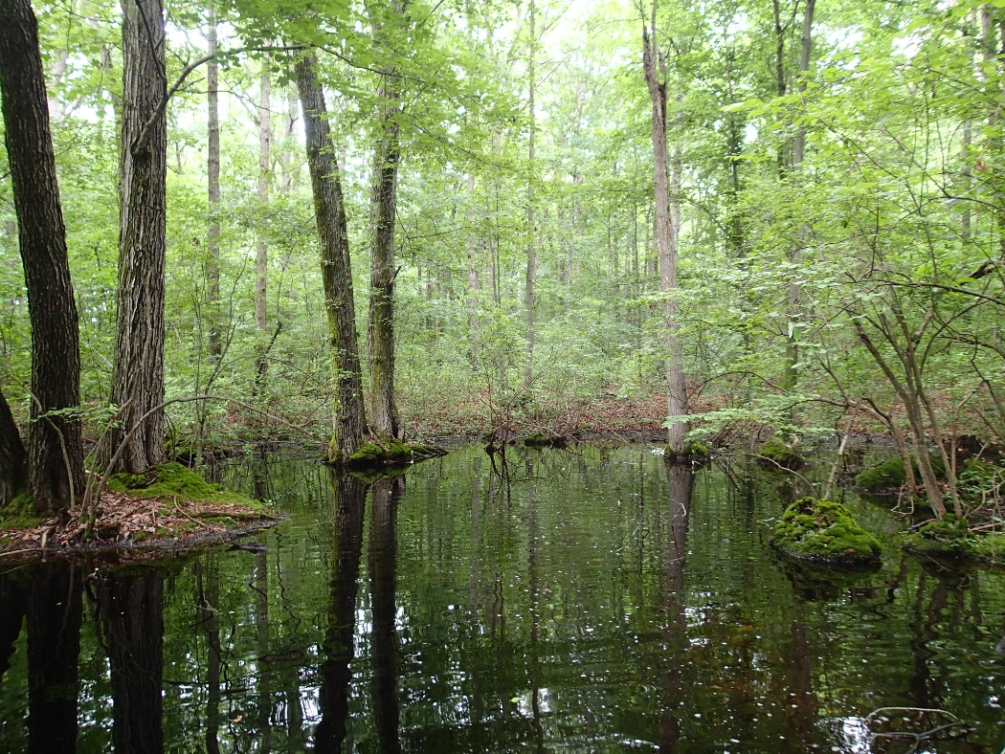
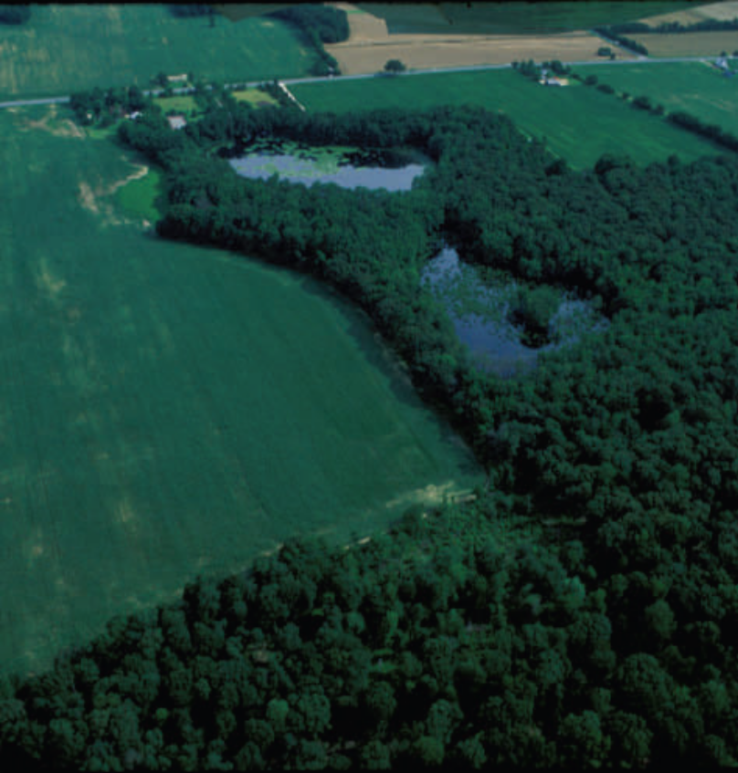
Delmarva Bays
Isolated, small, shallow,open, circular/oval
Lower NC and Kent counties
fed by rain, snow, or groundwater
16,000- 21,000 years old
Very important for amphibian reproduction
Coastal Plain Pond Depression

Slide 21
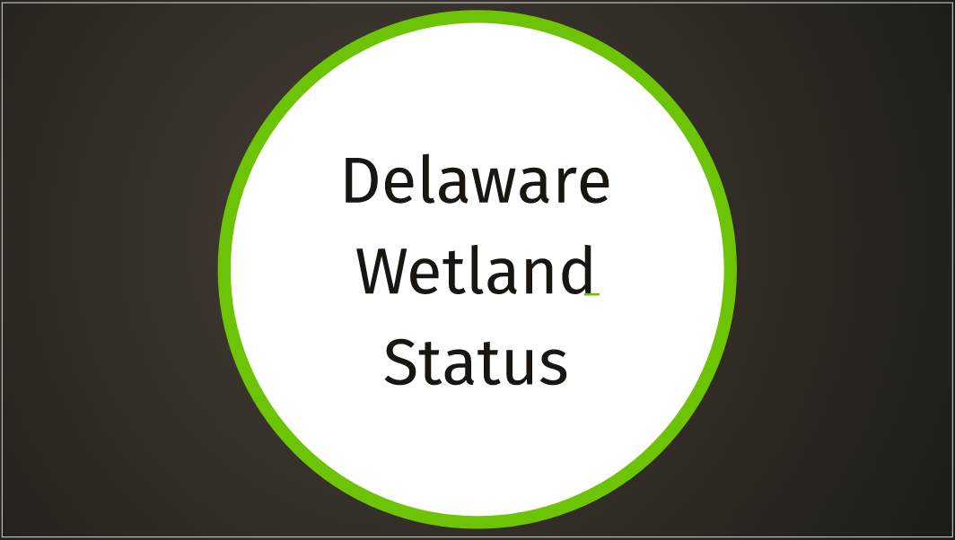

Slide 22
Where Delaware Wetlands Stand
Based on the new 2017 Wetlands maps, nearly 20% of the state is covered in wetlands.
Tidal wetlands (fresh and saltwater) represent the smallest wetland type in total acreage.
  These wetlands ring the Delaware Estuary* and the Nanticoke River which drains into the Chesapeake Estuary
Non-tidal wetlands (freshwater) make-up the majority of Delaware’s wetland acreage.
A decrease by 5% since 2007
*Estuary: where rivers meet the sea
Notes:
Which has dropped 5% since 2007 due to multiple reasons, technology, development, ag, sea level rise

Slide 23
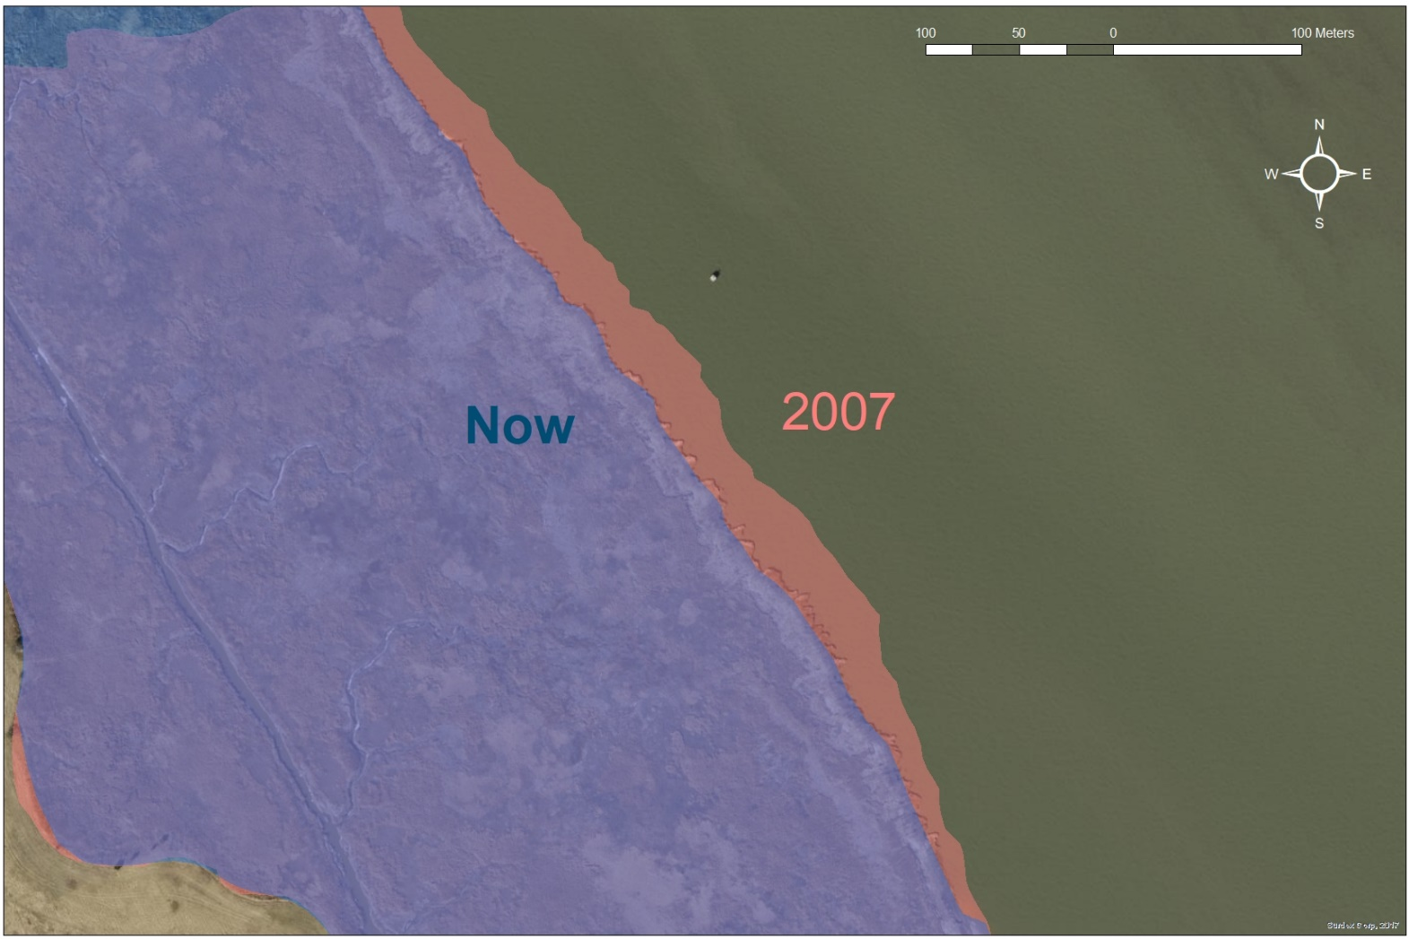
Wetland Loss Example: Erosion
~40m coastal wetlands washed away forever
Notes:
Approx 130 feet or almost 3 school bus lengths

Slide 24
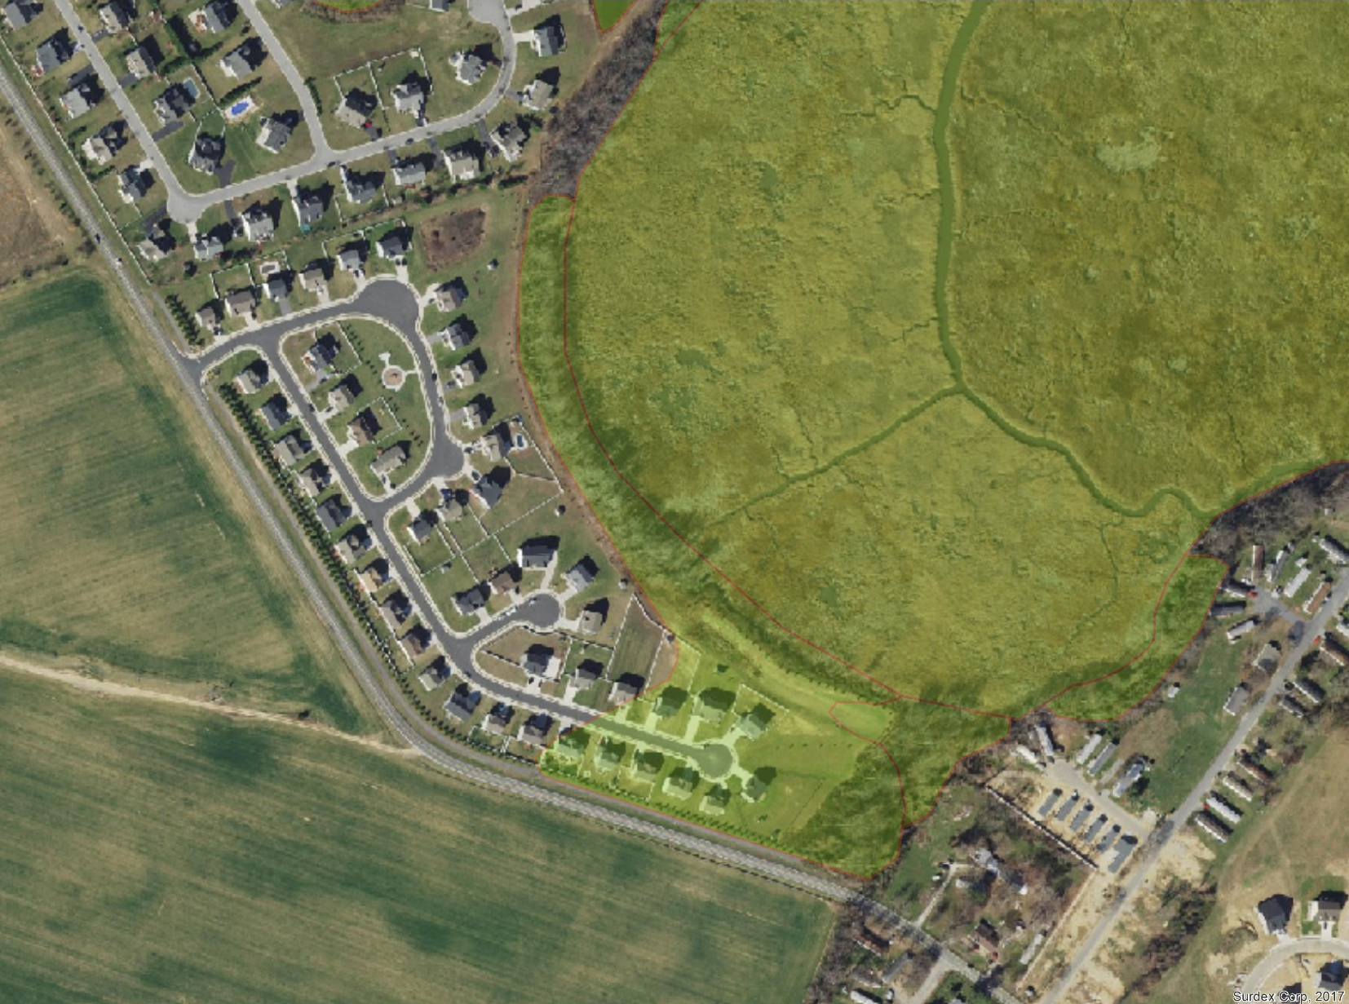
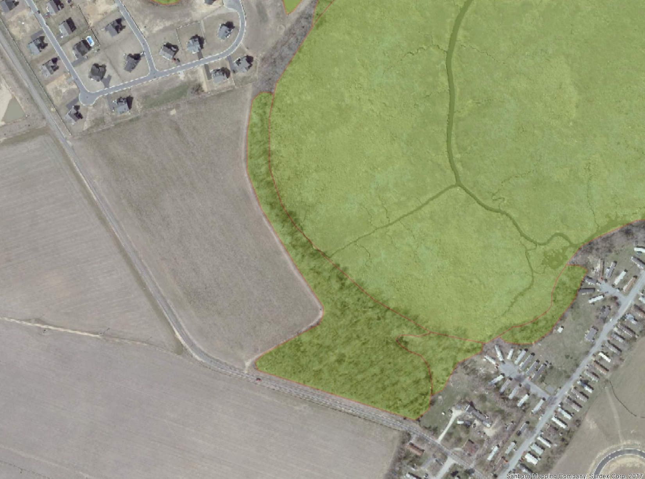
Wetland Loss Example: Development
2007
2017
5 acres wetlands lost
Notes:
A little less than 4 football fields

Slide 25
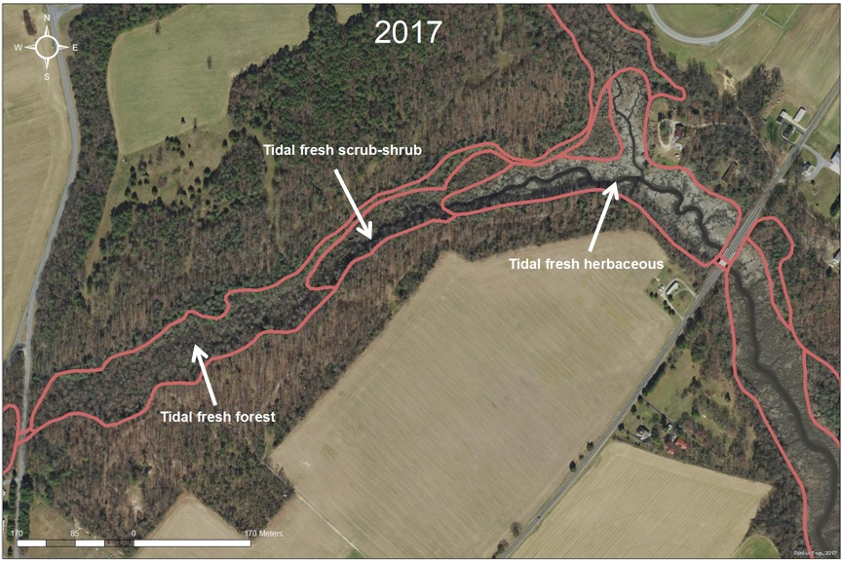
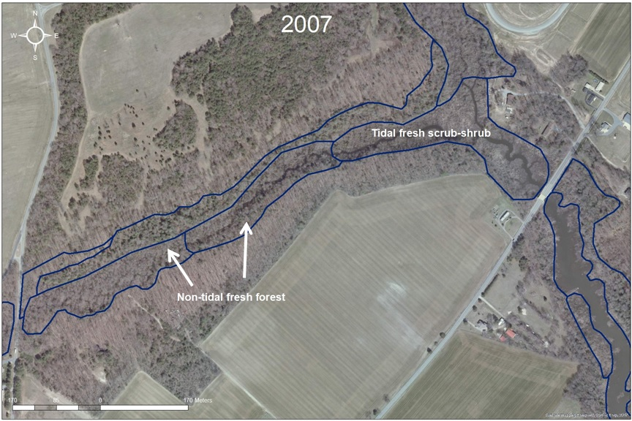
Wetland Change: Sea Level Rise

Slide 26
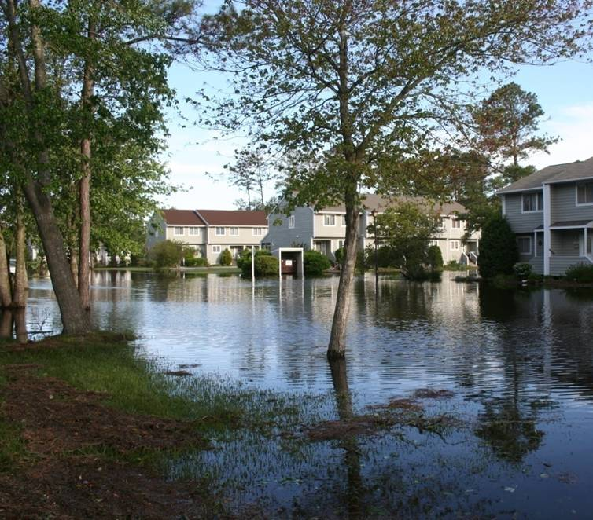
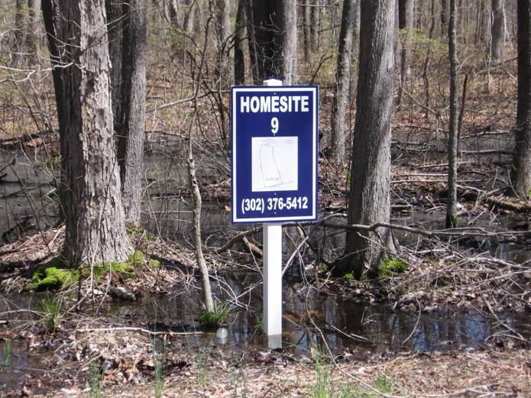
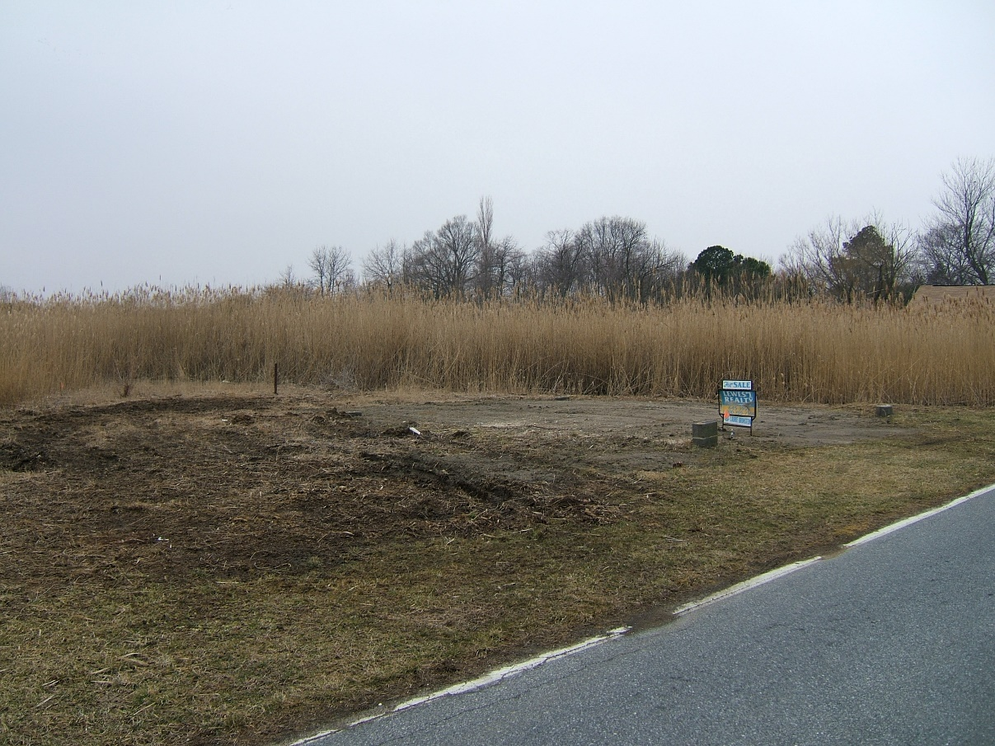
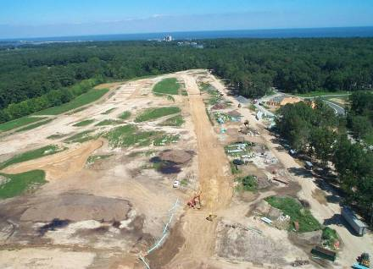
Is Building on Wetlands a Good Idea?

Slide 27
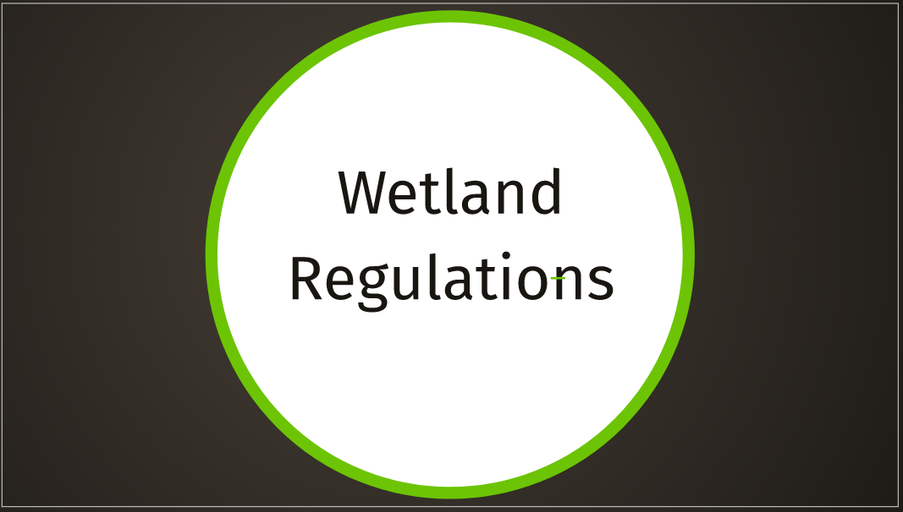
Notes:
Regulated at the county, state and Federal levels, each county has different buffer regulations

Slide 28
State of Delaware Wetland Regulations
Delaware only regulates tidal wetlands and large expanses (400 acres or more) of non-tidal wetlands.
There is NO state regulation over non-tidal freshwater wetlands less than 400 acres in size.

Slide 29
Federal Wetland Regulations
Managed through the U.S. Army Corps of Engineers
Jurisdiction determined by
  Section 401 & 404 of the Clean Water Act
  Section 10 of the Rivers and Harbors Act of 1899
Notes:
Clean Water Act is the main one that gives authority to both State and Federal levels to regulate wetlands.

